Slide 1
Integration

Slide 2
Web Service Node
Web service node can be used to invoke web services from process
Web service can be used as a Node or can also be added as action at other nodes.
Web Service action provides easy way to configure client to invoke web service.
Web service node may have error and compensation actions to handle web service errors.

Slide 3
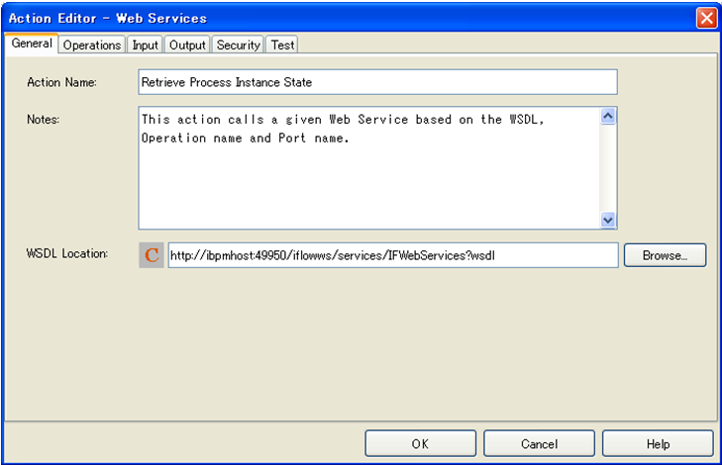
Web Services Setting: General
Specify the WSDL URL to start setting up web service action.
WSDL URL can be typed in or can be selected from a UDA or application variable
Application variables are shown as “%<variable name>%”

Slide 4
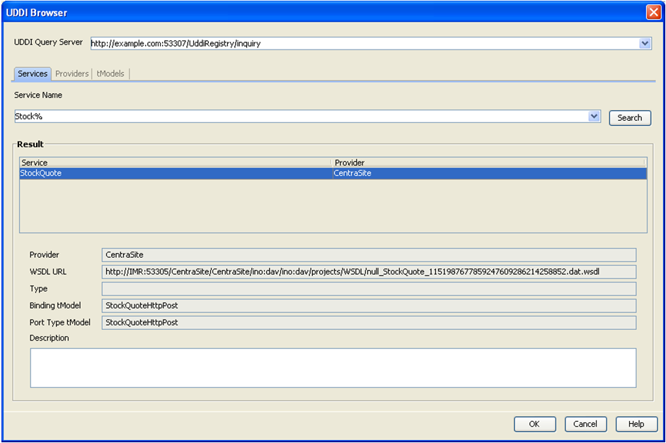
Web Services Setting: General
Web service can also be browsed and located on UDDI

Slide 5
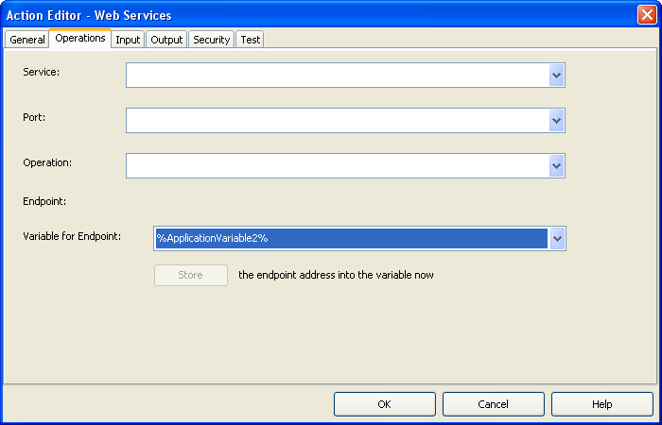
Web Services Setting: Operations
Select Service, Port and Operations from the dropdowns
Dropdown values are populated from WSDL
Endpoint can be dynamically specified using a UDA or an application variable.

Slide 6
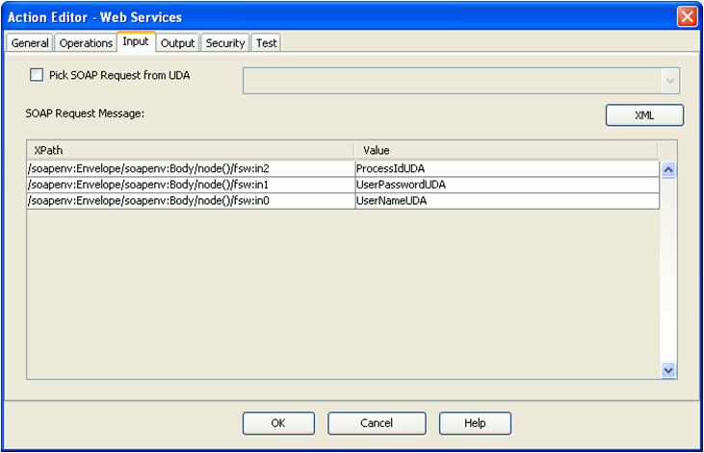
Web Services Setting: Input
Input is the input payload for the service invocation.
Input can be read from an XML UDA, typed-in or constructed using UDAs
For using XML UDA as input, select the checkbox, “Pick SOAP Request from UDA” and select UDA from dropdown

Slide 7
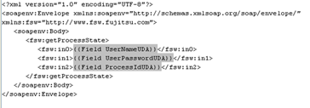
Web Services Setting: Input
Using UDAs
  Based on the input information from WSDL and selected operations, XPath table is populated
  Select UDA in each row to update the attribute value
XML
  Select XML button, it shows the free text editor with default input XML
  Update XML as required.
  Attribute values can be hardcoded
  To use UDAs for attribute values
  {{Field <uda_name>}}

Slide 8
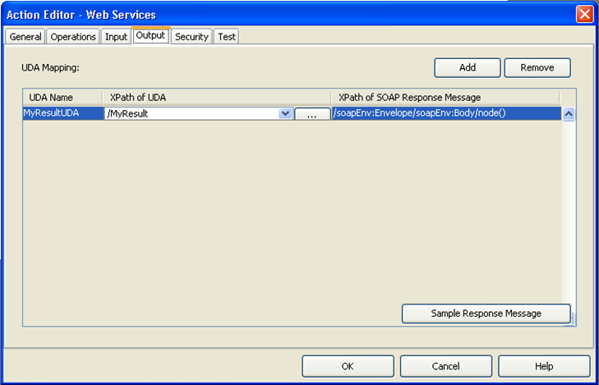
Web Services Setting: Output
Output from web service, or response processing can be configured in this section.
  Store response in an XML UDA
  Extract data from response using XPath and store in UDAs

Slide 9
Web Services Setting: Security
If web service requires authentication, username/password can be specified in Security tab
Test tab allows to test the service in Studio

Slide 10
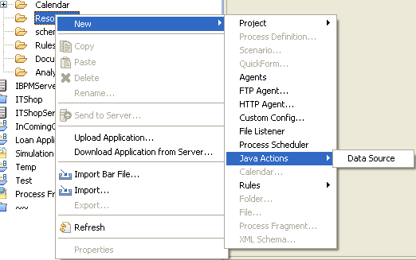
Database Action
      There are four database actions available to perform CRUD operations on any database.
  Delete SQL Java Action
  Insert SQL Java Action
  Select SQL Java Action
  Update SQL Java Action
      Database connection information is specified in an XML file
      Create Database configuration
Notes:
Generic Java Actions allow you to execute Java methods that are outside the scope of Interstage BPM. They enable you to customize process execution using methods of Java classes that you have implemented yourself.
No-Operation Java Actions are built-in Java Actions that specify no operation. These Java Actions allow you to catch a Java Action exception without executing any additional actions. Using No-Operation Java Actions, Interstage BPM simply moves on to the next sequential instruction.

Slide 11
Data source Configuration
Database connection information is stored in DataSourceDefinition.xml file
There may be more than one data source settings in the file.
Database action settings start with selecting the Data source
<DataSources>
<DataSource name="JAVAACTION_DB">
<property name="UserName" type="String">DB_USERNAME</property>
<property name="Password" type="String">DB_PASSWORD</property>
<property name="URL" type="String">DATABASE_URL</property>
<property name="DriverClassName" type="String">DATABASE_DRIVER_CLASS_NAME</property>
</DataSource>
</DataSources>

Slide 12
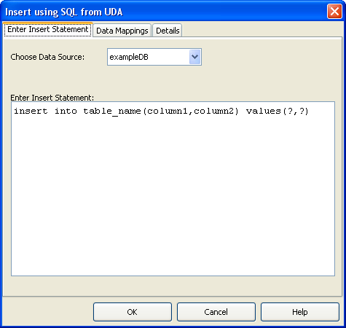
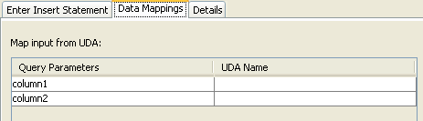
DB Action: Settings
Specify the query
  Only simple queries can be used with this action
  Use “?” for each column value, ? Can be mapped with UDAs to substitute values at runtime.

Slide 13
Agents
Agents are configurable system nodes, executed by server
Agents can be used to connect to external systems to perform some task or exchange data.
Agents are Java Programs, configuration information is stored in XML files.
There are two agents available out-of-the-box
  FTP
  HTTP
Interstage BPM provides a framework for creating custom Agents
Notes:
Agents are another mechanism available to add functionality to a Business Process. A agent is assigned to the Process Definition as a Role and allows a Node or activity in a Process Definition to execute without user interaction and can execute asynchronously. Interstage BPM provides prebuilt agents that can communicate using FTP or HTTP and custom agents can also be created and added using the Model API.

Slide 14
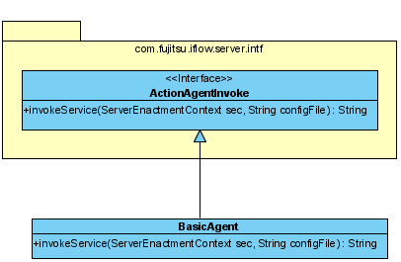
Creating Agents
Create a Java class that implements the ActionAgentInvoke interface
Implement method
  invokeService(ServerEnactmentContext sec, String configFile)
  This method is invoked by engine automatically when agents execute.
Create XML Configuration File
Notes:
Using the Model API custom agents can be created by defining a Java class that implements the ActionAgentInvoke interface. The custom agent class will need to implement one method called invokeService that takes the following argument types.
ServerEnactmentContext and a String argument that if used is the filename to a configuration file.

Slide 15
Agent Config File
To create config file
  right click on “resources” folder in the application
  Select “New → Agents”
  It creates a default agentsConfig.xml in the resources folder
  Edit config file to add configuration for agents.
  File can contain multiple agent configurations.
<ActionAgentList>
<ActionAgent>
<Name>@BasicAgent</Name>
<Description>Demonstrate Basic Agent</Description>
<RetryInterval>20</RetryInterval>
<EscalationInterval>1</EscalationInterval>
<ClassName>com.fujitsu.fast.BasicAgent</ClassName>
<ClassPath>\\Interstage\\IBPM\\classes</ClassPath>
<ConfigFile></ConfigFile>
</ActionAgent>
</ActionAgentList>
Notes:
In addition to the Java class, Agents require a xml configuration file. In the agent configuration file displayed we can see the areas in blue are the supplied values contained within the xml tags. The name tag is the name of the Agent and is the value used to reference the Agent by and must begin with an @ sign. A description that describes the purpose or use of the agent, RetryInterval value time between retries, EscalationInterval number of times to retry, the Java class name of the Agent, an optional classpath or otherwise can be left blank and lastly a optional config file name that is passed to the agent when invoked.
Only one Agent config xml file per Workflow Application but the config file can contain several Agent definitions.

Slide 16
Agent Class
invokeService method in Agent, returns a string value which is interpreted by engine as “choice” to continue processing
  Return “null” : engine continues to retry based on config setting
  Return a string value: engine tries to match it with names of outgoing arrows and makes choice on the matching arrow. If none of the choices match, throws exception
  Agent throws exception: process goes to error state.
package com.fujitsu.iflow.server.intf;
public class ServiceAgent implements interface ActionAgentInvoke
{
public String invokeService(ServerEnactmentContext sec, String configFile)
throws Exception;
{
…………………………..<code/logic here>…..
…
..
return <String>;
}
}
Notes:
In addition to the Java class, Agents require a xml configuration file. In the agent configuration file displayed we can see the areas in blue are the supplied values contained within the xml tags. The name tag is the name of the Agent and is the value used to reference the Agent by and must begin with an @ sign. A description that describes the purpose or use of the agent, RetryInterval value time between retries, EscalationInterval number of times to retry, the Java class name of the Agent, an optional classpath or otherwise can be left blank and lastly a optional config file name that is passed to the agent when invoked.
Only one Agent config xml file per Workflow Application but the config file can contain several Agent definitions.

Slide 17
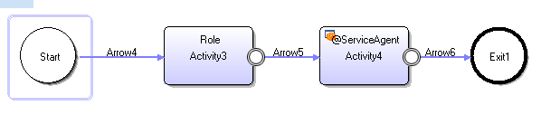
Assigning Agent to a Node
Agent is associated with an Activity Node
Activity node’s role should match with Agent name in agentConfig.xml file, prefixed with “@” e.g. “@ServerAgent”
Notes:
Agents are assigned as a Role

Slide 18
Trigger and Listener
Triggers allow Business Processes to respond to external events
Trigger can be
  An incoming email
  An incoming file
Triggers are typically used to
  Create and Start a process instance
  Take action on an Activity node
Listeners are configured to listen to events, and Triggers process the event to take necessary action.
File Listener
  Can process XML files, extract data and update UDAs
Notes:
Triggers add the ability for a Business Process to be notified of external events such as incoming data from an email or data placed in directory in the file system. A Trigger can be configured to respond to these events at the Process level or Node level. A Trigger can create a Process Instance from the incoming data or be used by a Node to decide which path to take in the Workflow.
Incoming data must be defined in well formed XML and mapped to a Process Definitions UDAs.

Slide 19
File Trigger and Listener
Configuring a file based trigger and listener requires
  Listener
    Create listener configuration file
    Specify listener settings
  Trigger
    Add trigger to process or node
    Configure event setting
    Provide data mapping
    Define action
Notes:
Triggers add the ability for a Business Process to be notified of external events such as incoming data from an email or data placed in directory in the file system. A Trigger can be configured to respond to these events at the Process level or Node level. A Trigger can create a Process Instance from the incoming data or be used by a Node to decide which path to take in the Workflow.
Incoming data must be defined in well formed XML and mapped to a Process Definitions UDAs.

Slide 20
Listener Configuration
To add a file listener configuration
  Right click on “resources” folder in application
  Select “New → File Listener”
  Default config file FileListenerConf.xml will be created in resources folder.
<FileListener>
<Directory>
<Path></Path>
<ScanInterval>60000</ScanInterval>
<StabilizationPeriod>2000</StabilizationPeriod>
<FileHandlerClass>com.fujitsu.iflow.server.impl.serverimpl.TriggerHandler</FileHandlerClass>
<PostProcessing>
<onSuccess>
<Delete></Delete>
</onSuccess>
<onError>
<Move></Move>
</onError>
</PostProcessing>
</Directory>
</FileListener>
Notes:
Using Interstage BPM Studio create a File Listener on the Workflow Application and then edit the File Listener configuration file and specify the directory the of incoming files. That’s all that’s required to adding a File Listener Trigger to a Workflow Application. The last step is to configure the Process Definition and decide how it will respond to the Trigger and this step will be covered in the Extending IBPM module.

Slide 21
Listener Configuration
Tag | Description
<directory> | Listener monitors file directory for incoming files, each directory tag represents one directory to be monitored
<path> | Path of the directory
<ScanInterval> | Time interval in milliseconds after which the directory is scanned for any new incoming file
<StabilizationPeriod> | Time interval in milliseconds for which the size of the file is observed (to see if it has changed) before it is processed.
<PostProcessing><onSuccess> | Action to be taken if the file is successfully processed. Possible actions are <Delete> or <Move>
<PostProcessing><onError> | Action to be taken if the file is not successfully processed. Possible actions are <Delete> or <Move>.
<Delete> | Deletes the file.
<Move> | 1. In non-SaaS mode, move file to any specified directory 2. In SaaS mode or non-SaaS mode when path is not specified moves the file to: “<ServerSharedRoot>/tenants/<tenant name>/apps/<application ID>/filelistener/<error/success>

Slide 22
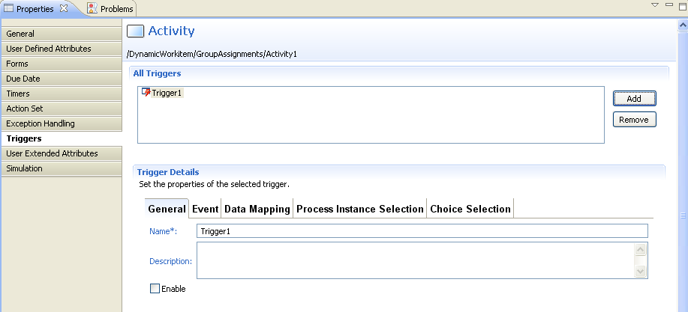
Trigger
Add trigger to process or activity node

Slide 23
Trigger Settings: Event
Event settings are used to filter and process the event
  URL for XML Schema
    Specify the URL of the schema against which the incoming file will be validated and processed
    This is a mandatory field
  Event Filter
    Used to filter and process only specific events, conditions can be specified using JavaScript.
    For example: the condition to start an instance only if the price of the item is greater than $20.00 is
Packages.java.lang.Float.parseFloat(
eventData.getXMLData("/shiporder/item/price/text()")) > 20
Notes:
We now look at Timers

Slide 24

Trigger Settings: Data Mapping
In this section we define the mapping between XML data and UDAs to extract data from XML file
Data mapping table allows mapping data using schema
To map data
  Click “add” to add a row
  Event Element: schema or xml element name
  Variable: UDA variable
  XPath of Variable: if UDA is an XML type, then define XPath to update an element value.

Slide 25
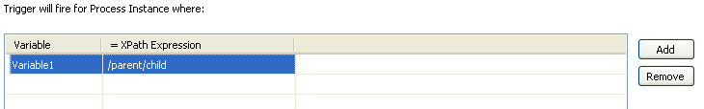
Trigger Settings: Process Instance Selection
This option is available only for activity level trigger
Allows to filter process instances based on predefined condition
Incoming file data is matched with UDAs in waiting process to filter the right process to invoke for this file.
If there are one or more instances waiting for the event, it will be processed if
  Value of UDA matches the element value in XML data defined by XPath
  There can be one or more UDA mappings defined here

Slide 26
Trigger Settings: Choice Selection
This option is available only for activity level trigger
Allows to make choice on the node as part of trigger action, based on predefined conditions
Choice Conditions
  Name of the choice
  True/False or JavaScript expression using the data from XML that evaluates in true or false.
  Engine will make choice on whichever choice evaluates to true.
  There can be a default choice, in case none evaluates to true.

Slide 27
Email Listener
Property Name | Value
EmailListenerAutoReplyEnabled | enables or disables the Interstage BPM Server sending out a message in response to the receipt of the task completion email message receipt of the email message containing Trigger payload
EmailListenerDeleteInvalidMessages | This parameter enables or disables the deletion of invalid task completion email messages
EmailListenerEmailAddress | Email message of the listener account
EmailListenerEnabled | Enable/disable (true/false) listener
EmailListenerPassword | Password for the mail server
EmailListenerPollingInterval | Initial value 900 seconds
EmailListenerPOPPort | Initial value 110
EmailListenerPropertiesFile | Properties file containing parameters required to access POP3 (optional)
EmailListenerServerHost
EmailListenerUserName | Username for the mail server
EmailStyleSheetFile | Style sheet file for formatting task messages

Slide 28
Email Trigger
Triggers for email listeners work the same way as for file listeners.
Email message must have xml file as attachment for event processing
If more than one files are attached, 1st attachment is processed.
Email message must be sent to email specified in “EmailListenerEmailAddress” setting
Message body must also contain access key for the application.
  Access keys are unique encryption keys that allows external systems to access BPM application and perform action.
  Application key can be generated from application settings in console.
  By default, key expires in 365 days. Expiration period can be changed by updating configuration parameter “ApplicationAccessKeyExpiration”
    ApplicationAccessKeyExpiration.BankLoanApplication = 120
Notes:
Timers assist the execution of a Process Definition by executing at some specified time either at the Plan level or Node level. Example a Timer could be assigned to an Activity and configured to execute after 1 minute from the time the Activity became active. There are four different types of timing that can be assigned to a Timer.
1) Absolute – on this date and time, 2) Calendar – relative time based on 24hr working day when the execution occurs within the Business Process, 3) Business – is similar to the Calendar option except times are calculated on business operating hours and Business Calendars(s) are defined by the business, 4) Lastly Advanced using Java Script language expressions a time can be programmed

Slide 29
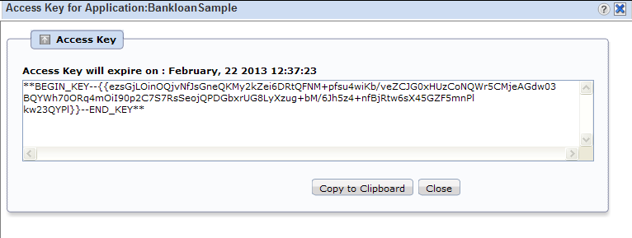
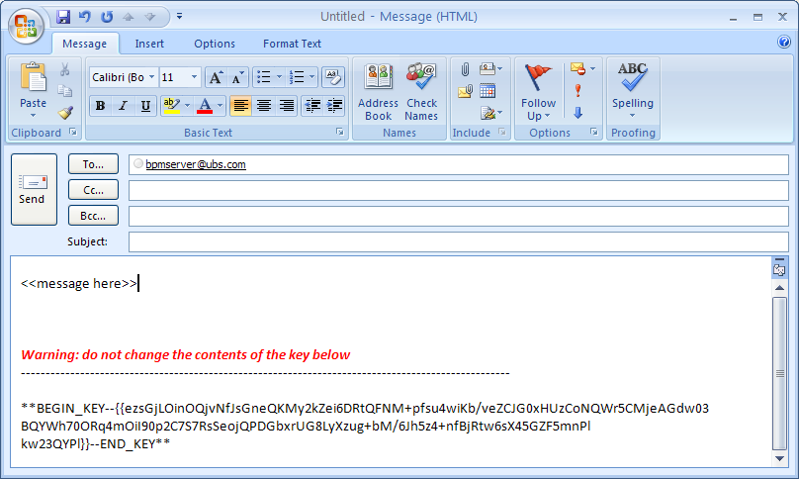
Access Key
Notes:
Timers assist the execution of a Process Definition by executing at some specified time either at the Plan level or Node level. Example a Timer could be assigned to an Activity and configured to execute after 1 minute from the time the Activity became active. There are four different types of timing that can be assigned to a Timer.
1) Absolute – on this date and time, 2) Calendar – relative time based on 24hr working day when the execution occurs within the Business Process, 3) Business – is similar to the Calendar option except times are calculated on business operating hours and Business Calendars(s) are defined by the business, 4) Lastly Advanced using Java Script language expressions a time can be programmed

Slide 30
Email Notification
Users can receive notifications when tasks are assigned to them.
Receive and save task as calendar event for easy reminders
Complete task by replying to emails
Useful for users in the field, they can access their emails on smart phones and complete the task without requiring to login to BPM console.
Notes:
30

Slide 31
Email Notification
Email Message contains
  Task details:
    Name, with ID;
    Description;
    URL (which will take the users to the console);
    List of all the responsible users for this task (Assignees);
    Task Priority;
    Name of the Process, with ID;
  Work List UDAs (name/value pairs);
  List of Workitem Choices;
  iCal Event for the Task;
  All choices for the task will be shown as “mailto” links. The users make their choice by clicking on the appropriate “mailto” link and then sends the auto generated response email with any comments.
Notes:
31

Slide 32
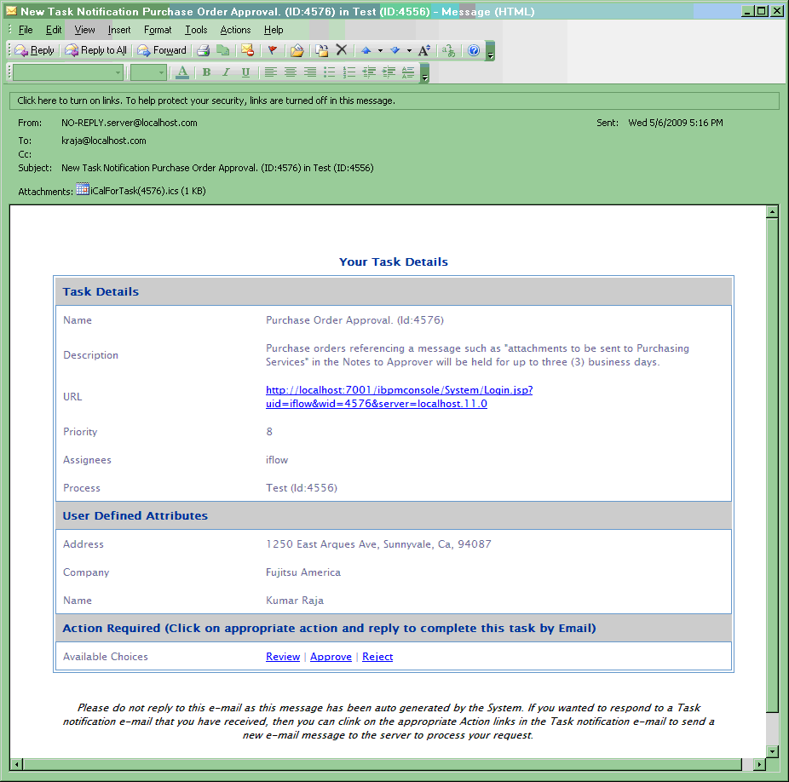
Email Notification Message
Notes:
32

Slide 33
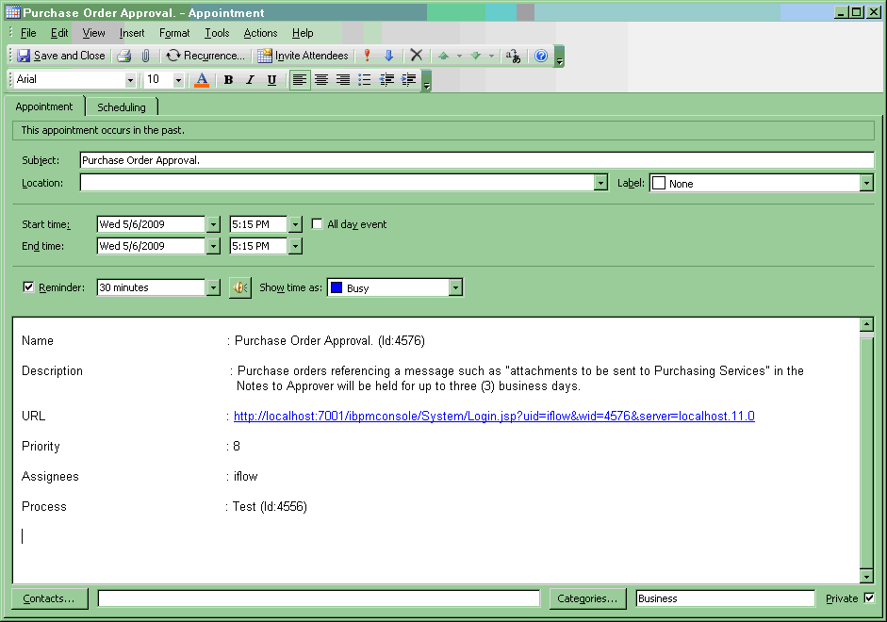
Send Email to Complete Task
Notes:
33

Slide 34
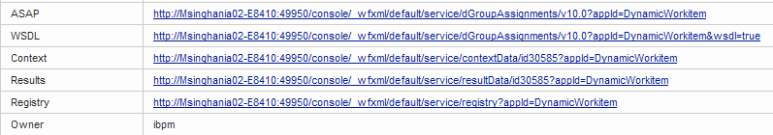
Process as Web Service
All processes are published as web service
External applications can access process using Web service clients and perform operations.
WSDL URLs are available on Process Definition Details Tab
Operations
  Create Instance
  List Instances
  GetProperties
  GetDefinition
  SetDefinition

Slide 35
Web Service Interface
There are number of web service interfaces available for accessing BPM engine
WorkItem List (Task List) Web Service Interface
  WSDL URL:
    <ServerBaseURL>/_wfxml/<tenantname>/service/wilist?appId=<application ID>&wsdl=true
  Operations
    GetWorkitemList
Process Instance List Web Services
  WSDL URL
    <ServerBaseURL>/_wfxml/<tenant name>/service/pilist?appId=<application ID>&wsdl=true
  Operation
    GetProcessInstanceList

Slide 36
Web Service Interface
Process Definition List Web Services
  WSDL URL
    <ServerBaseURL>/_wfxml/<tenant name>/service/pdlist?appId=<application ID>&wsdl=true
  Operation
    GetProcessDefinitionList
Workitem (Task) Web Services
  WSDL URL
    <ServerBaseURL>/_wfxml/<tenant name>/service/w<workitemID>?appId=<application ID>&wsdl=true
  Operation
    GetProperties
    UpdateWorkItem

Slide 37
Web Service Interface
Process Instance Web Services
  WSDL URL
    <ServerBaseURL>/_wfxml/<tenant name>/service/p<processInstanceID>?appId=<application ID>&wsdl=true
  Operation
    GetDetails
    UpdateDataItems
    ChangeState

Slide 38



