Slide 1
Administration

Slide 2
Tenant Management
Tenant Management is done by Tenant Administrator or “super user”
Super User account is created during installation
By default, a “default” tenant is created.
To login to tenant manager, use this URL
  http://[host]:[port]/console/TenantManager.page
Tenant Manager can
  Add/Delete Super Users
  Manage BPM configuration Properties
  Add/Delete Tenants
  Manage Tenant Properties
Notes:
Users with Admin Role can view logs and configure their location and rotation.

Slide 3
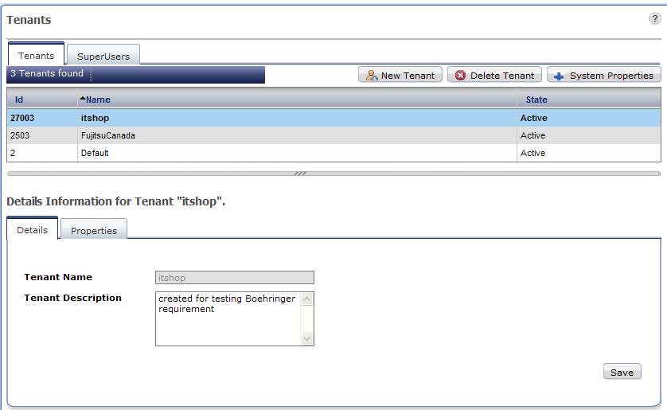
Tenant Manager Console

Slide 4
Create Tenant
To create a new tenant
  Right click and select “Create New”
  Step1: Provide “Tenant Name” and description
  Step2: Create an admin user
  Step3: specify User directory type
    User directory is used for authentication and authorization
    Local: BPM database is used to store user credentials
    Remote: provide connection information to connect to LDAP or AD
  Select “Create”
  Right click on Tenant name in the list and select “Activate”
Tenant is created with default properties
To update properties, open “properties” tab, change the properties and Save

Slide 5
Managing Console Environment
System Administration tab is visible only to Tenant Admins
Tenant Administrator can
  Manage Users and Groups (for local directory setting only)
  Login Sessions: view all active sessions and ids
  Manage Applications
  Manage Configurations
    Server/Console Configuration
    Logging configurations
    Skins
    Logos
Admin and Process Owner can
  Manage Processes
    Publish
    Archive processes
    Change owners

Slide 6
Application Management
Basic Operations
  Start/Stop applications
  Modify, Uninstall/Delete applications
  Modify Owner
  Export
  Access Key
    Encryption key that will allow the users to access the application from external systems like Email and JMS
Application Variable
  Admin can view and update application variables

Slide 7
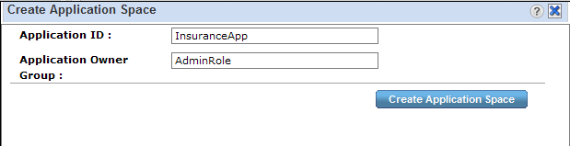
Application Management
Create App Space
  For creating dynamic processes in a separate application, app space needs to be created first.
  Admin can create app space and assign owner to the app

Slide 8
Application Management
Synchronize with DMS
  This function allows synchronizing application files with DMS. Ideally these two will be in sync but may get out of sync for variety of reasons
  For example: two separate BPM consoles are connected to one server, when applications are deployed on one console, other gets out of sync.
  On synchronizing, if
    DMS is more up to date, console is updated with DMS
    DMS is outdated, warning message is displayed with information
    Application folder/space is missing, error message is displayed
Synchronize with Repository
  If WebDAV repository is used for storing files and documents, this option will synchronize console with repository.

Slide 9
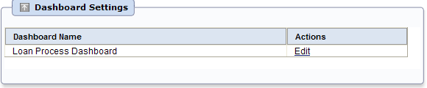
Application Management: Settings
Settings tab in application details provide options to customize application area of console.
Dashboard Settings
  Create application specific dashboards
    Select available panels
    Change dashboard background color
    Users can further customize panel settings for their profiles.

Slide 10
Application Management: Settings
Decision Table Settings
  View available decision tables
Customize Application Accordions
  Customize console left-hand menu and main menu items
  Menu cannot be customized for individual users, there are only two views supported, “Admin Users” and “Non Admin Users”
* [Dashboard|getDashboard.page]
* [Tasks|getMyTasks.page]
** [My Tasks|getTaskListDisplay.page|icon->web/images/icon_MyTasks.gif]
** [My Team Tasks|getTeamTasks.page|icon->web/images/icon_MyTeamTasks.gif]
** [Task Searches|searchTask.page|icon->web/images/icon_Searches.gif]
* [Analytics|analytics.page#url:'connectAnalytics.page']
* [Community|cmntManager.page]
**[My Pages|wikilistShow.page?actionName=myWikiList]

Slide 11
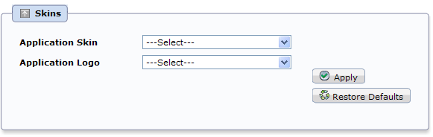
Application Management: Settings
Skins
  Each application may have its own logo and style-sheet for personalization
  To change, copy images and style-sheets in following folder
    Logo: “<console Installation Directory>/tenants/<tenantName>/apps/<Application ID>/web/images”
    Style sheet: “<console Installation Directory>/tenants/<tenantName>/apps/<Application ID>/web/styles”
  Select image and style sheet from drop down and apply

Slide 12
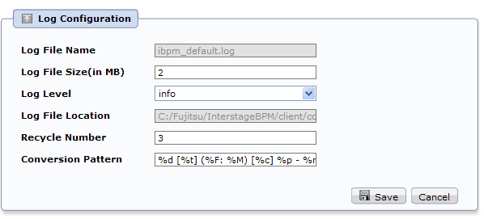
Log Configuration
Change log configuration to control
  The information to be logged
  Log file size
  Number of backup files to be kept etc.

Slide 13
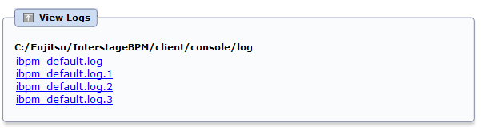
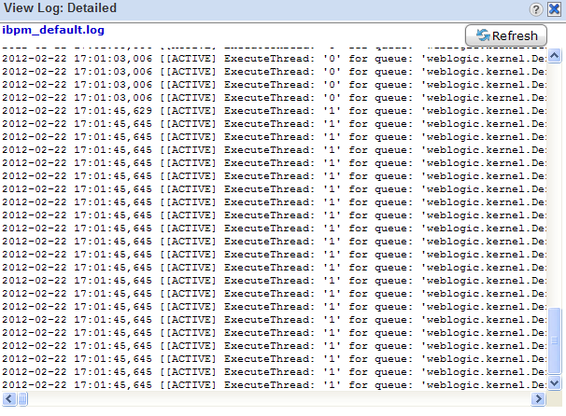
View Log
Admin can access server log in the console

Slide 14
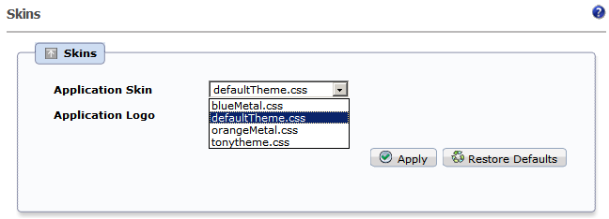
Console Skin
Admin can also update console skin (logo and style-sheet)
Three style sheets are provided by default
Notes:
Change the Skin to one of the already configured ones or add your own.
To Add your own copy the CSS to \Interstage\J2EE\var\deployment\ijserver\IBPMConsoleWU\apps\console.war\web\styles
Example: New theme tonytheme.css created by copying one of the other css files.
Restore back to original by selecting “Restore Defaults” button

Slide 15
Process Administration
Process Archiving
  Old process instances can be archived (archiving improves performance)
  Only process instances in Closed, Aborted, or Error state can be archived.
  Archiving a process instance is one step short of permanently deleting it. While you can view the details and history of an archived process instance, you can neither edit it, nor access its BPMN view
  Archival is irreversible. Once archived, a process instance cannot be reinstated; it can only be deleted.
To archive a process instance
  Open the “Summary” tab and click “archive”
Archived processes can be accessed by selecting “All/My Archived Process” filter in “My Process”

Slide 16
Process Administration
Process Migration
  When a process definition is updated and deployed, all new instances will use updated definition, but already running instances continue to use the old process definition
  If old processes are also required to be updated, they can be migrated to new version of definition.
To migrate a process
  Right click on process in the list and select “migrate”
  User will be asked to specify options to migrate.
  Multiple process instances can be selected and migrated in batch
    Result summary will provide details of successfully migrated and failed process

Slide 17
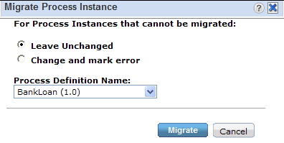
Process Administration
Migration Setting
  Leave Unchanged
    If migration fails for a process, skip that process
  Change and mark error
    Migrate to new definition and change the state to “Error”
  Dropdown provides list of all available definitions, select the target definition and select “Migrate”

Slide 18
Process Administration
Migration Restrictions
  Migration preserves the process instance state as long as all the active tasks (activities) have matching names in the destination process definition
  If an activity in the source process instance has no correspondingly named activity in the destination process definition, the source process activity will be considered to be "removed“
  If an activity in the destination process definition has no correspondingly named activity in the source process instance, the destination process activity will be added to the source process instance
  Target definition must have an activity matching the name of currently active activity in source process.
  If the assignee of an active node is changed during migration, the corresponding work item is not changed

Slide 19
DMS Configuration
Interstage BPM can be configured with a DMS repository that supports WebDAV
Default repository is file based. There can be more than one DMS configured with a tenant
To change DMS repository
  Update DMS configuration
  DMS Configurations are stored in DmsCollections.xml
    “BPM Installation Directory>/ server/instance/default/tenants/<tenantName>/resources/DmsCollections.xml”
<Dms>
<Path>C:/Fujitsu/InterstageBPM/attachments</Path>
<ImplementationClass>com.fujitsu.iflow.dmsadapter.impl.FileSystemDmsSessionImpl</ImplementationClass>
<Name>Attachments</Name>
</Dms>

Slide 20



