Slide 1
DYNAMIC BPM

Slide 2
Dynamic BPM
Dynamic BPM provides the flexibility to use processes in ad-hoc way
In many scenarios, processes cannot be mapped completely at design time
  Process is not standardized
  Not enough visibility to map process correctly
  Process needs to evolve before they can be standardized
  do the work, then figure out what process was followed;
  support “unstructured” or “ad-hoc” work;
  allow flexibility in “structured” work;
  Not possible to map all scenarios in a template, requires flexibility to change, or too much change renders process definition useless
Notes:
Process Confabulation was coined by Michael zur Muehlen, Stevens Institute of Technology.
Dynamic BPM:
allows an organization to do the work the way it is really done;
avoids the need for many versions of very similar process definitions;
allows the work to proceed as normal and the underlying processes to be elucidated later;
supports unstructured and ad-hoc work;
allows for flexibility in structured work;
supports greater collaboration between the people who do the work; and
still operates in an environment that provides tracking and auditing.
Major Components:
Dynamic Process;
Dynamic Task (subtasks);
Comments.

Slide 3
Dynamic Process
Allows a Process Instance to be created without a Process Definition.
This is done by:
  Create basic template with one root task
  Add nodes at runtime as required (sub tasks)
  Involve people to work (at runtime) to complete the task
When the owner decides that the goal has been accomplished, they complete the root task, which completes the process.
Notes:
Allows a Process Instance to be created in the absence of a Process Definition.
This is done by:
specifying the goal of the process as a description;
having one task (the root task) created for the person who created the process.
This task can be sub tasked to other people.
When the owner decides that the goal has been accomplished, they complete the root task, which completes the process.

Slide 4
Subtasks
Users working on tasks can add subtasks and assign to other people.
This includes tasks from dynamic processes as well as tasks from a regular (or “structured”) process.
Subtask can be assigned to one or more people.
Workitems (tasks) are created for the assignees just like they are for assignees of an activity node.
Subtasks can be further sub-tasked.
The parent tasks shows in "waiting" state" but can still be worked on.
Notes:
Tasks can be sub tasked to other people.
This includes tasks from dynamic processes as well as tasks from a regular (or “structured”) processes.
The sub task can be assigned to one or more people.
The sub task is a node instance. It is like a new type of node, with its own behavior (state model) similar to an activity node.
Work items (tasks) are created for the assignees just like they are for assignees of an activity node.
These work items work like work items for activity nodes.
Sub tasks can be further sub tasked.
The parent tasks can still be worked on.

Slide 5
Dynamic Task
The pre-conditions are:
  a Process Definition already exists
  a Process Instance has been started in the usual way.
  Note that Bob and Mary from Facilities are assigned the task of preparing for the presentation.
PD: Organize quarterly meeting
S
Facilities
Presentation
Secretary
Invitations
E
PI: Organize quarterly meeting
Workitems – STATE_ACTIVE
WI:Mary
WI:Bob
S
Facilities
Presentation
Secretary
Invitations
E
Node Instance – STATE_RUNNING
Notes:
In the Dynamic Task example <c>:
a Process Definition already exists <c>; and
a Process Instance has been started in the usual way.
So far this is what would be expected.

Slide 6
Dynamic Task - Subtask Creation
Bob implicitly accepts the Presentation task and:
  creates a Book Projector subtask and assigns it to Sam and Joe; and
  creates a Book Room subtask and assigns it to Mary and Wendy.
PD: Organize quarterly meeting
Facilities
Presentation
Secretary
Invitations
The PD has not changed.
The original PI …
… is changed with the addition of the new dynamic subtasks.
S
E
PI: Arrange quarterly meeting
PI: Arrange quarterly meeting
Workitems – STATE_ACTIVE
WI:Mary
WI:Mary State=Inactive
WI:Bob
WI:Bob State=Waiting
Facilities
Presentation
Secretary
Invitations
Facilities
Presentation
S
State=Waiting
S
E
WI:Joe
WI:Sam
Node Instance – STATE_RUNNING
Sam, Joe
Book Projector
Regular Workitems
WI:Wendy
WI:Mary
Dynamic Tasks
Mary, Wendy
Book Room
Secretary
Invitations
E
Notes:
Say for example that Bob accepts the Presentation task and:<c>:
creates a subtask to Book a Projector and assigns it to Sam and Joe <c>; and
creates a subtask to Book a Room and assigns it to Mary and Wendy.
The Process Definition has not changed <c>.
The original Process Instance <c> is changed with the addition of the new dynamic subtasks <c>.

Slide 7
Dynamic Task - Subtask Completion
Dynamic tasks have one fixed choice called “Complete”.
Sam books a projector and completes his WorkItem.
PD: Organize quarterly meeting
Facilities
Presentation
Secretary
Invitations
The PD has not changed.
S
E
PI: Arrange quarterly meeting
PI: Arrange quarterly meeting
Sam and Joe’s workitems are deleted and the Book Projector subtask is completed.
WI:Mary State=Inactive
WI:Mary State=Inactive
WI:Bob State=Waiting
WI:Bob State=Waiting
Facilities
Presentation
Facilities
Presentation
State=Waiting
S
State=Waiting
S
WI:Joe
WI:Sam
Sam, Joe
Book Projector
Sam, Joe
Book Projector
Regular Workitems
Workitems deleted
as usual
WI:Wendy
WI:Wendy
WI:Mary
WI:Mary
Dynamic Tasks
Mary, Wendy
Book Room
Dynamic Tasks
State = Completed
Mary, Wendy
Book Room
Secretary
Invitations
Secretary
Invitations
E
E
Notes:
Dynamic tasks have one fixed choice of “Complete”.
Sam books a projector and completes his Workitem.
His and Joe’s Workitems are deleted and the Book Projector subtask is completed.

Slide 8
Dynamic Task - Final Subtask Completion
The final subtask is completed when Wendy books a room and completes her workitem.
PD: Organize quarterly meeting
Facilities
Presentation
Secretary
Invitations
The PD has not changed.
S
E
PI: Arrange quarterly meeting
PI: Arrange quarterly meeting
Wendy and Mary’s workitems are deleted and the Book Room subtask is completed.
As all subtasks are complete the original task is put back to state=Running.
Bob’s workitem goes into state=Accepted and Mary’s to state=De-active.
WI:Mary State=Inactive
WI:Mary State=Deactive
WI:Bob State=Waiting
WI:Bob State=Accepted
Facilities
Presentation
Facilities
Presentation
S
State=Waiting
S
Sam, Joe
Book Projector
Sam, Joe
Book Projector
Workitems deleted
as usual
Workitems deleted
as usual
WI:Wendy
WI:Mary
Dynamic Tasks
State = Completed
Mary, Wendy
Book Room
Dynamic Tasks
State = Completed
Mary, Wendy
Book Room
Secretary
Invitations
Secretary
Invitations
E
E
Notes:
The final subtask is completed when Wendy books a room and completes her workitem <c>.
Wendy and Mary’s workitems are deleted and the Book Room subtask is completed.
Since all the subtasks are now complete the “Presentation” node instance (the original task that spawned the subtasks) is put back into Running state.
Because Bob implicitly accepted the Presentation workitem its state becomes Accepted and consequently Mary’s workitem state becomes Deactive.

Slide 9
Dynamic Task – Original Workitem Completion
Bob now completes the original workitem.
PD: Organize quarterly meeting
Facilities
Presentation
Secretary
Invitations
The PD has not changed.
S
E
PI: Arrange quarterly meeting
PI: Arrange quarterly meeting
PI: Arrange quarterly meeting
PI: Arrange quarterly meeting
The process moves on to the next task … in this case Invitation and a workitem is created for Jane.
WI:Mary State=Inactive
WI:Mary State=Deactive
WI:Mary State=Inactive
WI:Bob State=Waiting
WI:Bob State=Accepted
WI:Bob State=Waiting
Facilities
Presentation
Facilities
Presentation
Facilities
Presentation
Facilities
Presentation
State=Waiting
S
State=Waiting
S
S
S
Sam, Joe
Book Projector
Sam, Joe
Book Projector
Sam, Joe
Book Projector
Sam, Joe
Book Projector
Workitems deleted
as usual
Workitems deleted
as usual
Workitems deleted
as usual
Workitems deleted
as usual
WI:Wendy
WI:Wendy
WI:Mary
WI:Mary
Dynamic Tasks
State = Completed
Dynamic Tasks
State = Completed
Mary, Wendy
Book Room
Dynamic Tasks
State = Completed
Mary, Wendy
Book Room
Mary, Wendy
Book Room
Mary, Wendy
Book Room
WI:Jane
Secretary
Invitations
Secretary
Invitations
Secretary
Invitations
Secretary
Invitations
E
E
E
E
Notes:
Bob now completes the original workitem <c>.
The process moves on to the next task, in this case Invitation, and a workitem is created for Jane.

Slide 10
Dynamic Task
The user who creates a subtasks can decide that the subtask is no longer needed. In this case the subtask state is put into state=Aborted.
The user who create a subtask or subtasks can complete their own workitem before any or all of the subtasks are complete. In this case the subtasks that were not complete are put into state=Aborted.
If Bob completed
his workitem before
Sam or Joe or Mary
or Wendy completed
their subtasks this
would be the result.
PI: Arrange quarterly meeting
Facilities
Presentation
S
State=Completed
Sam, Joe
Book Projector
State=Aborted
Mary, Wendy
Book Room
WI:Jane
Secretary
Invitations
E

Slide 11
Dynamic Task – Subtasking Subtasks
Sam finds that both the portable projectors are broken.
He creates a subtask for Dave to fix the broken projector.
PI: Arrange quarterly meeting
PI: Arrange quarterly meeting
In this case the original dynamic subtask has been further subtasked.
WI:Mary State=Inactive
WI:Mary
WI:Bob State=Waiting
WI:Bob
Facilities
Presentation
Facilities
Presentation
S
State=Waiting
S
WI:Joe
WI:Joe
WI:Sam
WI:Sam
Sam, Joe
Book Projector
Sam, Joe
Book Projector
WI:Dave
Regular Workitems
Maintenance
Fix broken proj
WI:Wendy
WI:Mary
Dynamic Tasks
Mary, Wendy
Book Room
WI:Wendy
Secretary
Invitations
Secretary
Invitations
WI:Mary
E
E
Mary, Wendy
Book Room
Notes:
What would happen if Sam found that both the portable projectors were broken.
He can create a subtask (of his own subtask) for Dave to fix the broken projectors <c>.
Note that as before the Process Definition does not change … just the Process Instance.

Slide 12
Dynamic Task –Using Comments
Scenario: The projectors may not be fixed before the meeting.
  Mary books a room and completes her workitem.
  After Sam creates the “fix broken projector” sub task, he uses his workitem (in waiting state) to write a comment:
    “Bob, both our projectors are currently broken. I have asked maintenance to fix one quickly, but from my past experience, they may not be able to fix it in time for your meeting.”
  Bob sees Sam’s comment. He creates another Book Room subtask with a comment:
    “Mary, Wendy, please see if we can have our meeting in another building that has a room with a built-in projector.”
  Wendy finds such a room in an adjacent building and books it. She comments:
    “I have booked room 102 in bldg B, which has a built-in projector”.
  Bob completes his workitem.
  Secretary Jane sees Wendy’s comment, and includes the location “Building B, Room 102” in her meeting invitations.

Slide 13
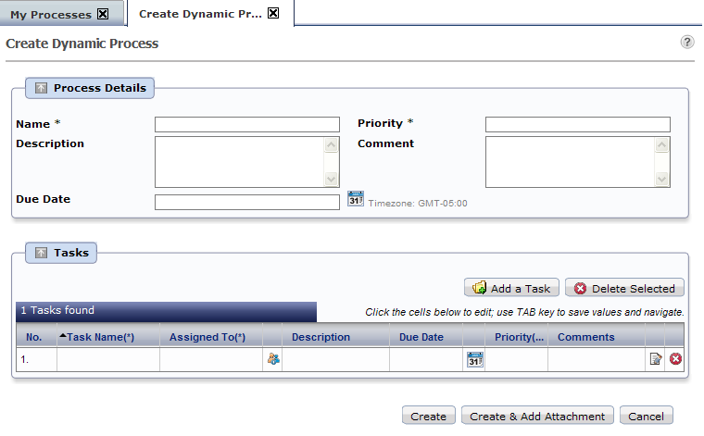
Creating dynamic Process
Dynamic process can be created directly in console without process definition.
Creating dynamic process creates an instance with one task
Select “Create Dynamic Process” on “My Process” tab

Slide 14
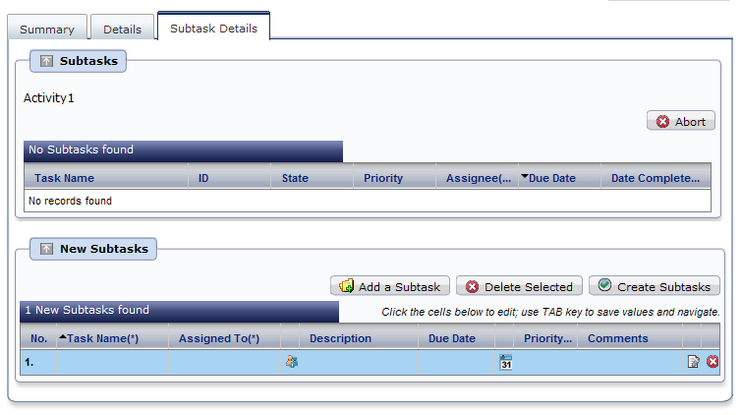
Creating Subtask
Subtasks can be added in task panel in BPM Console
Add more rows if required
Enter task information

Slide 15
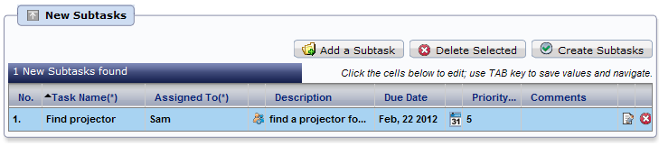
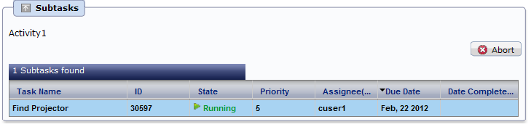

Creating Subtask
Add Subtask information and “Create”
Subtask is created and assigned
Parent Task is in “Waiting state

Slide 16



