Slide 1
Business rules

Slide 2
Business Rules
Business Rules "the language of business"
Business logic, policies can be expressed as Business Rules
Rules are stored in a repository and shared between activities, processes or even other applications.
Business users can modify rules without reprogramming
  Reduced costs and provides faster turnaround time
  Increased visibility
  Business experts have the control instead of technical experts
Example
  If
    credit rating is between 700-750
  and
    age between 30-35
  then
    APR is 5.6%
Notes:
Business Rules the language the business speaks and understands. Traditionally IT systems represent business rules as embedded programming logic. Changes in the business require changes to the IT System that result in increased costs and time to implement. Through the use of a Business Rules engine imbedded programming logic is extracted out the application and replaced with rules that can be maintained outside of the application by business users. When changes occur in the business rules the business user can make the changes and implement them with little interruption to the IT Systems.
Interstage BPM supports integration into ILog and Fair Isaac Blaze Business rules engines and provides built Business Rules support through the use of Decision Tables.

Slide 3
Business Rules Support
Interstage BPM supports integration with third party Business Rule Engines (BRMS)
Out-of-the-box Actions to integrate with
  ILog JRules
  Fair Isaac Blaze Advisor
Other third party engines can be integrated using Web Service or Java Interface.
In-built support for defining and executing Business Rules
Notes:
Business Rules the language the business speaks and understands. Traditionally IT systems represent business rules as embedded programming logic. Changes in the business require changes to the IT System that result in increased costs and time to implement. Through the use of a Business Rules engine imbedded programming logic is extracted out the application and replaced with rules that can be maintained outside of the application by business users. When changes occur in the business rules the business user can make the changes and implement them with little interruption to the IT Systems.
Interstage BPM supports integration into ILog and Fair Isaac Blaze Business rules engines and provides built Business Rules support through the use of Decision Tables.

Slide 4
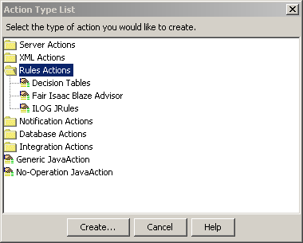
Business Rule Actions
Business Rule actions can be used to easily integrate with Rule Engine
Sent Input from UDAs
Execute rules at any point during process execution
Store result in UDA for further processing.
Notes:
Interstage BPM provides native support for:
JRules from iLog;
Blaze Advisor from Fair Isaac; and
its own Decision Tables.
Rules are selected from the Rules Actions dialog in the Action Set tab for many of the Interstage BPM nodes.

Slide 5
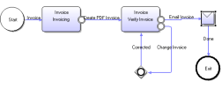
Decision Tables
Decision Tables allow users to create business rules in Studio.
Create and package rules with process applications
Rules can be shared among all process definitions within the application.
Rules are stored in XML format.
Organization
  Application contains Process Definition and
  “Rulesets”
  Rulesets contains Decision Tables
  Ruleset is a logical grouping of DTs
  Any process definition can access any DT
Notes:
Decision tables are another method of decision making.
In Interstage BPM Studio:
Decision Tables allow users to create advanced rules without programming;
one or more Decision Tables are contained in a Rule Set; and
one or more Rule Sets are contained in an Application.
Decision Tables examples …

Slide 6
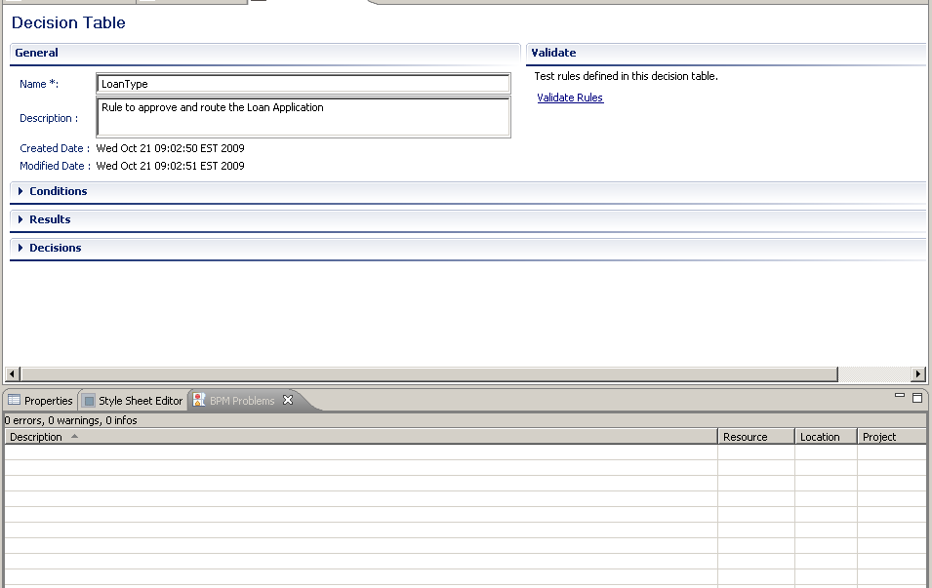
Creating a Decision Table
Decision Table Editor in Studio provides easy GUI interface to define rules
  create and manage Decision Tables; and
  Validate business rules.
Notes:
The Decision Table editor is part of Interstage BPM Studio. It provides the facilities to:
create and manage Decision Tables; and
validate the business rules that they contain.
This slide shows the Decision Table Editor.

Slide 7
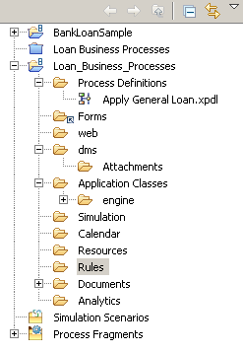
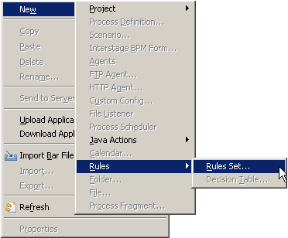
Create Rule Set
One or more Rule Sets may be created in Application
Rule Set stored in Rules Folder
Notes:
Decision Table a e nested inside Rule Sets and Rule Sets reside in the Rules folder which is contained in the Workflow Application. The Rule Set along with the Decision tables within it are available to all the Process Definitions in the Workflow application.

Slide 8
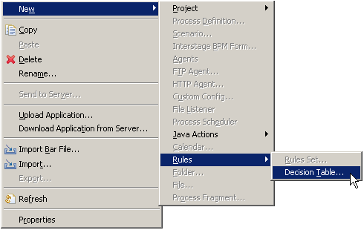
Create Decision Table
Create Decision Table – Example “DT 1”
Select Rule Set to save Decision Table
Notes:
To create a Decision Table start by selecting the Rule Set folder to relate the rule to and then select Decision Table from the pop-up menu.

Slide 9
Decision Table Elements
Decision Table Elements
  Name
  Description
  Conditions
    Conditions are “if” part of business rules e.g. “if Customer 'age is between 25-35”
    Here Customer’s Age will be mapped to a UDA for input
  Results
    Are “then” part of business rules e.g. “then APR is 5.6%”
    APR will be mapped to a UDA for output
  Decisions
    Each combination of condition and result form one decision, OR each rule in decision table is considered a decision.
Notes:
A Decision Table is made up of the following elements: Name, Description, Conditions, Results and list of Decisions.
The name and description are self explanatory on the next slides will define the Conditions, Results and Decisions.

Slide 10
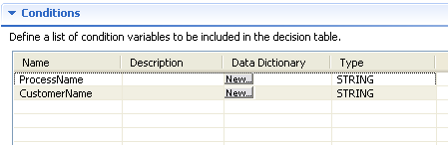
Defining Conditions
Name
  Conditions can be defined by using arbitrary names of condition attribute e.g. “Customer Age”
  A Rule may have multiple condition attributes
  Each condition attribute is evaluated with “AND” operator in decision execution.
Description
  Used for documentation
Type
  Data type of attribute, this
  should match the UDA to map

Slide 11
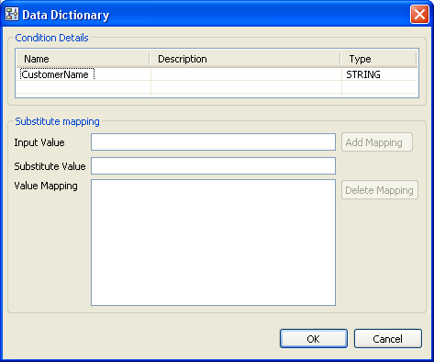
Defining Conditions: Data Dictionary
Data Dictionary provides an option to substitute an input value with something else before rule evaluation
Substitution may be required in scenarios where data is coming from another system and values used are coded.
Data Dictionary Mapping
  Input value: value of UDA e.g. EXEC
  Substitute Value: mapping value to be used for rule evaluation e.g. “Executive”
Example:
  Customer Type
    Executive – EXEC
    President Club – PRSCLB

Slide 12
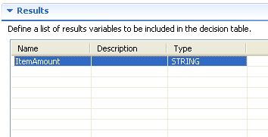
Defining Results
Define result attribute names and data-types
A rule may have multiple result attributes, each maps to a UDA
After rule execution, result UDAs are updated.
Attribute names can be different from UDA names, mapping is done separately.
Notes:
One or more Conditions and Results can be defined in a Decision Table.
A Condition is made up of the following attributes: name, description, type and a Data Dictionary or alias.
A Result is made up of a name, description and a type.

Slide 13
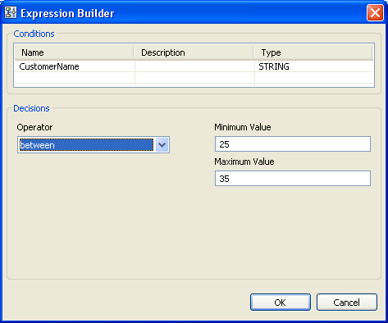
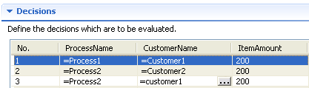
Decisions
Decisions section is created based on information provided in Condition and Result section.
  Type-in values to create rules
  Use operators to create conditions
  Operators
    =, !=, <, >, <=, >=, in, between, like, notlike
Notes:
A Decision uses the Condition(s) and Result(s) to form the logic in the Decision Table (rule).
The Condition is effectively the “if” of the Decision and the Result is where a value is assigned to the Result(s).
Start by clicking the “Add” Button to add a Decision.

Slide 14
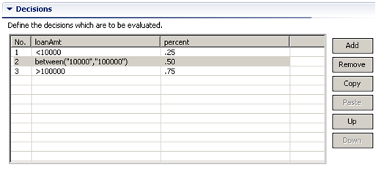
Rule Execution
Rules in a DT are evaluated sequentially
Once a rule matches input condition, execution stops and results are returned.
DT does not validate rules for overlapping condition
  e.g. >=100 and <=100 both conditions will be true for a value of 100
Rule sequence can be changed by using “Up” and “Down” buttons
Notes:
Assign values to each Result in the Decision Table “Decision”.
If the loan amounts less then ten thousand return .25, loan amounts between ten thousand and one hundred thousand return .50 and loan amounts over one hundred thousand return .75

Slide 15
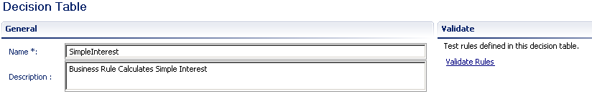
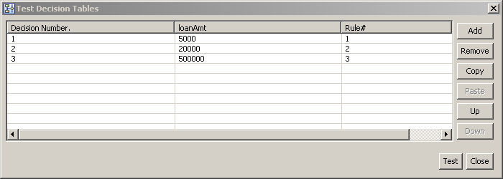
Testing Decision Table
Test the rule by selecting “Validate Rules”
Enter different Condition Values
Notes:
Test and validate the Decision tables decisions by selecting the “Validate Rules” link and add different values to see which rule, i.e. the Decision will be invoked for that value.

Slide 16
Decision Table Java Action
Decision tables can be invoked in process definition by adding Decision Table Action at a node or at Process Definition level.
iLog JRules (IBM) or Blaze Rules engine can also be connected to execute rules using available Actions
Notes:
Add the Decision Tables Java Action to the Process Definition and then configure it.

Slide 17
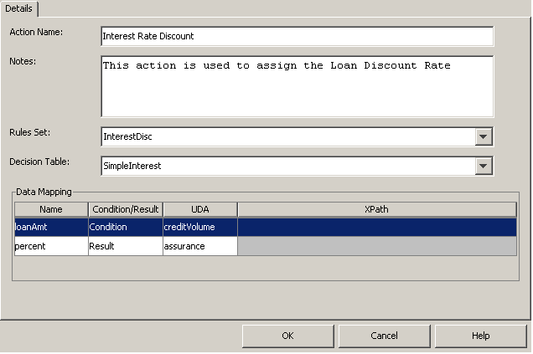
Decision Table Java Action
Action interface shows all available rules sets and tables within application.
Configure:
  Select Decision Table to execute
  Map UDAs for Condition attribute
  Map UDAs for result attribute
  UDAs are filtered based on Data
  Type
  XML UDA can be used to map to
  String condition with XPath
Notes:
Configure the Decision Tables Java Action by mapping the Decision Tables Conditions and Results fields to the Process Definition’s UDAs.
Map loanAmt to creditVolue and percent to assurance.
Note only UDAs with the same type will be displayed for the Conditions and Results.

Slide 18
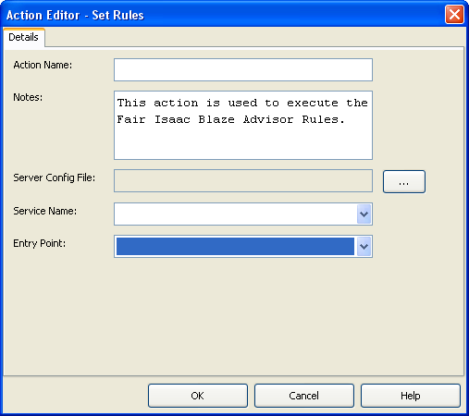
Blaze Advisor Action
Blaze Advisor uses “service” and “deployment manager” XML configuration files to connect to engine.
In order to invoke Blaze Engine from BPM
  Generate configuration files in Blaze
  Copy “.server” and “.dmanager”
  files in “dms/attachment” folder in
  application
  Browse and select server config files
  Select service name and entry points
  Note: follow admin guide for setting classpath and other configuration to invoke Blaze from BPM Engine.
Notes:
The Decision Table is displayed on the Process Definition Diagram

Slide 19
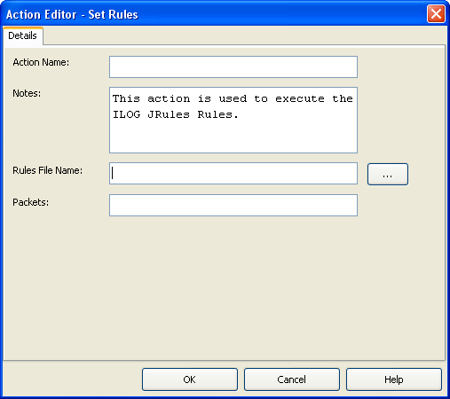
iLog JRules Action
In order to invoke Blaze Engine from BPM
  Generate rule file in JRules
  Copy file in “dms/attachment” folder
  Browse and select file
  Note: follow admin guide for setting classpath and other configuration to invoke JRules from BPM Engine.
Notes:
The Decision Table is displayed on the Process Definition Diagram

Slide 20
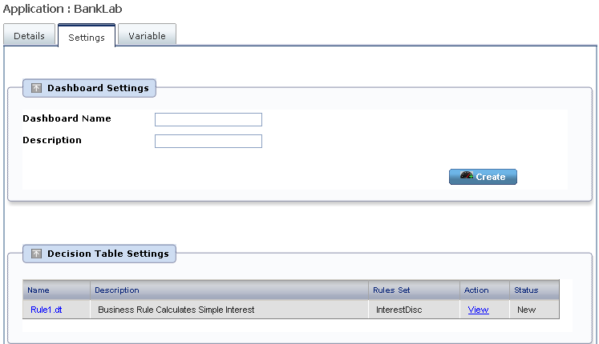
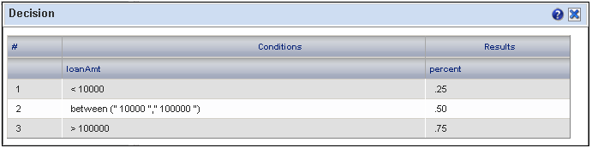
Interstage BPM Console View
View Decision Tables in Interstage BPM Console
  Browse to application and select the “Settings” tab
  Select Decision Table to View rules (edit is not allowed in console view)
Notes:
View Decision Tables and their configurations in Interstage BPM Console

Slide 21



