Slide 1
Forms

Slide 2
Forms
Forms can be assigned to
  Start node
  Activity node
  Voting node
One Form can be reused at many Nodes
Any node may have one or more forms
  If multiple forms are added, they are displayed as tabs
Default Form
  Default form is displayed if no form is assigned
Notes:
Forms are used to display the Business Process’s UDA to a user allowing them to view and make modifications to them.
Forms can be assigned to a Start Node, Activity Node and a Voting Node. A form definition can be reused and assigned to more then one activity and conversely a different Form can be assigned to each node. If no form is defined a default form is used by Interstage BPM Console which displays all the UDA’s defined in a generic layout.

Slide 3
Form Editor
Drag-n-drop to create rich interactive forms easily
Maintain forms as part of BPM project, package and deploy
Pre built widget to access and manipulate UDAs
  Basic and Advance widgets
  Layouts
  widget properties, style
  Define events and JavaScript functions
Creates JSP forms
  JSPs can be generated and extended to add more functionality
Edit Source in source code view
Preview forms in studio
Notes:
Quick Forms are created using Interstage BPM Studio’s form designer module. Users create forms using a WYSIWYG editor and in addition can access and modify the generated source directly. A Quick Form is stored in a single file of type JSP (Java Server Page). HTML and Java JSP pages is required to make changes to Quick Form files.

Slide 4
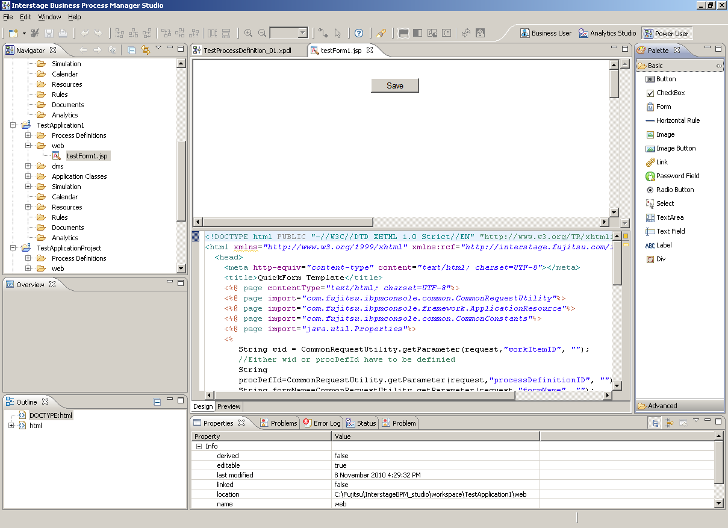
Interstage BPM Forms Designer
Notes:
The Quick Forms Designer (which is part of Interstage BPM Studio) has these panes:
<c>WYSIWYG Pane – visually layout and design the form
<c>Source Code Pane – view and edit source code
<c>Properties Pane – configure component properties using UI
<c>Palette Pane – holds components available and that can be used in Forms
<c>Outline Pane – displays components hierarchy of Form

Slide 5
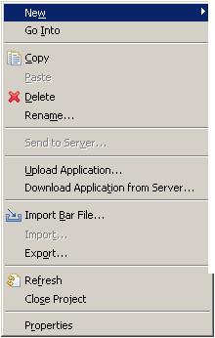
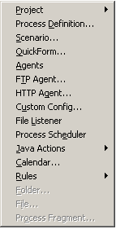
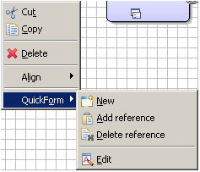
Selecting Form Design Menu
Create form
  New -> Quick Form
Create and attach form to Node
    Right Click on Node→ QuickForm→New
Notes:
Quick Forms menu is accessed either through the Navigator or right clicking on the node and selecting the Quick Form option.
The Process Designer option offers additional options to add and delete a Form reference to a Node.

Slide 6
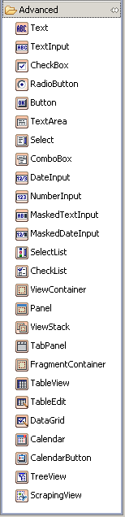
Control Palette
There are two sets of widget
Basic
  Basic HTML widget
Advanced
  HTML widget with associated actions to access UDAs
  In-built validation support
Notes:
The palette contains HTML Ajax enabled Components to create rich browser based UI’s for Interstage BPM process definitions. There are two main category of components: container and component. A container is used to hold components for example a Panel or Tab Panel and the component is the part of the form the users interacts with such as a Text Field or Select List.

Slide 7
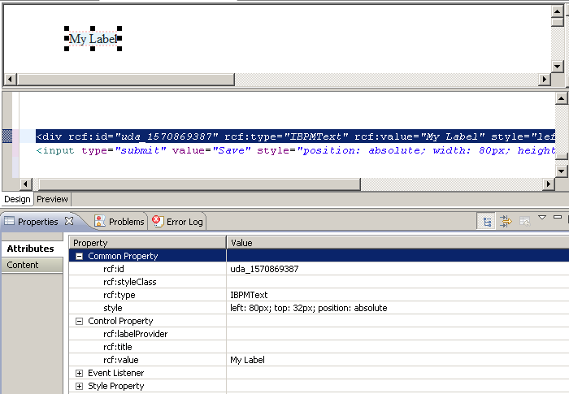
Add Widgets
Drag and drop controls on the panel
Configure widget Properties
  Property Attributes
  Edit Source
Notes:
Components can be configured visually using the properties dialog or by editing the source directly through the source pane.

Slide 8
Common Widget
Text
Text Input
Date Input
Checkbox
Select
Table
Notes:
We’ll review the above components which are some of the most commonly used in forms design.

Slide 9
Widget : Text
Used to display read-only text or labels
Text can be static or a UDA value
<div rcf:id="uda_2019988988" rcf:type="IBPMText" rcf:xpath="" rcf:value="Text" style="left: 112px; top: 125px; position: absolute">
</div>
Tag | value
rcf:id | UDA name with prefix “uda” e.g. “uda_CustomerName”
rcf:type | control type identifier
rcf:xpath | XPath expression, if UDA is XML type
rcf:value | default value of label text. If UDA is assigned, UDA value will replace default value

Slide 10

Widget : TextInput
<div style="position: absolute; width: 188px; height: 78px; left: 237px; top: 82px“>
</div>
<div rcf:id="uda_1563017640" rcf:type="IBPMTextInput" rcf:xpath="" rcf:width="155px“ rcf:height="20px" style="left: 12px; top: 12px; position: absolute“ rcf:mandatory="true" ></div>
<div rcf:id="error_1563017640" rcf:type="IBPMText" rcf:value=“ Mandatory*" rcf:color="#FF0000“ rcf:width="155px" rcf:height="20px" style="left: 14px; top: 46px; position: absolute"></div >
Tag | value
rcf:id | UDA name with prefix “uda” e.g. “uda_CustomerName” and with prefix “error” for validation control e.g. “ error_CustomerName”
rcf:mandatory | True/false

Slide 11

Widget : CheckBox & RadioButton
Radio Button and Check box group
  It’s not allowed to create multiple widgets with same id, that puts a constraint on creating Widget Group
    Constraint: form cannot have two widget with same UDA, rcf IDs are unique.
    Solution: use basic HTML control with UDA values
Creating group in BPM Form
  Use Basic Widget
<span rcf:type="IBPMText" rcf:value="Language:" ></span>
<input type="radio" NAME="uda_Variable1" value="English"
<%=(ibpmUDAprop.getProperty("uda_Variable1").equals("English"))?"checked":"" %>>
<span rcf:type="IBPMText" rcf:value="English" ></span>
<input type="radio" NAME="uda_Variable1" value="Japanese"
<%=(ibpmUDAprop.getProperty("uda_Variable1").equals("Japanese"))?"checked":"" %>>
<span rcf:type="IBPMText" rcf:value="Japanese" ></span>

Slide 12
Widget : Select
Tag | value
rcf:id | UDA name with prefix “uda” e.g. “uda_Country” and with prefix “error” for validation control e.g. “ error_Country”
rcf:options | semicolon separated list of values e.g. “USA;UK;AUS”
rcf:prop_options | Name of UDA with list of values

Slide 13

Widget : Date Input
Date widget can be combed with Calendar widget for easy input
  Display and update Date UDA
  Date Popup Button displays Calendar
<div rcf:id=“uda_ReqDate" rcf:type="IBPMDateInput" rcf:value="Requestor Date:“ rcf:target=“IBPMPopupCalendar_0885822></div>
<div rcf:id="IBPMPopupCalendar_0885822" rcf:type="IBPMPopupCalendar“ rcf:targetDateInputId=" uda_ReqDate"></div>
<div rcf:id="CalendarButton_0885822762" rcf:type="CalendarButton“ rcf:target="IBPMPopupCalendar_0885822“ ></div>
Notes:
Date input component displays and allows input of a date value to a uda of type date either directly inputting the value into the date field or by using the popup calendar.
Supply the correct uda name to the IBPMDateInput component’s rcf:id attribute and to the rcf:targetdateInput attribute of the IBPMPopupCalendar component.

Slide 14
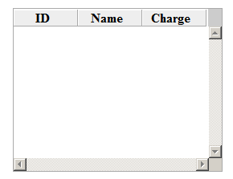
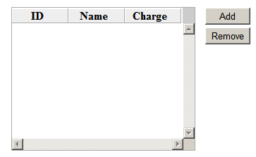
Widget : Table View and Edit
Used for displaying XML (UDA) in tabular format.
  Table View is read only
  Table edit allows editing values
    Editing cell values results in updating XML element values
    Adding/deleting rows in table results in updating XML (UDA) structure.
Table View
Table Edit
Notes:
Interstage BPM Quick Forms has two table components to display and edit data in a row column format.
Table View used to display or view only data and Table edit to view and edit, add and remove rows of data.
The table components use a uda of type XML.

Slide 15
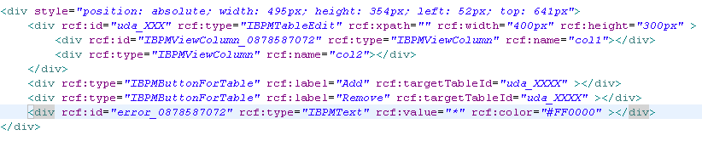
Table Edit
Tag | value
rcf:id | uda name with prefix “uda” e.g. “uda_dataXML” and with prefix “error” for validation control e.g. “ error_dataXML”
rcf:name | Name of IBPMViewColumn control should match the XML element name
rcf:targetTableId | Target for button action, UDA name or the id of table control.
Notes:
Configure the rcf:id attribute to the uda of type xml.
Configure the column headings and the column’s cells to the XML element names in the supplied XML DOM.
For example: rcf:name is where the column heading appears and the rcf:propertyName is where the XML element name appears.
Users will need to edit and add these entries manually through the source editor pane.

Slide 16
UI Container
View Container
Panel
  Container with title and body
View Stack
  Used to switch display in the same section of screen
Tab Panel
Fragment Container
  Specify container information in a separate file

Slide 17
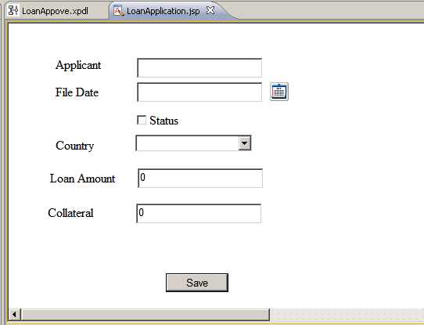
Sample Form
Example Loan Application Quick Form
Notes:
The sample Loan Application form displayed in Interstage BPM Studio

Slide 18
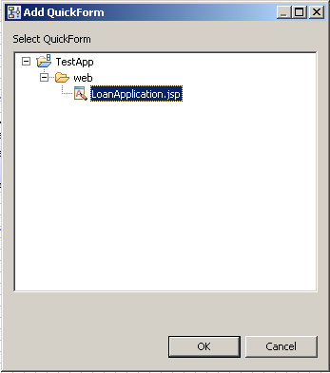
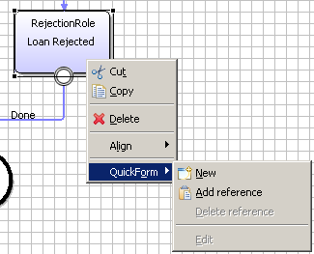
Assign Form reference to Node
Assign LoanApprove QuickForm to all Nodes
  Add reference
Notes:
Assign the Quickform to the node by right-clicking on the Node and selecting the Add reference option under the Quick Form menu.
A popup dialog will appear with the defined Quick Forms – select the LoanApplication Quick form and press OK

Slide 19
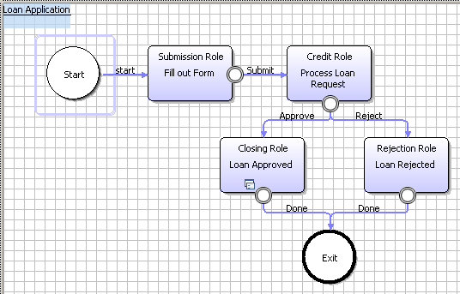
Add Form Reference to Node(s)
Form Icon
  Form Icon will appear on nodes with Forms assigned
Notes:
A node that has a Form assigned will display a Form Icon symbol as shown.

Slide 20
Widget Properties
Common Property
  id, style, type
Control Property
  enabled, read-only, password, max length
Event Listener
  Mouse of key event listeners e.g. onBlur, onFocus, onChange, onKeyPress
Style Property
  Look and feel, color, padding, border etc.
Validation Property
  Mandatory: true/false

Slide 21
Event Listener
HTML/JavaScript event listener and action framework is a powerful functionality to provide interactive rich UI experience to users.
Capture events based on user actions and perform actions to manipulate the UI as required.
example:
  On selecting Country from one Select/Combo-box, change list of states in another select box.
  Event used: onChange/onValueChange
  call JavaScript function “updateStates()” to update the values in 2nd select box.

Slide 22
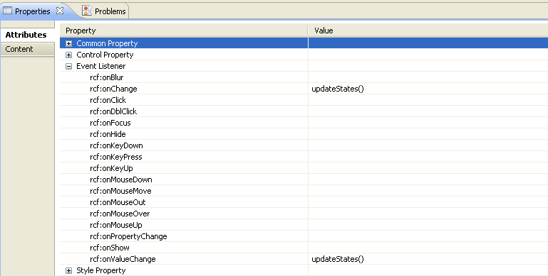
Event Listener
<div rcf:id="uda_1872941250" rcf:type="IBPMTextInput" rcf:xpath="" rcf:width="155px" rcf:height="20px" style="left: 12px; top: 12px; position: absolute" rcf:onChange="updateStates()“ ></div>

Slide 23
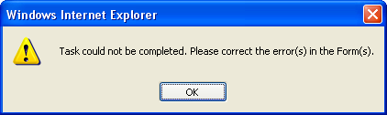

Form Validation
Form is validated for errors when
  Form is saved
  User makes choice to complete the task
All controls with “error” tag are evaluated and if validation fails, JavaScript message is displayed:
JavaScript error message:
Form Error Message:

Slide 24
Form Submission and Choices
Choice buttons are generated using outgoing arrows from the node
Choices are displayed in Choice panel below form panel
“Save” button is generated by default on the form.
On Save, any change on the form is saved and UDAs are updated.
On Submit (make choice), UDAs are updated and task is completed.

Slide 25



