Slide 1
Interstage BPM Console

Slide 2
Console Menus
Dashboard
Tasks
  My Tasks
  My Team Tasks
  Task Searches
Community
  My Pages
  My Team Pages
  Shared Pages
Process Management
  My Processes
  Process Definitions
  PI Searches
  PD Searches

Slide 3
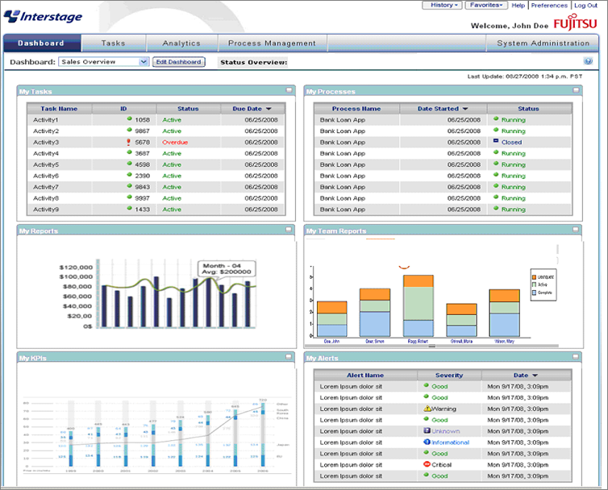
Dashboard
Notes:
It can also show Key Performance Indicators via the Dashboard.

Slide 4
Dashboard Preferences
Users can configure their dashboard
Configuration is stored in user profile.
Edit Dashboard Name
Show/Hide Panels
Configure each Panel
  Name
  Data Displayed

Slide 5
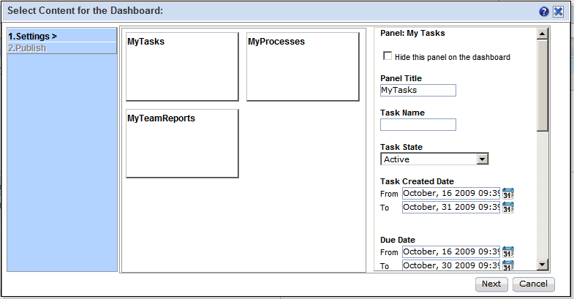
Dashboard Preferences
The user can set preferences such as “task filtering” and selecting which components to show.

Slide 6
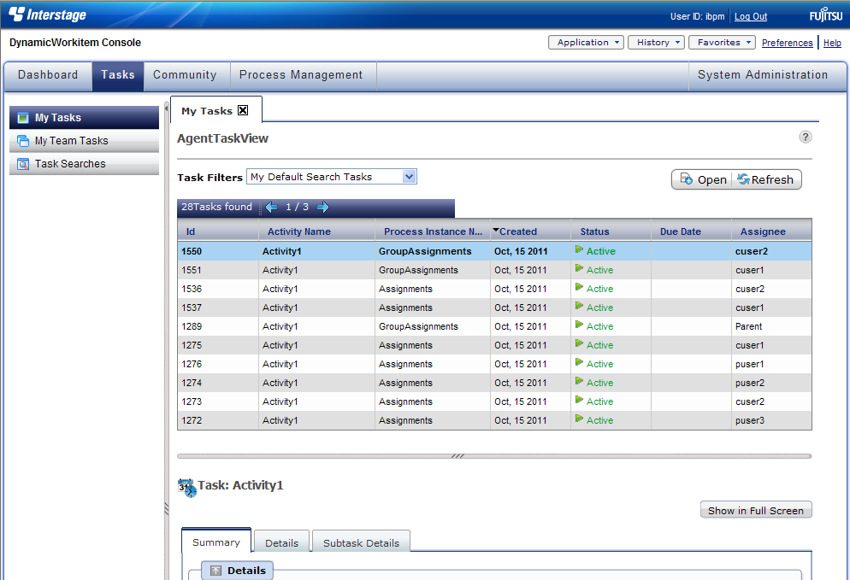
My Tasks
Task Filters
Task Table

Slide 7
Task Management
Filters
  My Tasks
    Active, Accepted, Declined, Completed, Inactive, Overdue, Waiting, Future
  All Tasks
    Future, Inactive
Details
  Summary
    Task summary, actions and choices
  Details
    Task form, data, attachment, choices
  Subtask Details
    Create, edit subtask

Slide 8
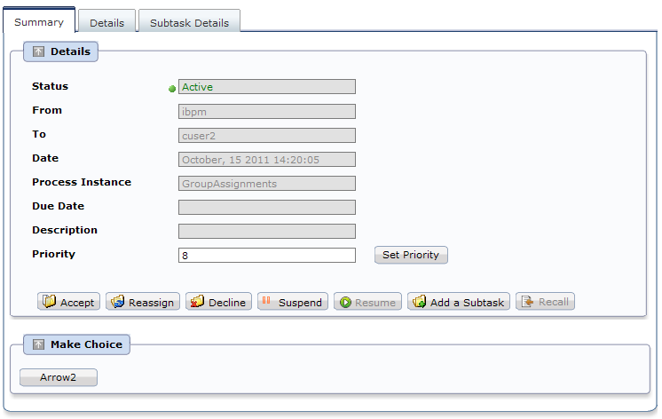
Task Summary

Slide 9
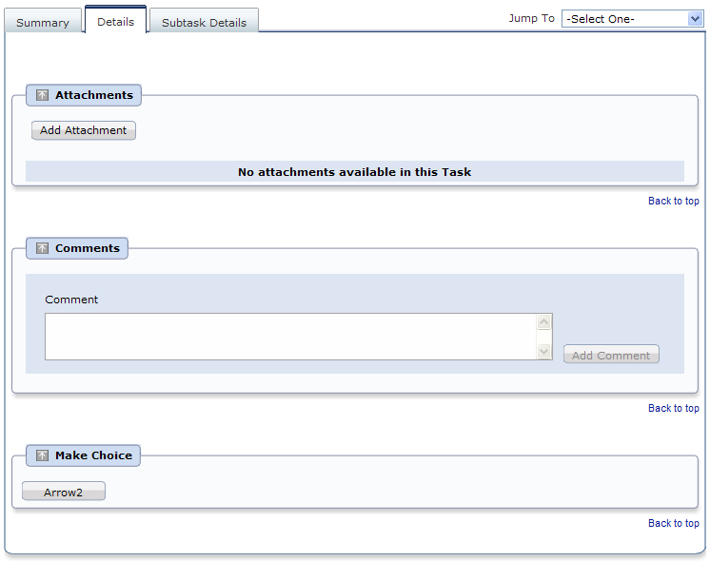
Task Detail

Slide 10
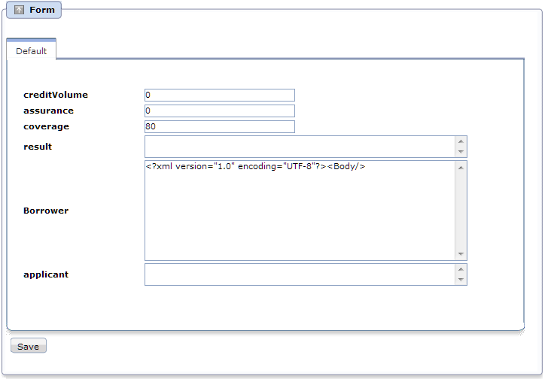
Default Form
Default Form is created when no Form is assigned
Displays all UDAs
Notes:
Interstage BPM will automatically generate and display a default Form if no Form has been assigned to a Node. The screen show’s what a default form would look like for the Loan Application examples defined UDA’s.

Slide 11
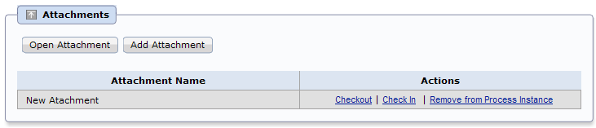
Task Detail – Manage Attachment
Add attachments to process
Attachments are shared with all process users
Check-in/Check-out functionality depends on DMS feature.

Slide 12
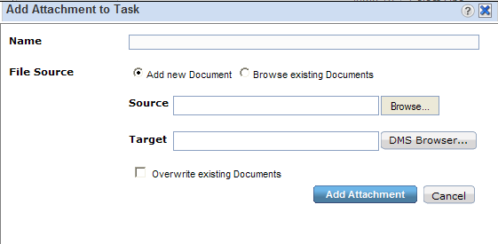
Task Detail – Manage Attachment
Add Attachment
  Attachment Name
  File Source
    Add New
      Add new document to DMS
    and attach
      Source: location of document
      Target: location in DMS to store
    Browse Existing
      Browse existing documents from DMS and attach.
      Opens DMS browser to select the document

Slide 13
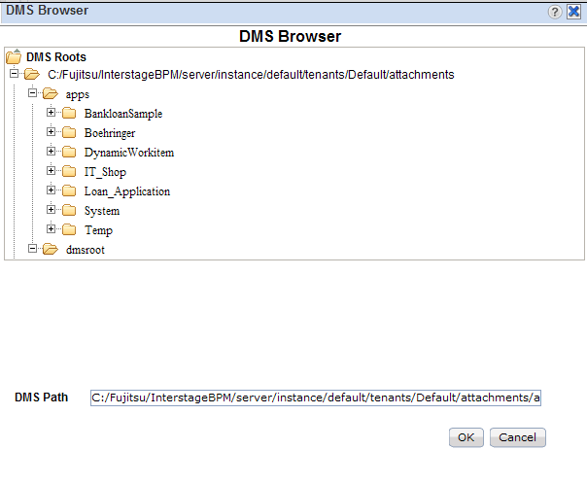
Task Detail – Manage Attachment
DMS Browser
  One or more DMS can be configured for storing documents
  DMS can be a file system or WebDAV supported repository

Slide 14
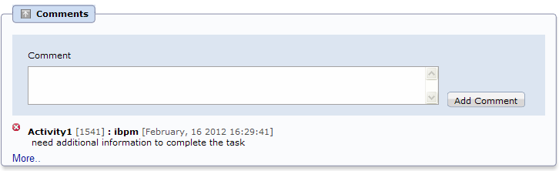
Task Detail – Comments
Users working on task may write comments
  Share information with other users
  Additional information before reassigning task to a different user
  Can be also used to log user feedback for future updates.

Slide 15
My Team Tasks - Overview
Team Manager/Supervisor can manage team tasks.
  Check workload on team members
  Validate team performance
  Assists in better planning
    Re-Distribute tasks among team members
    Plan for future tasks, holidays, vacations.
Name | Title
Keith Swenson | Manager
Shamim Quader | Engineer – Product Development
Kumar Raja | Engineer – Product Development
Sameer Pradhan | Engineer – Product Development
John Smith | Engineer – Product Development

Slide 16
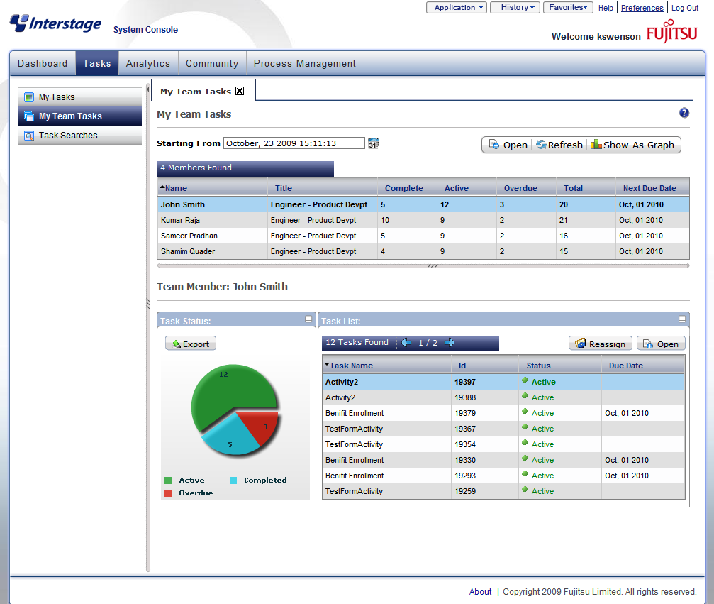
My Team Tasks
The manager’s view of the team’s tasks.
Team Task list
Notice Reassignment option here
Member Task List
16
Notes:
Clicking on “My Team Tasks” shows the team’s tasks.
<c> Click one team member to see their detail.

Slide 17

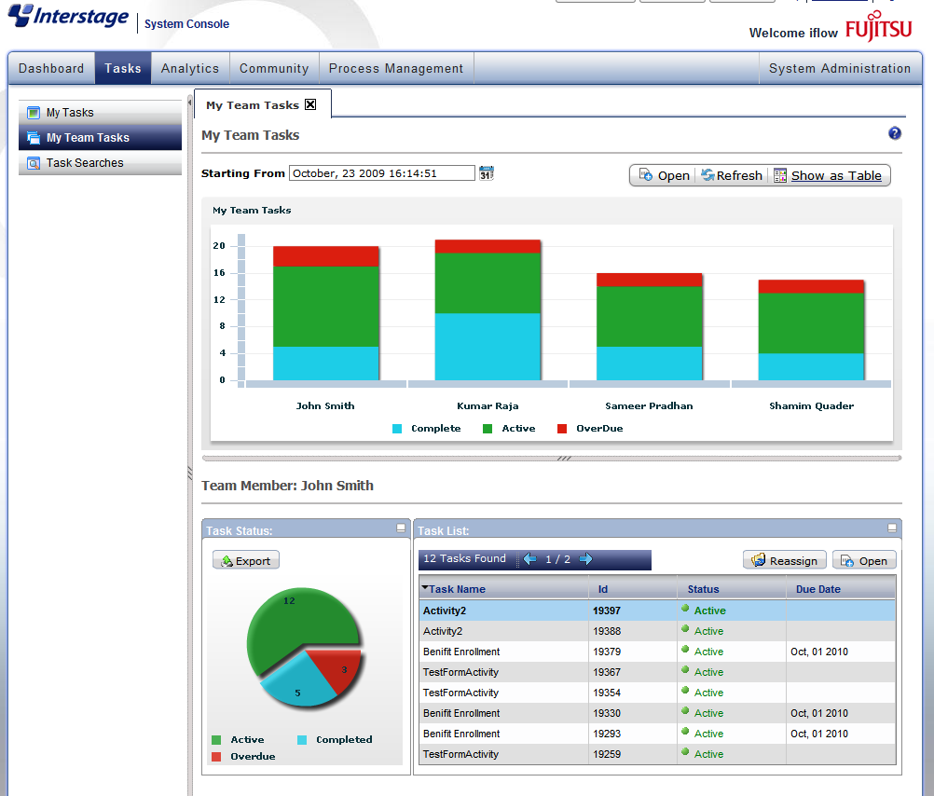
My Team Tasks
Show as Graph: Toggles the screen between the table and the graphical view

Slide 18
My Team Tasks
When a team manager logs-in to the console, he/she can view his/her tasks and team’s task.
By default, users will see their reports for the last 7 days.
  Change the date for more history data

Slide 19
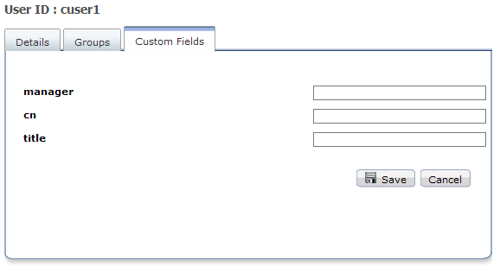
My Team Tasks
Team Configuration
  User accounts can be assigned a manager by entering Manager’s username in the “manager” attribute
  “manager” attribute is configurable.
  map an already existing LDAP attribute to the “managerattribute” attribute or define an attribute called ‘manager’.
Tenant Property
“managerattrribute” = “myManager”

Slide 20
Task Searches
Create custom search queries and save for future use
Replace the task list table in “My Task” with custom list table
Search Criteria
  Task Properties
  Process Definition and Process Instance Name
  Assignee
  UDA values
  Perform sorting
Display UDA values in result list table

Slide 21
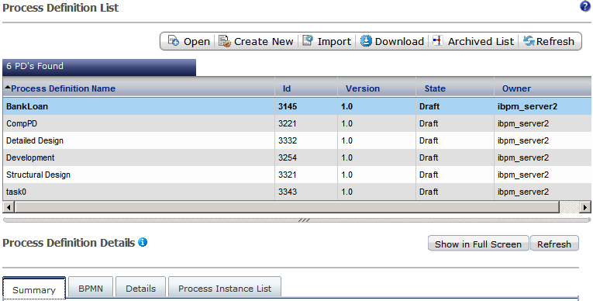
Process Definition
The table by default shows all process definitions owned by user.

Slide 22
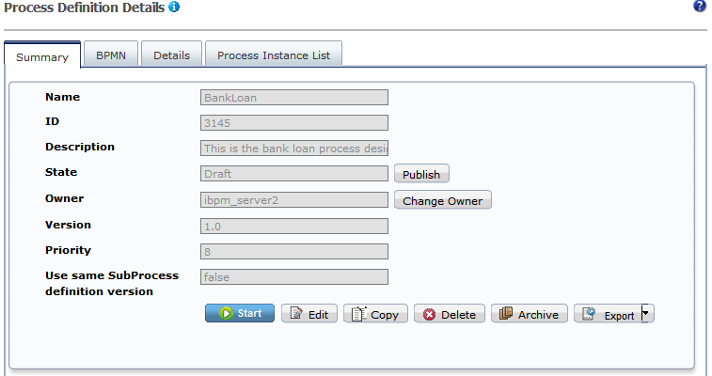
Process Definition Details - Summary
Summary of PD and available Actions

Slide 23
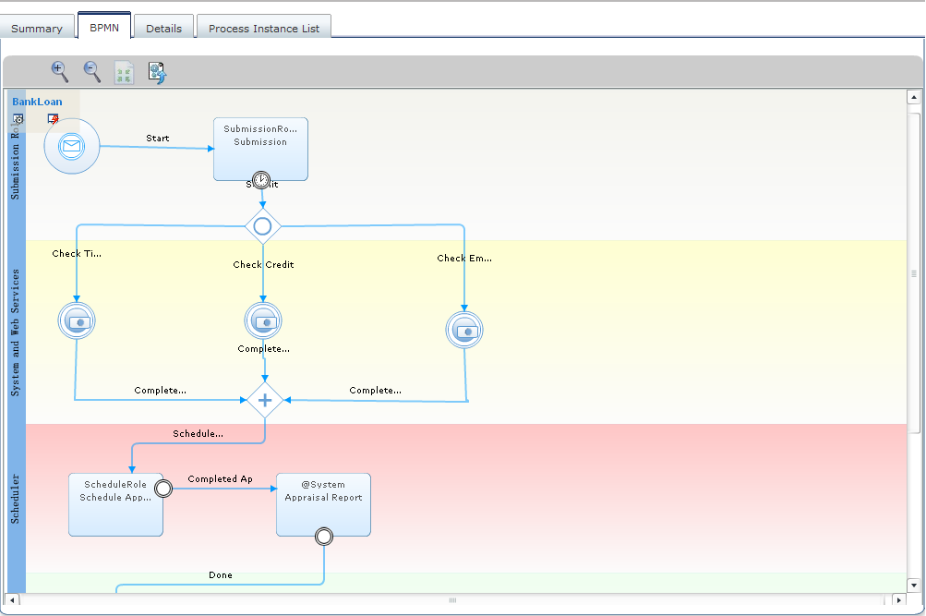
Process Definition Details: BPMN
BPMN Flash Viewer

Slide 24
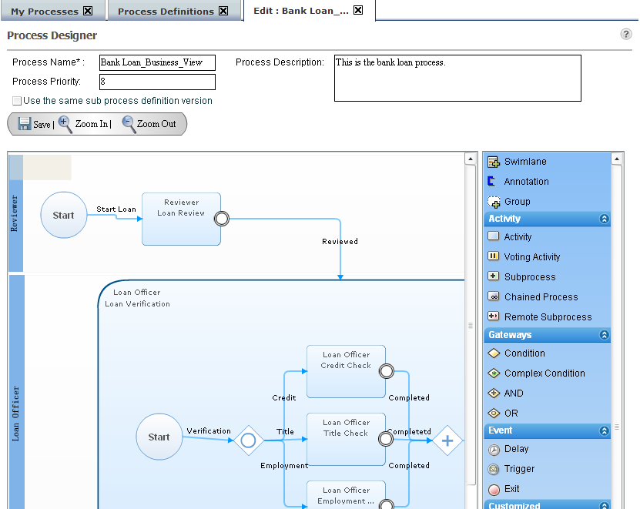
Process Definition Details: (BPMN)Create/Edit
Process Definitions can be edited and created in BPMN Flash Editor
  Process definition cannot be edited if it has active Process Instances.
Node Pallet

Slide 25
Process Definition Details
Details tab
  Shows details about process definition in text mode
  Users can access information about nodes, actions, timers everything.
Process Instance List
  Shows list of process instances created from selected process definition.
  Helps assess the change impact.

Slide 26
Process Instance
See the list of process instances
Default view shows only PIs owned by user
Filters:
  My Processes
    Active, Inactive, in Error State, Dynamic
  All Process
    Active, Inactive, Archived, in Error State
Process Instance Details
  Summary
  Details
  BPMN
  History

Slide 27
Process Instance
Editing Process Instance
  A process instance can be edited (structurally) without editing the Process Definition
  Useful in scenarios where urgent fixes/changes are required to the running processes
  Editing PI results in a new PD with same design as edited PI.
  New PD’s status is “Private” (private for PI)
  Private PD can be upgraded to Draft and Publish.

Slide 28
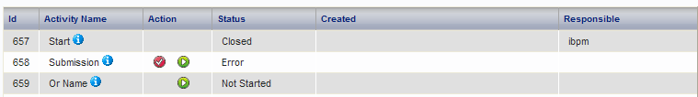
Process Instance Details: Detail
Process Details
Node Instance Details
  Shows list of all nodes and status
  Allows to execute nodes in ad-hoc manner (useful for ad-hoc processes where activities do not depend on each other)
Process Instance Attributes
Timer Instance List
Attachment Panel
Comment Panel
Stop
Start

Slide 29
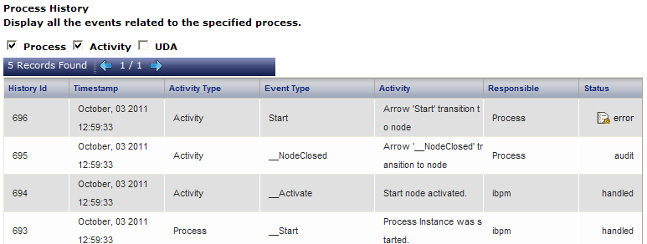
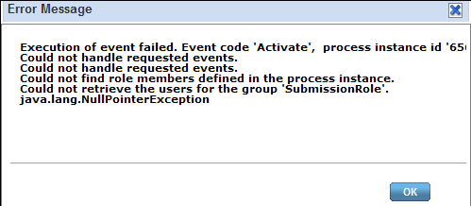
Process Instance Details: History
Shows process execution history/audit
Helps tracking changes to
  Process
  Nodes
  UDAs
Shows error details if node fails

Slide 30
Process Ownership
Process owner has certain privileges over other users
Process Definition owner:
  User who creates Process Definition becomes the owner of Process Definition
Process Instance owner
  Defined in process definition properties (Owner Group or “OG”)
  Can be assigned in Owner Action (OA)
  If instance owner is not defined, definition owner becomes instance owner
  If owner is defined in OG as well as OA
    User/group from Intersection of OG and OA is assigned as owner
    If intersection is empty, definition owner becomes owner of instance.

Slide 31
Process Ownership
Users can see and edit only definitions and instances owned by them
Filters “All xxx Process” are available only to administrators
Filters “All xxx Tasks” are available only to owners and admins
Only Owners (and Administrator)
  Can edit definition and instances
  Can publish process definitions
  Can add comments to process instance (also the “task assignees” and “process initiator”)
  Can change ownerships

Slide 32
Process Searches
Process Definition and Instance search allows searching for processes using custom queries
Queries can use UDA name-value, process properties etc as search parameters
Create and Save searches and set them as default
Customize default list view to add/remove columns, add UDAs in table for more business visibility.

Slide 33
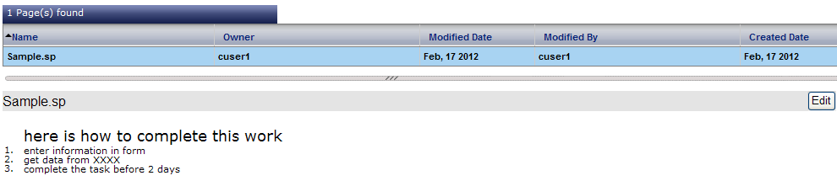
Community
Create pages using Wiki syntax
Share pages with others easily to enhance collaboration

Slide 34


