Slide 1
Adding details to process model

Slide 2
Node Properties
Node properties
  General
  User Defined Attributes
  Forms
  Due Date
  Timers
  Action Set
  Exception Handling
  Triggers
  Simulation
Notes:
Name
Description
Priority: Currently descriptive?
Assignees: Role or user
Commit transaction after completion
Enable Recall – If set a user can recall and redo a completed task
Enable Future Workitem – Discussed on next slide
Iterator Setting: Used for Iterator Nodes … Discussed in more detail later.

Slide 3
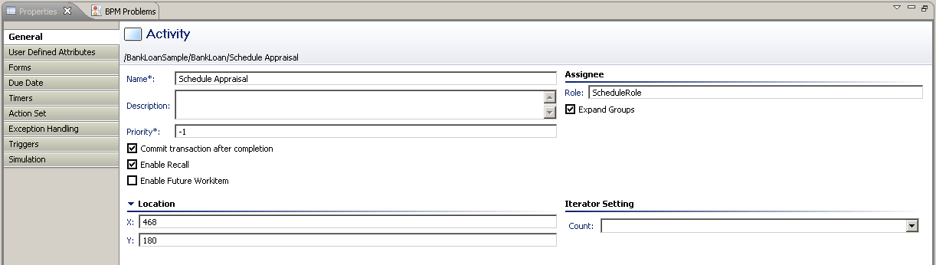
General Attributes
  Name and Description
  Role
  Transaction Setting
  Expand Group
  Enable Recall
  Future Workitems
  Iterator Setting
Notes:
Name
Description
Priority: Currently descriptive?
Assignees: Role or user
Commit transaction after completion
Enable Recall – If set a user can recall and redo a completed task
Enable Future Workitem – Discussed on next slide
Iterator Setting: Used for Iterator Nodes … Discussed in more detail later.

Slide 4
General Attributes
Transaction Setting
  Provides the option to commit or hold when task completes
  Commit may be delayed if data loss is acceptable in case of crashes
Expand Group
  Individual work items for each member (Expand Group)
  Users in the same role share copy of one work item
Notes:
Name
Description
Priority: Currently descriptive?
Assignees: Role or user
Commit transaction after completion
Enable Recall – If set a user can recall and redo a completed task
Enable Future Workitem – Discussed on next slide
Iterator Setting: Used for Iterator Nodes … Discussed in more detail later.

Slide 5
Recalling Task
Recalling Task allows a user to recall a Task they previously completed, to edit and resubmit, if required.
  Example: User completes Activity1 and the Process moves to Activity 2. The user may decide to recall the Activity1 task.
Can only Recall one task at a time
Can recall multiple levels through iterating each level
  Example: Recall Activity3, then Activity2 and finally Activity1

Slide 6
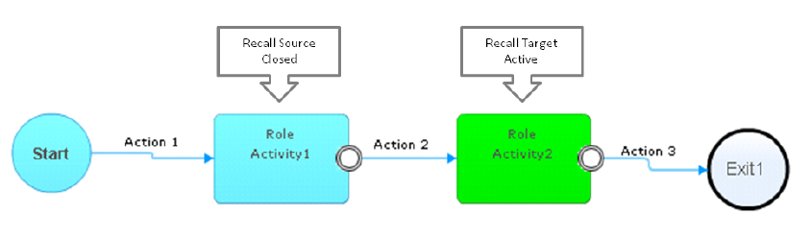
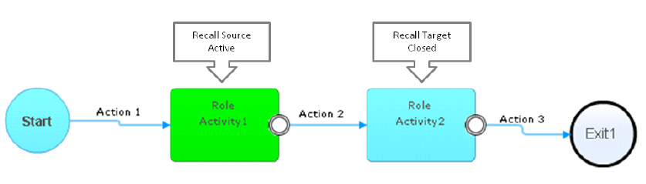
Recalling Task
After Recall

Slide 7
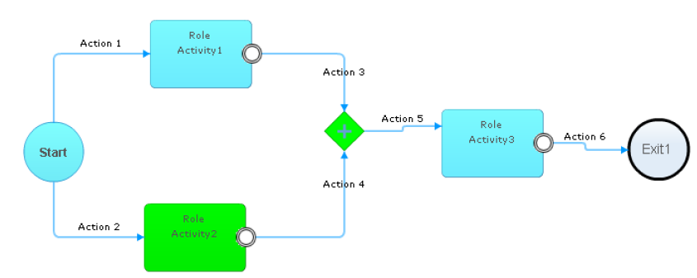
Recalling Task
Recalling Parallel task

Slide 8
Future Tasks
Allows users to estimate how many tasks might come to their queue in future.
Helps in better planning future activities
Users can search for future tasks in the task page on console.
Future tasks show only incoming tasks for active instances/requests.
Notes:
Users can filter the task on their "My Tasks" page in the Console to show likely future activities.
The "Enable Future Workitem" checkbox from the previous slide controls whether an activity is to be considered likely.
This example <c>, shows the filter on the “My Tasks” Console display.

Slide 9
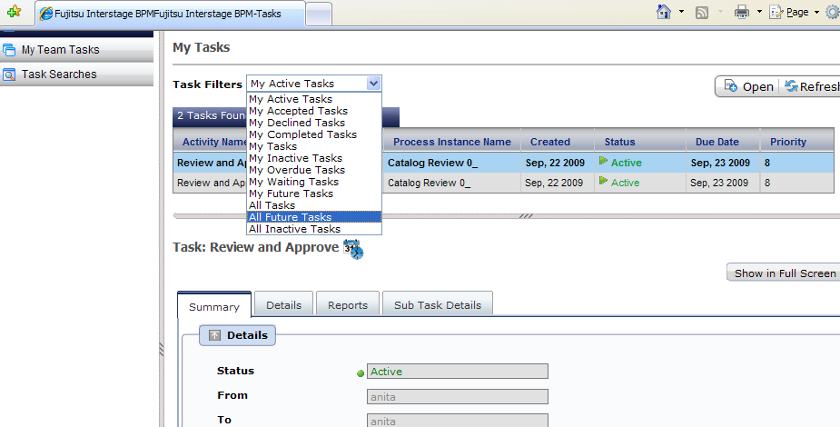
Future Tasks
Users can filter the task on their "My Tasks" page in the Console to show likely future activities.
Notes:
Users can filter the task on their "My Tasks" page in the Console to show likely future activities.
The "Enable Future Workitem" checkbox from the previous slide controls whether an activity is to be considered likely.
This example <c>, shows the filter on the “My Tasks” Console display.

Slide 10
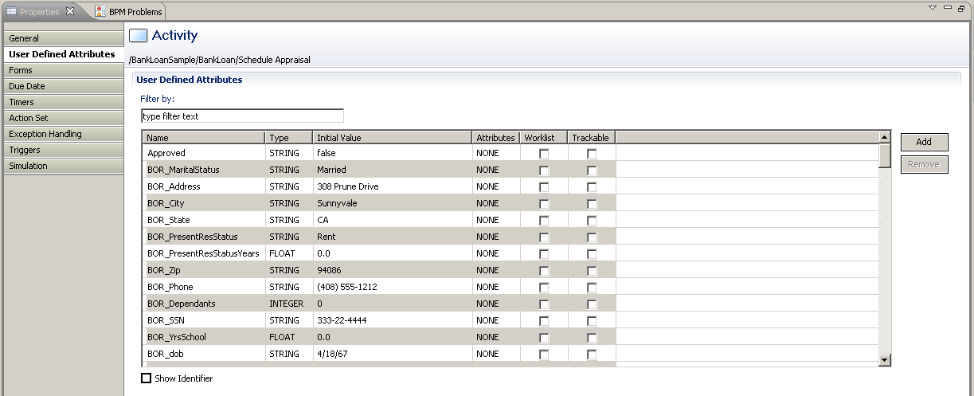
Node Properties - User Defined Attributes
User Defined Attributes – Process data variables.
UDAs can be updated by user in the task details form:
  STRING, FLOAT, INTEGER, LONG, BOOLEAN, DATE, BIGDECIMAL and XML
Notes:
User defined attributes are variables that hold process specific data for an executing process.
Their values can be:
initialized when a process is instantiated;
updated by a user via a form or through the Interstage BPM console; and
updated by an agent or action.
They can have a data type of:
STRING;
FLOAT;
INTEGER;
LONG;
BOOLEAN;
DATE;
BIGDECIMAL; or
XML.

Slide 11
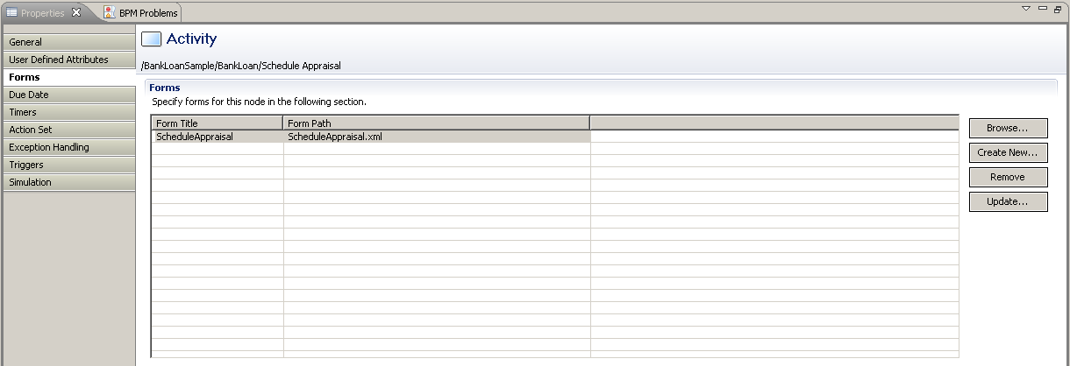
Node Properties - Forms
Forms can be attached to Activity nodes to present information to the users, required to complete the tasks.
Users can edit/enter data and submit the task.
Interstage BPM forms designer provides rich form building capability.
JSP pages can also be attached as forms.
Notes:
Forms can be used to display and, if needed, modify data from User Defined Attributes and other data sources.
More complex, AJAX based, screens can be created using the Interstage BPM Studio Forms Editor.

Slide 12
Java Actions
Process Level
  Init Action and Owner Actions
    Executes at process instance start time
  Commit Action
    Executes upon process completion.
Node Level
  Role Action
    Executed after assignee resolution and before task assignment
  Prologue Action
    Executed before the node performs its task
  Epilogue Action
    Executed after the node finishes its task and before the process instance moves on to another node
Notes:
Generally Business Process Management Systems provide the ability to execute code as part of the running of a Process Instance.
In the case of Interstage BPM this is Java code or JavaScript.
The code can manipulate process data and influence execution of a Process Instance.
It can be executed at various points in a Process Instance, including:
process instance start time
- init script/action, process instance owner script/action
work item activation time
- prologue script/action, role script/action
work item completion time
- epilogue script/action
process instance end time
- commit script/action
timer expiry or a due date is reached
– timer action

Slide 13
Pre-Defined Java Actions
These groups of pre-defined Java Actions are available:
  Server – enable to interact with the BPM Server
  XML - add XML substructures, text elements, or attribute values to User Defined Attributes (UDAs) of type XML.
  Rules - Java Action to invoke rules engines and execute business rules
  Notification - notify users on events related to process execution
  Database – allows to interact with external databases
  Integration – allows to access external systems from process definition
  Custom – Generic and No-operation Java Actions
Notes:
Server Actions enable you to interact with the Interstage BPM Server. Using Server Actions, you can
Assign an activity to a user or escalate an activity
Make an automatic choice
Retrieve the process initiator or performer of an activity
Set standard attributes like process instance name, description, or priority
Set the value of User Defined Attributes (UDAs)
Evaluate a JavaScript
XML Actions to add XML substructures, text elements, or attribute values to User Defined Attributes (UDAs) of type XML. In addition, you can delete XML substructures, text elements or attribute values from a UDA of type XML, assign an XML string to a UDA of type XML and extract values from XML data.
A Rules Action is a special type of Java Action that acts as an interface to a rules engine. This interface allows you to use advanced process logic in your process definitions at every point in the process definition where you could attach an Action Set.
Interstage BPM supports the following rules engines:
ILOG JRules
Blaze Advisor
Notification Actions notify users on events related to process execution. Users can be notified, for example, that a process or a single activity has been started. Currently, emails can be sent for notification.
Database Actions allow you to interact with external databases that are independent of Interstage BPM. You can retrieve data from a database and assign it to User Defined Attributes (UDAs). You can also send data back to the database, and you can delete data from the database.
Standard SQL queries are used to access the database.
Integration Actions allow you to access external functions from within your process definition.
You can integrate any system that exposes its functions as a Web Service, and you can execute remote commands.
Generic Java Actions allow you to execute Java methods that are outside the scope of Interstage BPM. They enable you to customize process execution using methods of Java classes that you have implemented yourself.
No-Operation Java Actions are built-in Java Actions that specify no operation. These Java Actions allow you to catch a Java Action exception without executing any additional actions. Using No-Operation Java Actions, Interstage BPM simply moves on to the next sequential instruction.

Slide 14
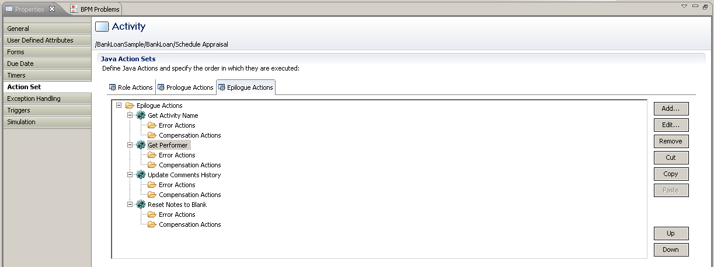
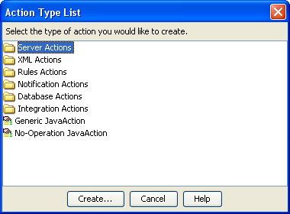
Adding Actions
Notes:
This slide shows the “Action Set” where actions are associated with various points in an Activity Node’s execution.
These points are:
Prologue;
The action is executed before the node performs its task.
Role; and
The action is executed after role resolution.
This allows the assigned user to be changed depending on the conditions.
Epilogue.
The action is executed after the node completes its task but before the process moves to another node.

Slide 15
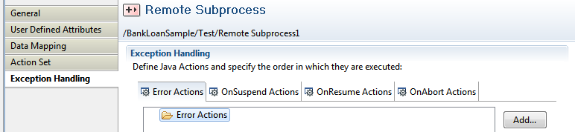
Exception Handling
Error Actions – Only available at Process Level
  Used to handle error in “Remote Subprocess Nodes”.
OnSuspend, OnResume, and OnAbort
  Executes when a process or task is Suspended, Resumed or Aborted.
Notes:
OnSuspend, OnResume, and OnAbort Actions (On*Actions) are executed just before a process instance changes its state due to the fact that an Interstage BPM Administrator has issued the command to suspend, resume or abort the execution of a process instance.
On* Actions can be defined for individual activities (for example individual nodes) or for process definitions. Assume you define, for example, an OnSuspend Java Action both for a node and for a process definition. If this node is active when an Administrator issues the command to suspend the process instance, the Java Actions are executed in the following order:
1. The OnSuspend Java Action of the Node is executed.
2. The OnSuspend Java Action of the process definition is executed.
Similar to all other Java Actions, On* Action Sets can contain a number of other Java Actions.

Slide 16
Due Date and Timer
Due Date
  Specify when an activity is due to be completed once it has become active
  Due date is displayed to the user and task is sorted in descending order by default.
  Allows to take some action when due date expires.
Timer
  Allows to take some action at pre defined time/schedule
  Can be repeated after each specified interval
Notes:
A timer can be associated with an Activity Node to influence process execution.
A timer is a time-based trigger which can be:
Absolute;
This is triggered at an absolute time of the day and day of the year.
Calendar;
This is triggered after a specified time has elapsed since the Activity Node became active.
Business; and
Similar to Calendar but based on a Business Calendar.
Allows settings such as two hours after opening time.
Advanced.
This uses time and day codes in conjunction with the Business Calendar to define more complex settings, such as:
BM(-1) – the last business day of the month; and
WN(7) – the next Saturday after today.
Timers can be specified as “periodic” if they are to occur repeatedly.

Slide 17
Due Date and Timer Type
Due Dates and Timer types depend on the schedule/date configuration
  Absolute - triggers at a predefined specific date and time
  Calendar - trigger after specified time has elapsed
    Time specified in Days and Hours
  Business - based on a Business Calendar
    can use working hours from a Business Calendar
  Advanced – define expressions using Time and Day codes and Business Calendar to define more complex timers
    BM(-1); - the last business day of the month
    WN(7); - the next Saturday after today
Timers can be marked as Periodic if they are required to trigger repeatedly
Notes:
A timer can be associated with an Activity Node to influence process execution.
A timer is a time-based trigger which can be:
Absolute;
This is triggered at an absolute time of the day and day of the year.
Calendar;
This is triggered after a specified time has elapsed since the Activity Node became active.
Business; and
Similar to Calendar but based on a Business Calendar.
Allows settings such as two hours after opening time.
Advanced.
This uses time and day codes in conjunction with the Business Calendar to define more complex settings, such as:
BM(-1) – the last business day of the month; and
WN(7) – the next Saturday after today.
Timers can be specified as “periodic” if they are to occur repeatedly.

Slide 18
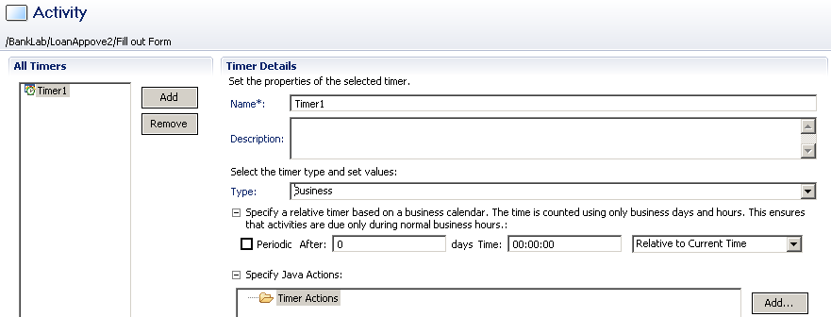
Configure Timer
Configure Timer to use business calendar
Notes:
Lastly configure Timer to use business calendar to calculate time.

Slide 19
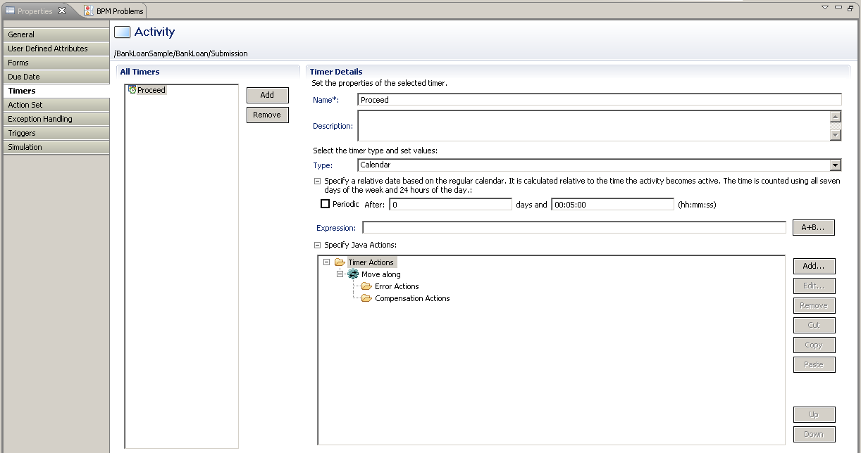
Due Date and Timer Actions
Action can perform some task when due date or timer expires
e.g.
  Send an Email (escalation)
  Evaluate a script or call an external interface
  Escalate Task by re-assigning it to a new list of users.
Notes:
This slide show where “Timers” are set.
This is where:
the type of timer (Absolute, Calendar, Business or Advanced) is set; and
the type of action that is required when the timer expires, for example:
send an email;
evaluate a script or invoke a Java Action set; or
escalate the activity by assigning it to a new set of users.

Slide 20
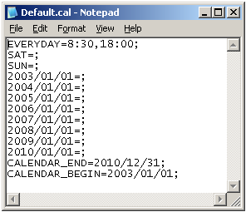
Business Calendars
Business Calendars define the hours of operation
Used by Timers to calculate execution time
Interstage Server has Default Calendar
  Hours 8:30am – 6:00pm
  Closed on Weekends
  Closed Jan 1, 2003 - 2010
  Valid for Jan 01, 2001 to Dec 12/31/10
Notes:
Business Calendars define the hours of operation for the business. Business Calendars are used to accurately calculate execution times. IBPM has a default business calendar which is used when no other business calendars have been defined.
The default calendar is configured with the following values: Mon – Fri 8:30am to 6:00pm closed on weekends, and New Years and valid from Jan 2003 to Dec 31, 2010.

Slide 21
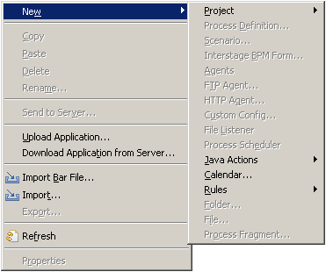
Creating Business Calendars
Create Business Calendars
Supports Multiple Calendars
Calendars are Locale Specific
Notes:
Business Calendars are created in IBPM Studio and are part of the Workflow Application. Multiple Business Calendars can be created and Calendars Locale specific.

Slide 22
Defining Calendars
EVERYDAY
  Defines default business hours
    Example: EVERYDAY=9:00,17:00;
  CALENDAR_END
  End date the Calendar is valid until
  Max10 years from CALENDAR_BEGIN
    Example: CALENDAR_END=2010/12/31;
  CALENDAR_BEGIN
    Begin date the Calendar is valid from
      Example: CALENDAR_BEGIN=2010/01/01;
  TIMEZONE
    The Time zone using GMT
      Example: TIMEZONE=+10:00; (Brisbane Australia)
      Example: TIMEZONE=-5:00; Eastern USA (New York)
Notes:
Read bullets

Slide 23
Calendar: Optional Expressions
<Day of Week>=[hours, hours];
  Overrides EVERYDAY setting
  SUN,MON,TUE,WED,THU,FRI,SAT
  Hours of operation or blank no hours
  Example: SAT=9:00,12:00;
  Example: SUN=;
<DATE> Specific Date
  Overrides EVERYDAY and <DAY OF WEEK>
  Example: 2010/12/25=;
  Example: 2010/02/14=9:00,12:00; 15:30,17:00; (Long Lunch)
DST Day Light Savings Time
  Example: 2010/04/20=DST(1); Spring forward one hour
  Example: 2010/10/19=DST(0); Fallback
Notes:
Read Bullets

Slide 24
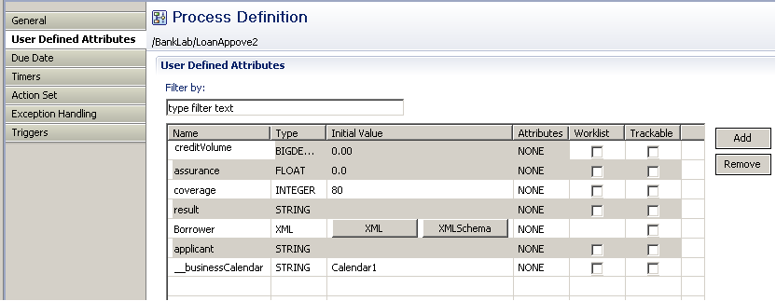
Assigning Business Calendars
Assign Business Calendar to BPD
Create UDA __businessCalendar (double underscore)
  Type String
Assign value to name of calendar (no extension)
  Example: Calendar1
Notes:
Assign Business Calendar to Process Definition by create a String type UDA __businessCalendar and assign the name of the Business Calendar without the extension.

Slide 25
Additional Nodes
Conditional and Complex Conditional Node
Email Node
Voting Node
Sub Process Node
Process Fragment
Compound Node
Notes:
Assign Business Calendar to Process Definition by create a String type UDA __businessCalendar and assign the name of the Business Calendar without the extension.

Slide 26
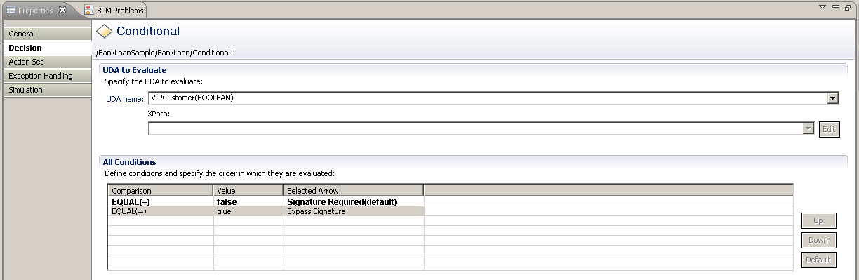
Conditional Node Properties
Used for conditional route of the process
Decision can be based on a UDA value or XPath expression (if UDA selected is XML type)
Supports simple true-false type conditions only
Notes:
This slide shows the “Decision” screen for the Conditional Node.
The conditions specified here are tested in order and the first condition that is satisfied is used to determine the exit arrow.
If no conditions are satisfied then the exit arrow of the “default” condition is used.

Slide 27
Complex Condition Node
Complex Conditional node supports complex expressions for conditional routing of process.
Complex Conditional Nodes give you more flexibility as they allow to specify conditions combining operators, dates, UDA’s, constant values etc.
Easily create expressions using Expression Builder
Notes:
The basic Conditional Node allows only simple conditions to be specified.
The Complex Conditional Node supports the specification of conditions using:
complex comparisons;
dates;
User Defined Attributes; and
constants, etc.
An expression can be created for each outgoing arrow from a Complex Condition Node.
These expressions can be entered manually or generated using the Expression Builder.
Java Actions can be executed when a Complex Condition Node is activated or completed.

Slide 28
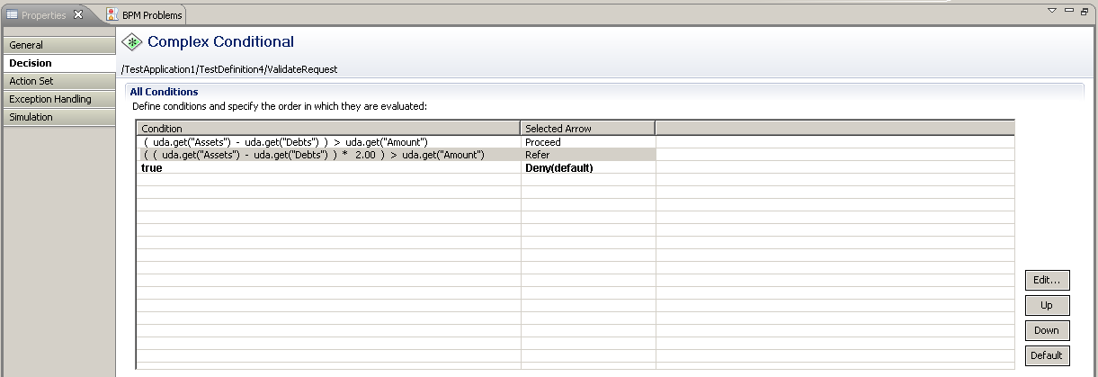
Complex Condition Node
Notes:
28
This slide shows an example of the Decision settings for a Complex Condition Node.

Slide 29
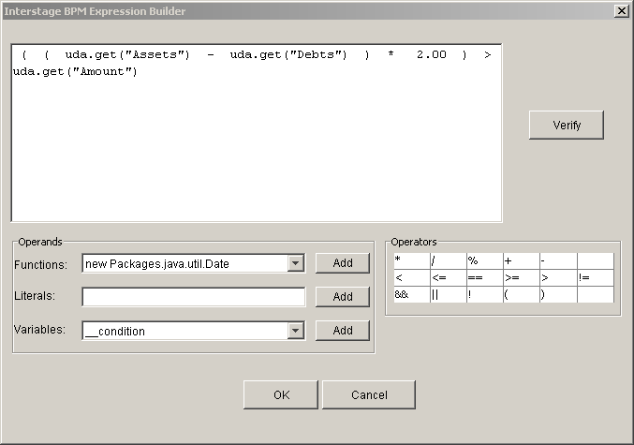
Expression Builder
Build and verify complex conditions using a simple editor
Also available for:
  Java Actions
  Triggers
  Email Nodes
Notes:
Here is an example of the Expression Builder.

Slide 30
Email Node
Use Email Node to send emails during process execution.
After sending the email, Email Node activates all outgoing arrows.
No user action is required with this node.
The address, subject and body fields can either contain fixed text or a combination of text and UDA values.
The Expression Builder is used to create complex expressions which combine UDA’s, text and conditions.
Notes:
30
The Email Node sends predefined emails.
After the email has been sent the Email Node activates all outgoing arrows.
This node is executed without user action.
Fixed text, UDA values or a combination of the two can be used for the:
addressee;
subject; and
body.
Use the Expression Builder to combine fixed text, UDAs and conditions.

Slide 31
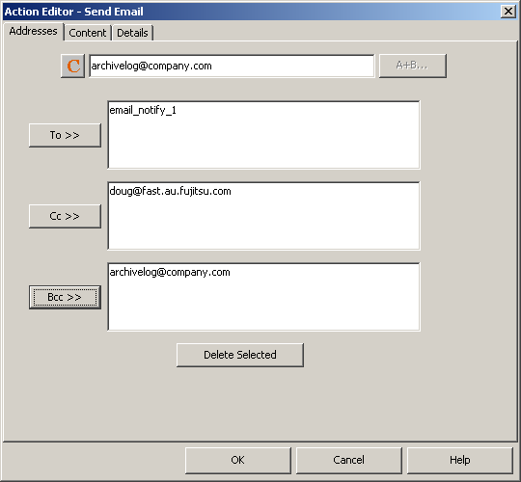

Email Node
Email Action can be attached to other nodes as well.
Supports attachment
Notes:
31
The Email Node sends predefined emails.
After the email has been sent the Email Node activates all outgoing arrows.
This node is executed without user action.
Fixed text, UDA values or a combination of the two can be used for the:
addressee;
subject; and
body.
Use the Expression Builder to combine fixed text, UDAs and conditions.

Slide 32
Email Node Properties
Addresses
  TO, CC, BCC
  Supports email ids, UDAs or expressions
Content
  Subject, From, Body (email message)
  Supports free text, UDA and expression
  Supports Text or HTML content in body
Attachment
  Process attachments can be attached to email message
  Document available in DMS can be attached
    Use actual path, UDA or expression for document to be attached.
Notes:
32
The Email Node sends predefined emails.
After the email has been sent the Email Node activates all outgoing arrows.
This node is executed without user action.
Fixed text, UDA values or a combination of the two can be used for the:
addressee;
subject; and
body.
Use the Expression Builder to combine fixed text, UDAs and conditions.

Slide 33
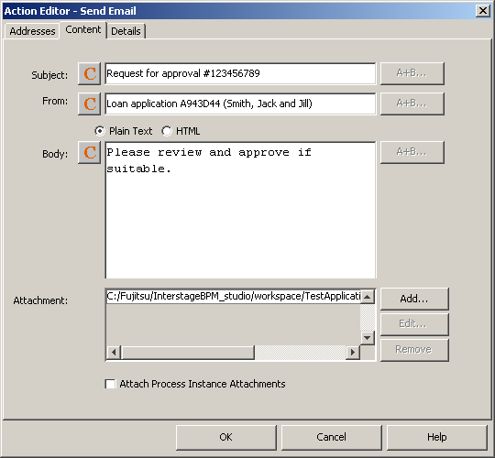
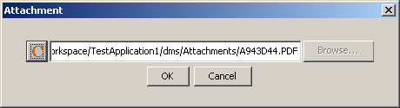
Email Node
Notes:
33
The “Send Email” dialog “Addressee” tab is used to set the To, Cc and Bcc fields.
<c> The “Content” tab sets the subject, body and any attachments.
To add and attachment click Add…. <c>, then click Browse … <c> to browse for a file.
Select the required file and click OK <c> .
More attachments can be added or removed as required.

Slide 34
Voting Activity Node
Simplifies support for groups of people and common interaction patterns.
Approved
if n>=3
Group members
Acceptable
n>50%
Approve Doc
Timeout 3 days
Reject
n<=1
Notes:
A Voting Activity Node allows users to work on an activity in collaboration with one another.
All users can make their own choice (or vote).
All of their votes can be polled.
he winning vote, represented by one of the outgoing arrows, is determined by the voting rules.

Slide 35
Voting Activity Node
A Voting Activity uses voting rules to determine the choice (outgoing arrow) that wins.
Voting Activities are designed so that many assignees can make their own choice on a particular work item.

Slide 36
Voting Rules
Types of rules that can be assigned to Voting Activity Nodes:
  Majority Rule
    A majority of votes for that choice make it the winning choice.
  Percentage Rule
    The specified percentage of votes for that choice would make it the winning choice.
  “Number of” Rule
    The specified number of votes for that choice would make it the winning choice.
When defining voting rules, you also choose a default rule that is chosen if none of the rules apply
Notes:
A voting rule is defined for each outgoing arrow.
The following rule types are available:
Majority Rule:
If this rule is assigned to a choice, a majority of votes for that choice make it the winning choice.
For example, if the majority rule were assigned to a choice called “Approve”, a majority of votes for the “Approve” choice would make that the winning choice.
The process instance would proceed along the “Approve” arrow to the next activity.
Percentage Rule:
If this rule is assigned to a choice, the specified percentage of votes for that choice makes it the winning choice.
For example, if a 50% rule is assigned to a choice called “Approve”, 50% of the total number of votes for the “Approve” choice would make that the winning choice.
"Number of" Rule:
If this rule is assigned to a choice, the specified number of votes for that choice make it the winning choice.
For example, if a "1" is assigned to a choice called “Reject”, one vote for “Reject” would make that the winning choice.
When defining voting rules, a default rule is also selected.
The default rule is chosen if none of the rules apply.

Slide 37
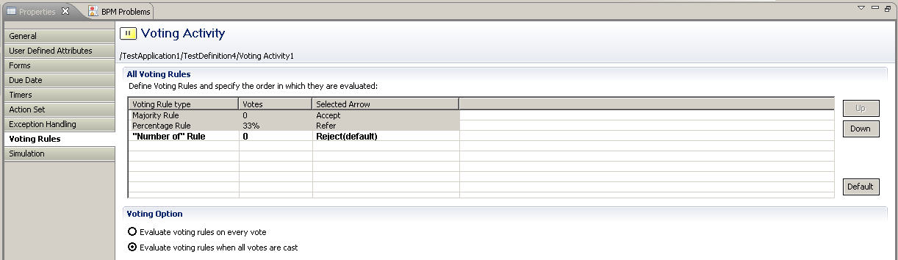
Voting Activity Node Properties - Validation
Evaluate voting rules on every vote
  if you want to complete the activity as soon as a voting rule is satisfied.
Evaluate voting rules when all votes are cast.
  To make sure that everyone gets a chance to vote.
Notes:
There are two methods for evaluating the voting rules.
The first evaluates the voting rules each time a vote is received.
Use this method to have the activity complete as soon as one rule is satisfied.
The second method only evaluates the voting rules when all votes have been cast.

Slide 38
Subprocess
Subprocess Node represents a step in a process where a task is accomplished by invoking another process.
Invoked Subprocess should be a valid independent process definition with one start and at least one exit node.
Usage
  Promotes reusability
  Helps improve visibility of large and complex process by breaking it down into smaller independent processes.
Behavior:
  instantiates a Process Instance from the Subprocess Definition
  Data can be shared to and from Sub Process
  Parent Process waits for Subprocess to complete
Notes:
The Subprocess Node references a Process Definition which is instantiated and executed synchronously.
The Process Instance does not need to be instantiated on the same Interstage BPM instance on which the Subprocess Node was running.
A mapping of data elements is used to provide data to, and receive data from, the Subprocess.
Once the Subprocess is complete an event is generated on each outgoing arrow.

Slide 39
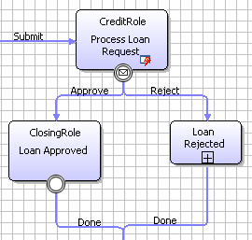
Subprocess –Data Mapping
If UDA in parent process have same name as UDA in Subprocess, mapping is done automatically
Modeler can map non-matching UDAs manually
  UDA data-type needs to be same for mapping to work
For XML UDAs, XPath can be used to mapping
Subprocess
Notes:
Associating a Subprocess Node or Chained Process node requires the process designer to create mappings for UDAs that will be used in the sub-process or chained process. To help simplify this task IBPM Studio has an auto mapping feature that creates the mapping automatically for matching UDAs.

Slide 40
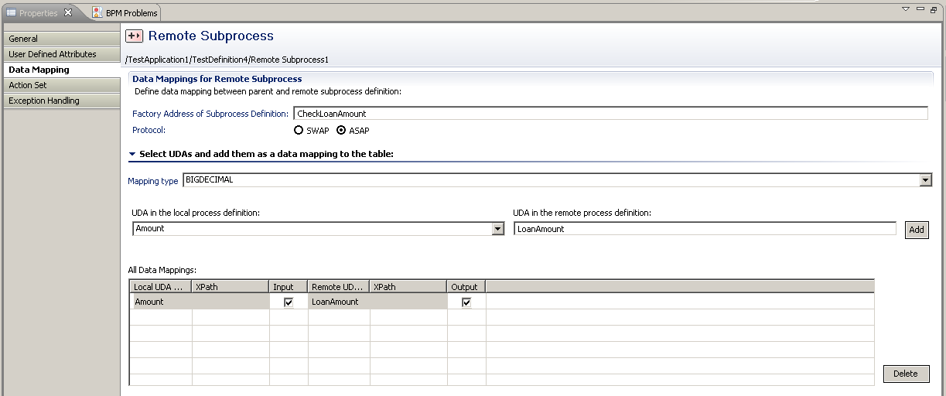
Subprocess – Data Mapping
Notes:
This slide shows the “Data Mapping” for a Subprocess.

Slide 41
Process Fragments
Create re-usable process library.
Fragments need not be valid process definitions.
Any part of process can be saved as a fragment and used in other processes.
UDAs are also stored in fragment and copied to the process definition.
Edit fragments after copying if required
Physically copied, not referenced.

Slide 42
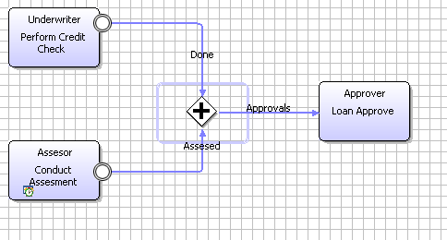
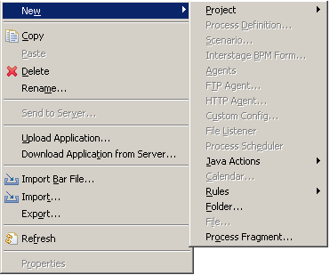
Define Process Fragments
Select parts of process to save as Fragment
Create Folder to store
Create Fragment
Notes:
Define new Process Fragments by first creating a folder to store them in and then creating the Process Fragments without a Start and End Node.

Slide 43
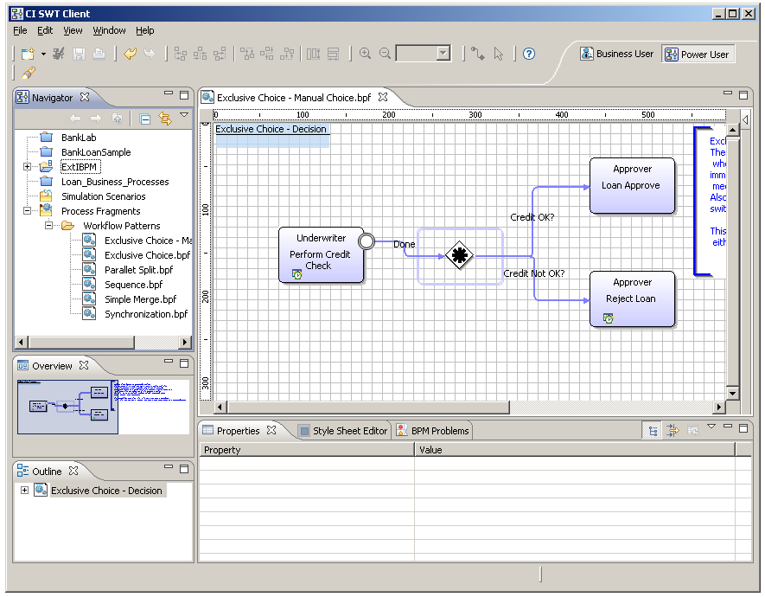
Process Fragments
Drag and Drop to reuse
Notes:
Located at the bottom of the Navigator Pane is the Process Fragments Folder. Process Fragments allow Process Designers to reuse common process routines when defining a Process Definition. Interstage BPM Studio ships with some common Process Fragments and allow for new ones to be created and added.

Slide 44
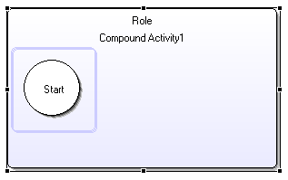
Compound Activity Node
Provides option to group set of nodes in process
Useful in modeling phases or milestones.
Once a phase is complete, a milestone in the process can be said to be achieved and the process can move to the next activity or another phase
Must have one start node and at least one exit node like a Subprocess.
May have child nodes within compound node.
Notes:
The Compound Activity Node provides a way of encapsulating a set of related processing elements.
It must have only one Start node.
It must have at least one Exit node.
Each Exit Node must have an outgoing arrow with the same name.
Iterator Nodes, Recall, Voting and Triggers are not supported in a Compound Activity Node.
A Compound Activity Node may have:
User Defined Attributes;
Action Sets;
Timers;
Due Date;
Forms; and
Priority.

Slide 45
Compound Node Execution
when a compound node is reached in the process execution
  Workitem is created for Compound Node and status is changed to “WaitingOnSubProcess”
  Start node within compound node executes and control moves forward to next node.
  When all child nodes complete execution, exit node executes.
  Compound node status changes to “Completed”
  Process moves forward.
Compound node
  May have due dates, actions etc like any activity node
  Name of child “Exit” node MUST match the name of outgoing arrow from compound to next node in the process.
  Cannot be recalled.

Slide 46
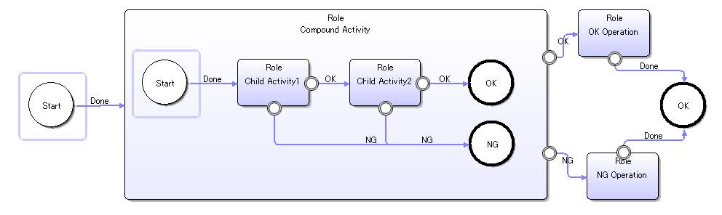
Compound Activity Node - Example
“OK” arrow
for ”OK” exit
Single Start Node
“NG” arrow
for ”NG” exit
Notes:
This slide shows an schematic of a Compound Activity Node.
Note:
<c> the single Start Node;
<c> the OK Arrow for the OK Exit Node; and
<c> the NG Arrow for the NG Exit Node.

Slide 47


