Slide 1
Simulation

Slide 2
Simulation
Simulate execution of a Business Process in Studio
Identify bottlenecks and optimize before deploying
Use historical data to test new process definitions for improvement.
Assign weight and costs to activities
Resource Assignment (Roles)
Generate and distribute reports.

Slide 3
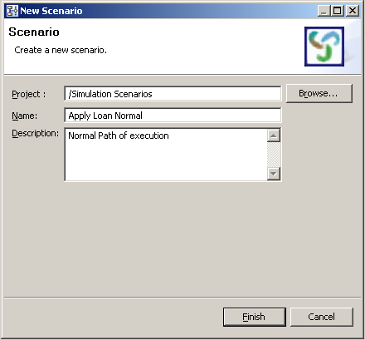
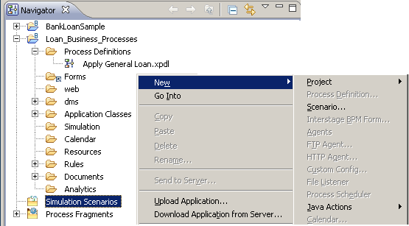
Simulation Scenario
Create Simulation Scenario
  Name
  Description
Notes:
Create Scenario for a Workflow Application using the Popup Menu and select Scenario menu. Enter a name and a description for the Scenario.

Slide 4
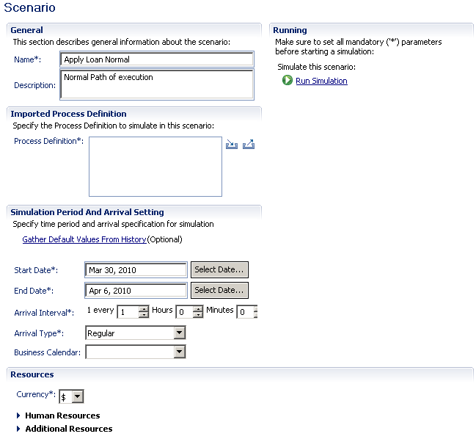
Simulation Properties
Process Definition
Period and Arrival Settings
Notes:
Set the Simulation Properties by first selecting the Business Process to Simulate.
Enter the Simulation Period and Arrival Settings.
Enter a Begin and End date the simulation will execute on.
Enter a arrival Interval – this is the number of times in a day the Business Process will execute
Arrival Type – Regular always at the same time or Random vary the time
Example: 6 times per hour with Random set the time in between creating the instances would vary
Business Calendar – specify a Business Calendar to use or use the default

Slide 5
Simulation Period and Arrival Settings
Controls the data flow i.e. number of requests/instances processed per unit time.
Start Date, End Date and Arrival Interval controls the total number of instance generated.
Arrival Type
  Regular: one instance per unit time
  Random: time interval between instances is random but total number remains the same
Business Calendar
  Business calendars can be created and used to control the number of requests e.g. if assignees work on task only during office hours.

Slide 6
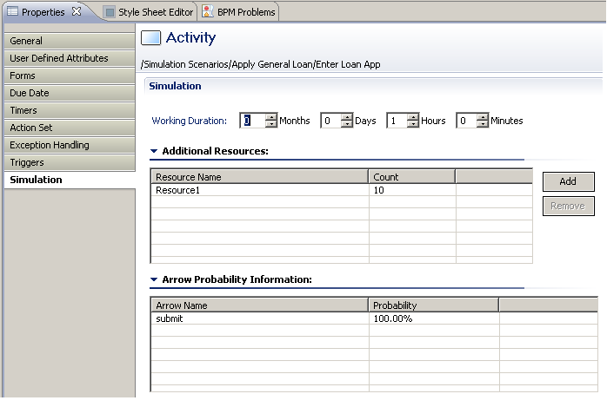
Resource Settings
Activity Settings
  Simulation Node Properties
Notes:
Additional Resources are set through the Node’s Properties Simulation Tab.
Add additional resources an Activity may need or use.
Work Duration Section: set the time amount of time required for this activity.
Additional Resources Section: Add additional resources used by this Activity.
Arrow Probability Information Section: set the probability of which path or arrow will be taken the least or most using percentages.

Slide 7
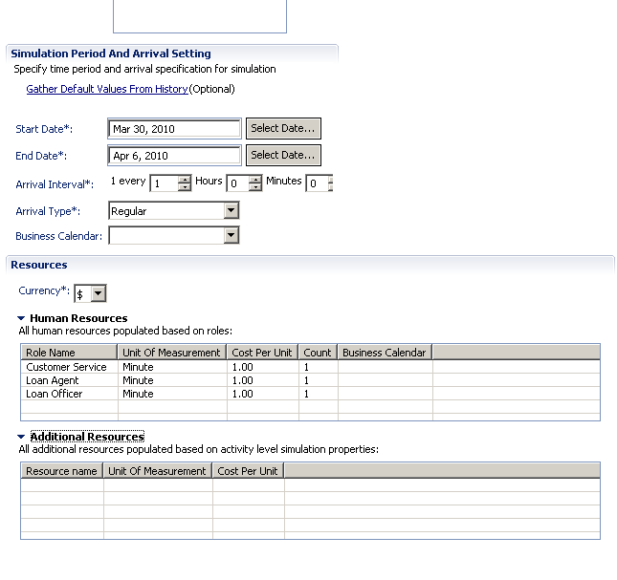
Resource Effort and Cost Settings
Notes:
Resources Section
Human Resources are populated based on the Roles defined in the Process Definition
Set the Unit Measure, Cost Per Unit and Count a resource would use. Setting these values help to cost resources and estimate how much a business process costs.
Additional Resources Section
Add additional resources required for an activity. Set these values through the Node’s Properties in the Process Designer – see Next Slide

Slide 8
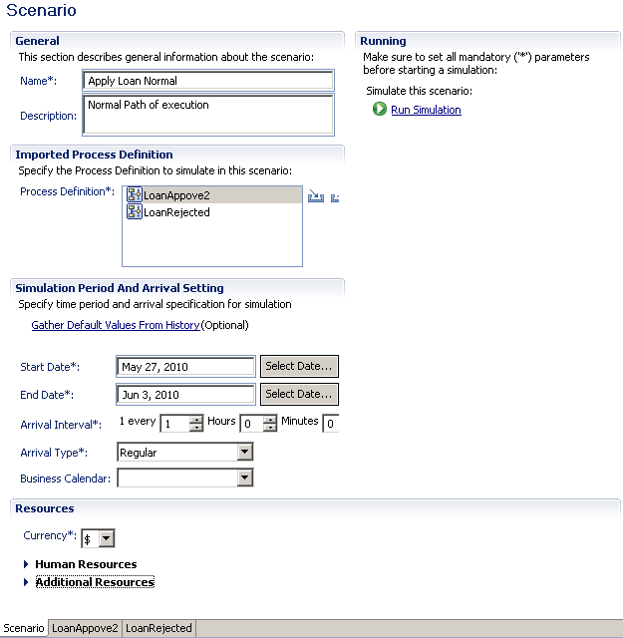
Run Simulation
Notes:
Set all values first and then click Run link to generate simulation data.
Changes to simulation data requires the Run button to be executed.

Slide 9
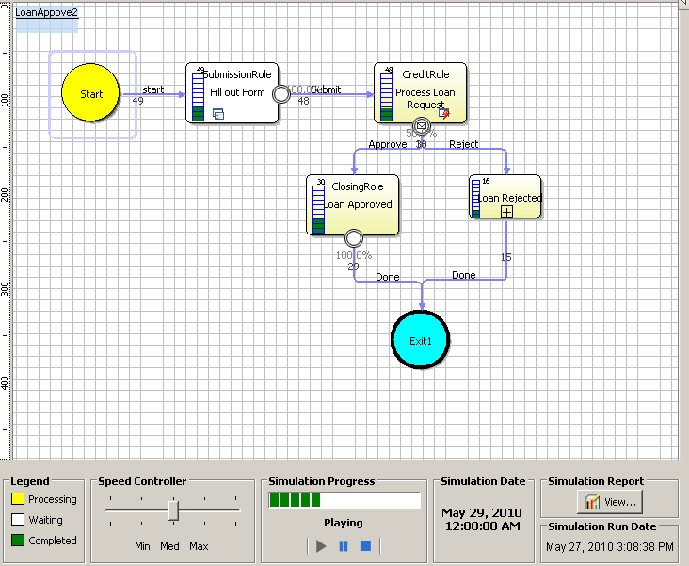
Play Simulation
50% Approve
Notes:
Play simulation to confirm all Activities are being accessed. If paths not being executed check the arrow probabilities percentages a likely cause is a path is set to 100%.

Slide 10
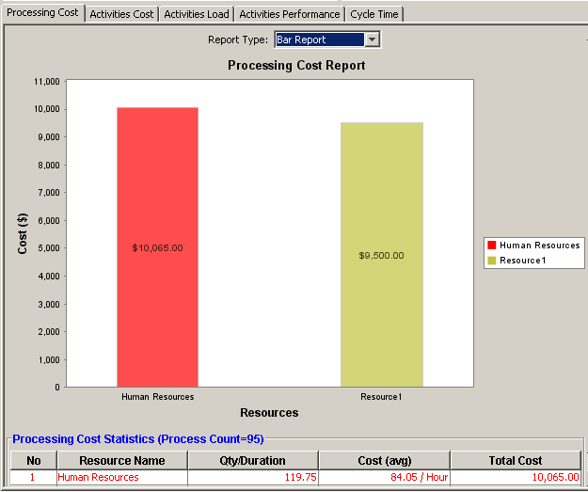
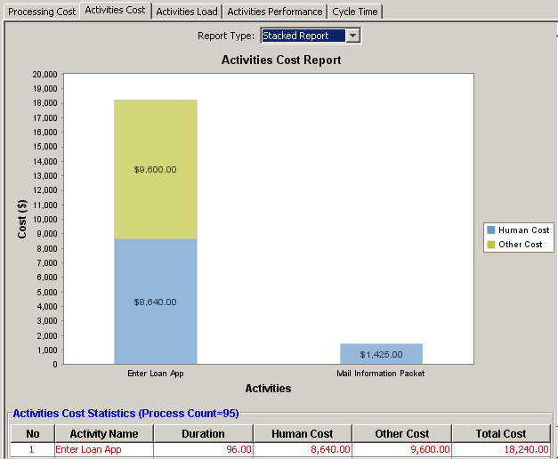
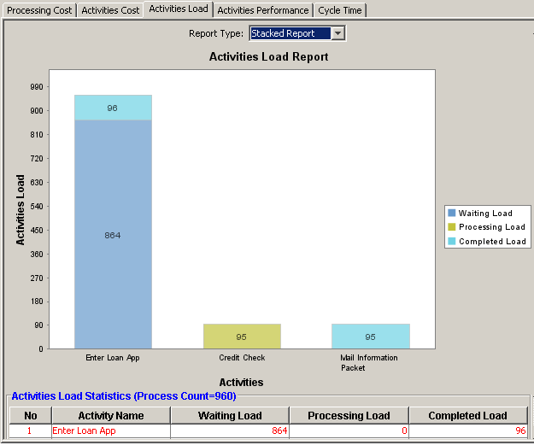
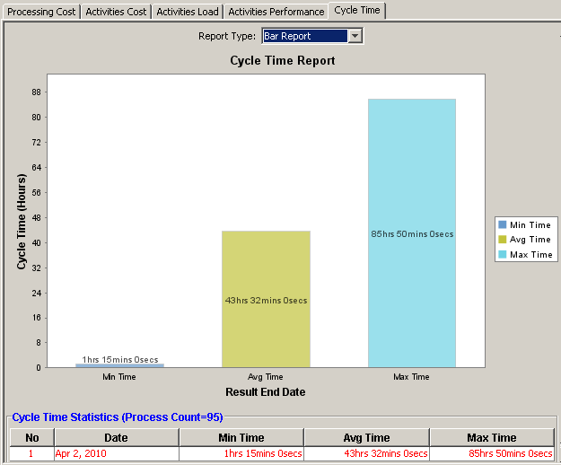
Simulation Reports
Simulation Graphs
Processing
Cost
Activities
Cost
Activities
Load
Cycle
Time
Notes:
Graphs are generated by Processing Cost, Activities Cost, Activities Load, Cycle Time and Activities Performance.
Note the Activities Performance is not shown.

Slide 11
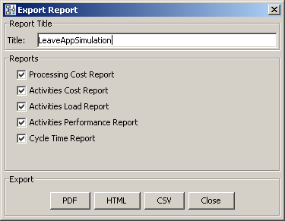
Export Reports
Notes:
Reports can be output in:
PDF format;
HTML format; or
CSV format.

Slide 12


