Slide 1
Creating A Simple process

Slide 2
Outline
Create Workflow Application
Model "Loan Application Process"
Assign Roles to Loan Application Process
Define User Defined Attributes (UDA)
Generate Process Definition Documentation
Notes:
Read slide

Slide 3
Process Steps
Customer applies for a loan at the bank branch
Loan Application and possibly an electronic copy (pdf attachment) of the application is sent for processing
Credit Check is performed
Welcome pack is mailed including legal documents and bank policies, (this could be a Compliance requirement)
Loan officer is assigned to review the loan application
Loan officer either approves or rejects the loan
If rejected, send out a rejection letter
if loan is approved, create Loan account and transfer funds
Send email to Loan Agent that the loan was approved
Notes:
Read slide

Slide 4
Loan Application Data Elements
Customer first and last name
Address
Loan Amount
Type of loan, personal or business
Purpose of loan
And More….
Notes:
Some of the key data used in applying for a personal loan would be first and last name, address, loan amount, type of loan personal or business and reason.

Slide 5
Roles in Loan Application
Roles defined
  Loan Agent
  Loan Officer
  Customer Service
Notes:
The “Apply General Loan” Business Process uses three roles: Loan Agent, Loan Officer and Customer Service. These roles will need to be created in the Interstage BPM server. We will create them in the next presentation “Deploy Workflow Application”.

Slide 6
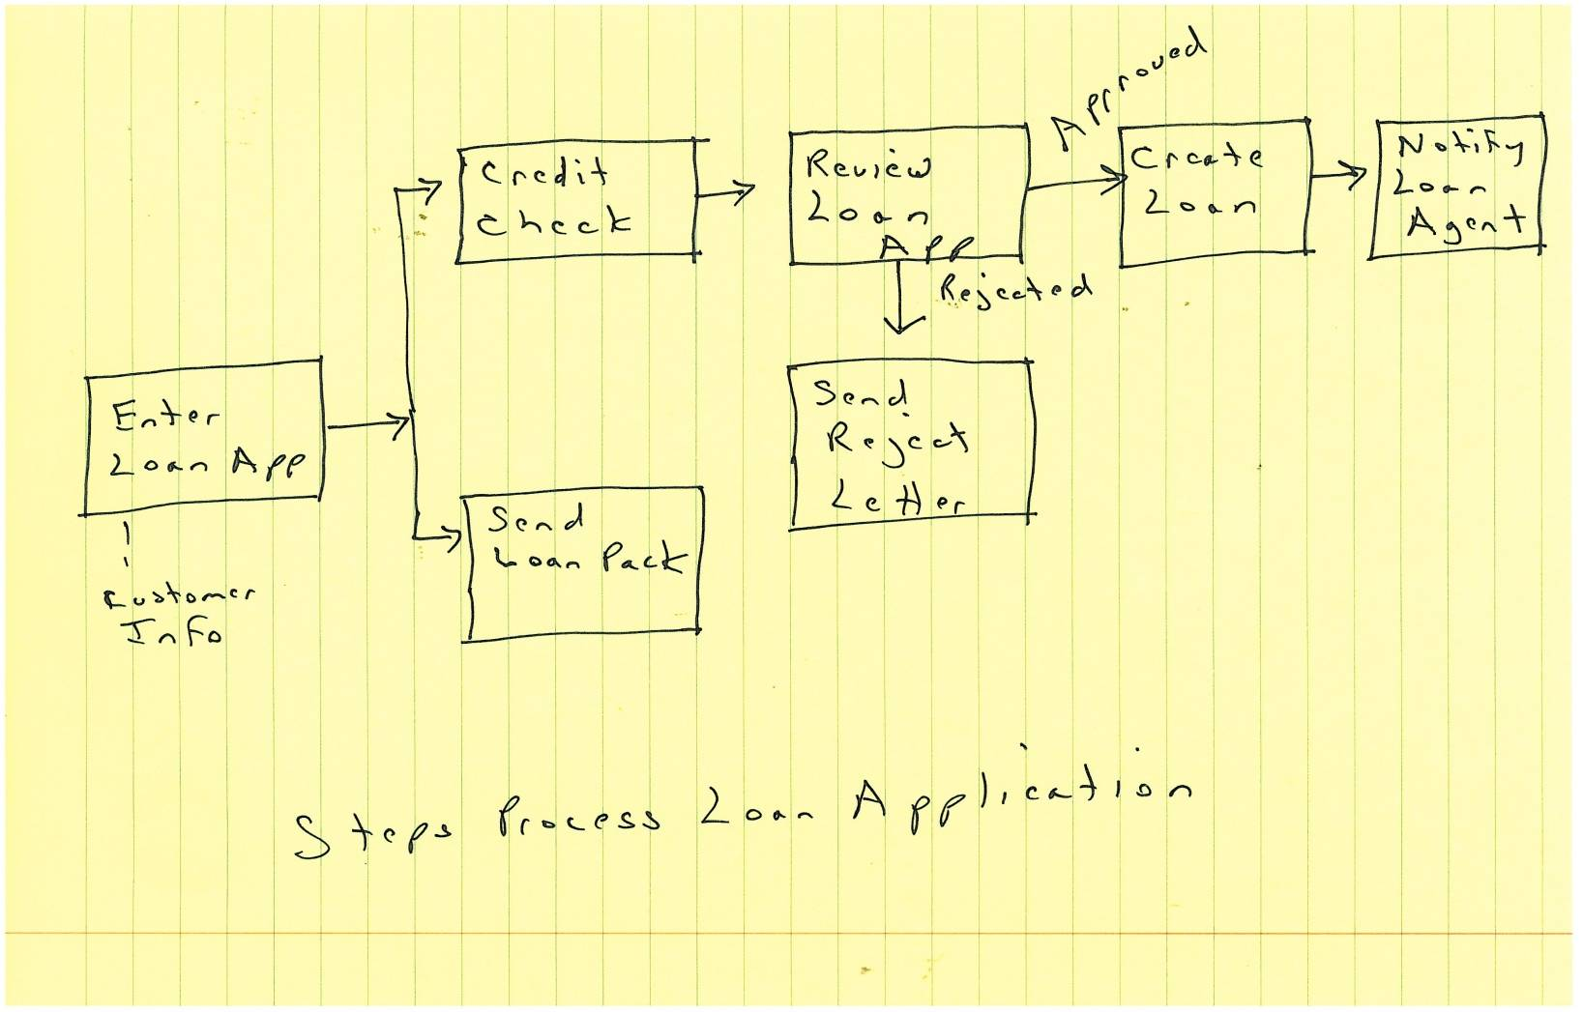
Loan Application BPD
Notes:
Loan Application Business Process brain stormed on notebook paper.

Slide 7
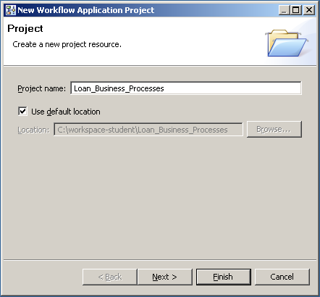
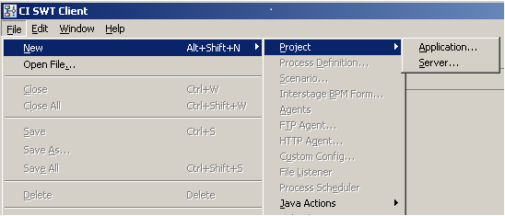
Create Workflow Application
Create a new project Application “Workflow Application”
  Process definitions and all related files are packaged together
  Files packaged as a BAR file
Loan_Business_Processes
Notes:
Create New Workflow Application – File->New->Project->Application
Workflow Application “Loan_Business_Processes” Note spaces are not allowed in name.

Slide 8
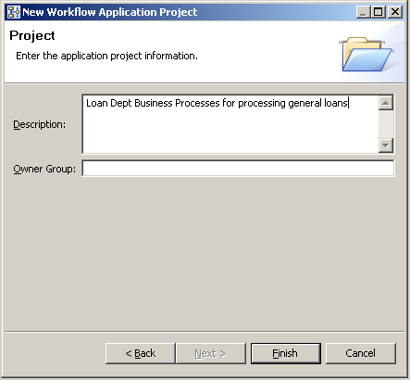
Workflow Application Description
Enter a Description
Leave Owner Blank
Notes:
Enter a description for the Workflow Application, example “Loan Dept Business Processes for processing general loans”
Leave Owner blank this will be filled in when we deploy the Workflow application

Slide 9
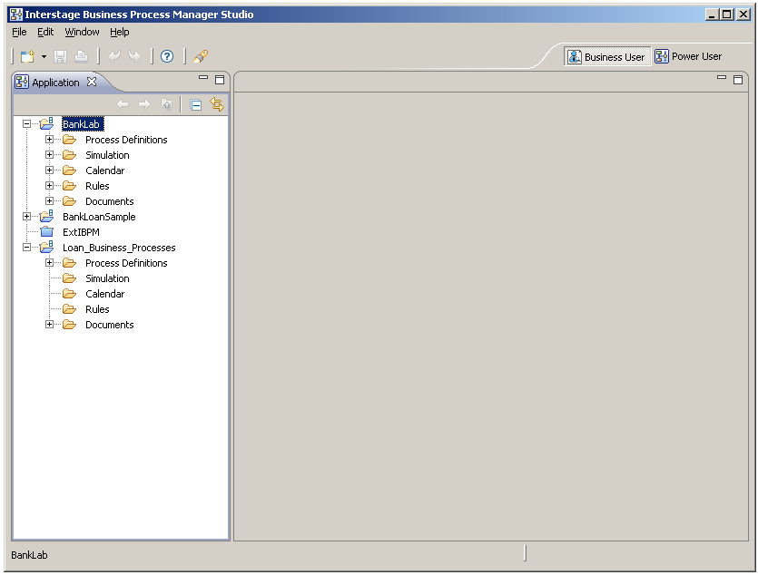
Workflow Application Layout
Workflow Application contains designated folders
Workflow Application Structure

Slide 10
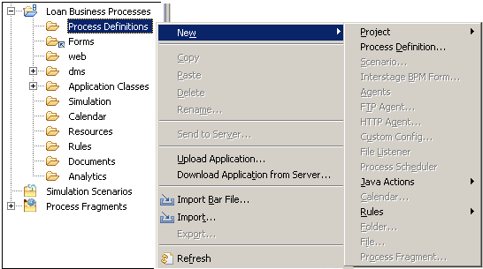
Create Process Definition - 1
Select Workflow project
Navigate “New→ Process Definition”
Notes:
Select the Workflow Application to create the Process Definition in and navigate menus to New Process Definition.

Slide 11
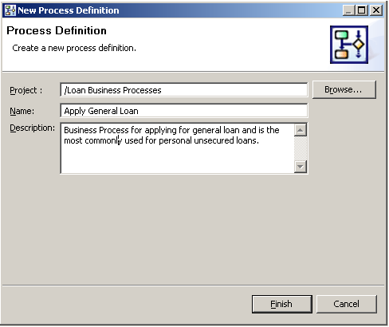
Create “Apply for Loan” Business Process
Enter name and description of Business Process
  “Apply General Loan”
Notes:
Enter the BP name “Apply General Loan” and a description that describes the Business Process.
For Example: Business Process for applying for a general loan and is the most commonly used for personal unsecured loans.

Slide 12
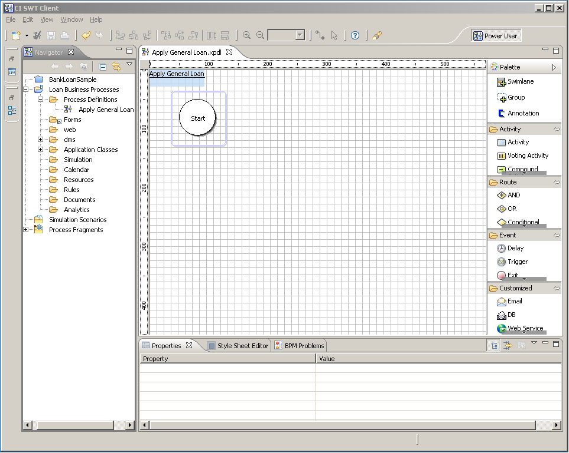
Model Process Definition
Model the “Apply General Loan”
Notes:
The Process Diagram is created with an initial Start element.
Drag and Drop Business Process diagram elements to the process diagram.

Slide 13
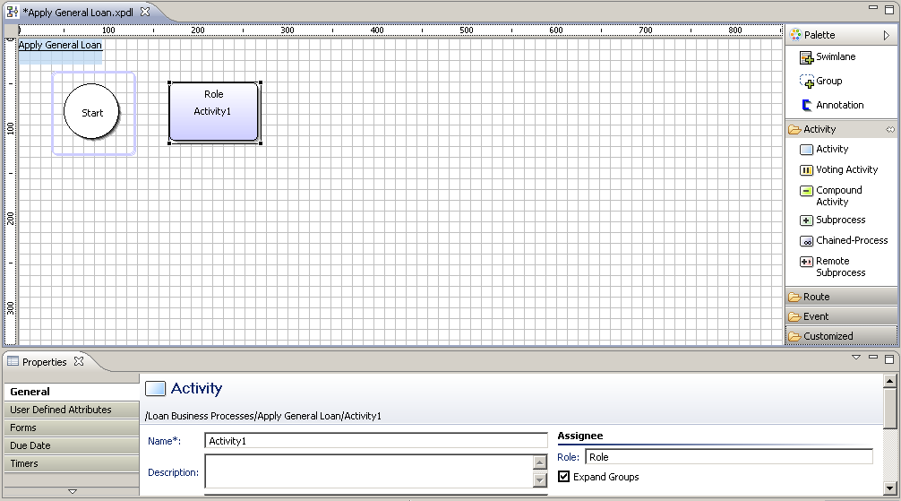
Adding Nodes and Properties
Name – name of activity
Description – description of the process step (this is added in email notification)
Role – the group assigned to carry out the work
Notes:
The node properties dialog is used to configure the Activity Node’s name, description and Role.

Slide 14
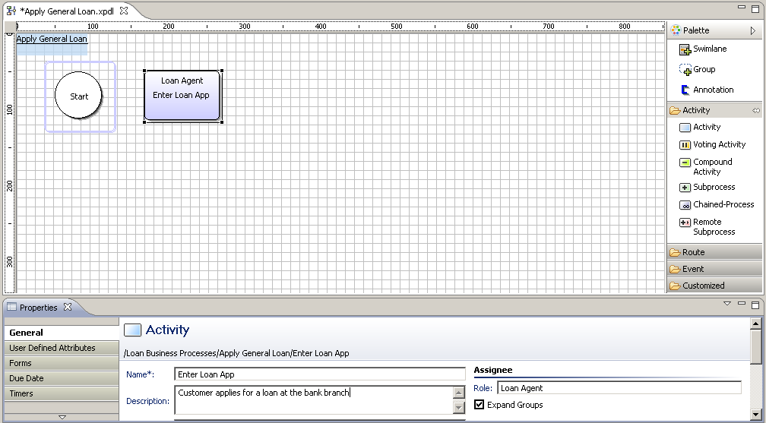
Configure Activity Node
First step in processing loan – “Enter Loan Application”
Work will be performed by a Loan Agent
Notes:
A Loan agent takes an application for a loan from a customer at one of the bank branches.

Slide 15
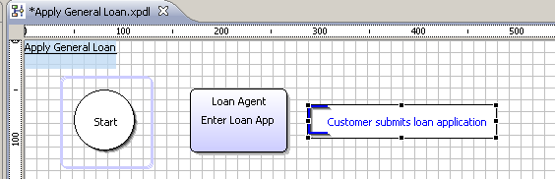
Adding Annotations
Add annotations for documenting information related to process model.
Documentation can also be provided in description, but Annotations are visible on the process model
Notes:
Annotations help explain the BPD and are way of adding comments to help one understand the BPD. Annotations are added by selecting area in the BPD and then dragging the mouse to draw the area it will appear in.

Slide 16
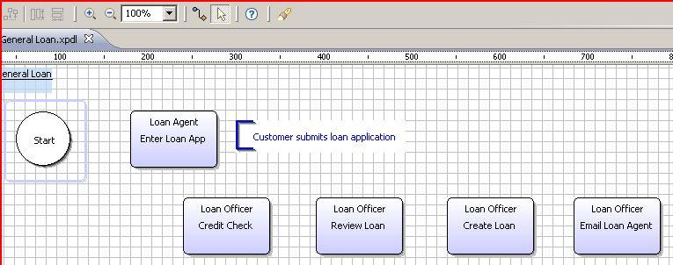
Connecting Nodes
Connect nodes with arrows
  Click on the From node and drag to the To node.
  Change arrow name to resemble the choices the user will make during the process execution
  Example: “Accept” or “Reject” a loan application
Notes:
Connect Nodes with Arrow tool – click on the From Node and drag arrow and connect to the To Node. Change name of arrow to reflect the choices in the Business Process.

Slide 17
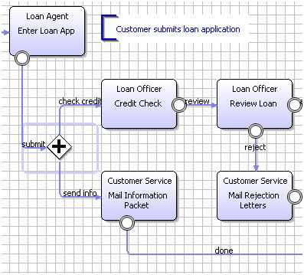
Parallel Tasks
Parallel processing after Loan Application is submitted
  "Credit Check” and “Mail Welcome Pack” tasks are performed in parallel
Notes:
Concurrent processing occurs after the Loan application is submitted. A Credit Check and a Welcome pack is sent to the customer.

Slide 18
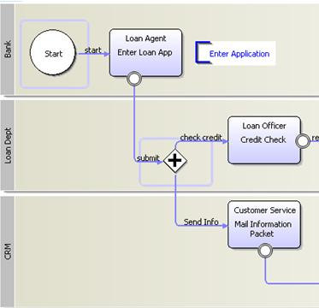
Add Swim lanes
Add Swim lanes to highlight areas of responsibility
Swim lanes can run either vertically or horizontally
Swim lanes add structure to diagrams
Bank Branch
Loan Dept
Customer Relations
Notes:
Swim lanes can be used to group tasks either vertically or horizontally and are used to highlight lines of responsibilities in the Process Definition. In the Apply General Loan BPD three swim lanes are defined for the Bank Branch, Loan Department and Customer Relations.

Slide 19
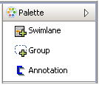
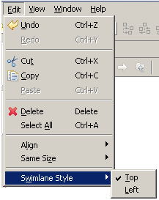
Add Swim lanes
Add Swim lane by selecting Swimlane from palette and drawing the Swimlane on the BPD
Change Direction of the Swimlane by placing the title on top or left
Notes:
Add Swimlane to the BPD by selecting Swimlane from the Palette and then drawing the Swimlane onto the diagram. Change the direction to Vertically or Horizontally by changing the Swimlane Style to Top (Vertical) or Left (Horizontal).

Slide 20
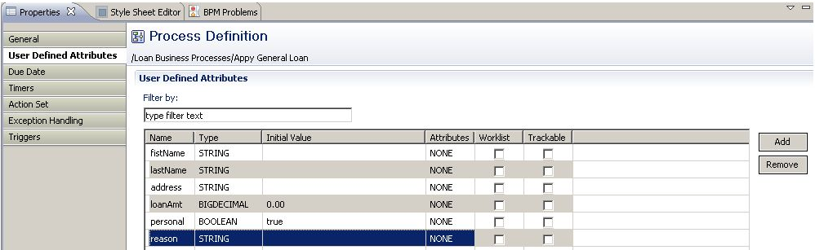
User Defined Attributes
Add UDAs
  String firstName, lastName, address
  BigDecimal loanAmt
  Boolean personal (default - true)
  String reason
Notes:
The Apply General Loan Process Definition uses the following UDAs, firstName, lastName, address, reason all type String, loanAmt type BigDecimal, personal type boolean with the default value as true. The personal UDA is either true it’s a personal loan or false it’s a business loan.

Slide 21
Generate Process Documentation
Generate Process Documentation
  Feature available in Interstage BPM Studio
Generates a simple report of a Process Definition
Supported Report formats
  PDF
  Html
  MS PowerPoint
Notes:
Interstage BPM Studio provides the ability to generate Process Definition reports in PDF, Html and Microsoft PowerPoint formats.

Slide 22
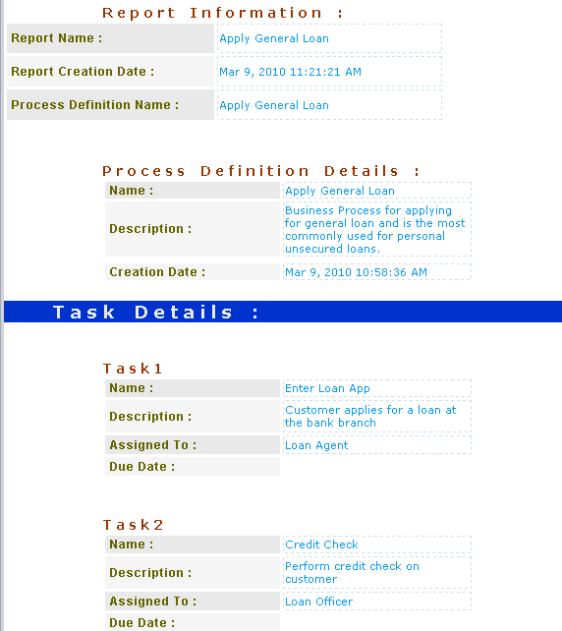
Apply General Loan Documentation
Notes:
Screen shot shows the Apply General Loan BPD generated as Html. Generated reports include the above information and a list of all the tasks in the Business Process Definition.

Slide 23
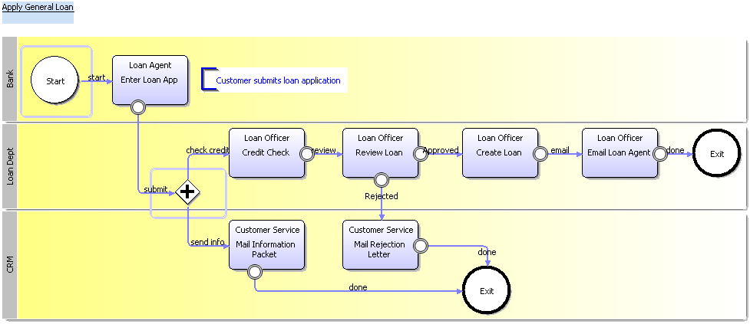
Completed Business Process
“Apply General Loan” Business Process Diagram (BPD)
Notes:
The completed “Apply General Loan” Business Process Definition diagram. The next section will review the steps to deploy and execute the BPD on Interstage BPM.

Slide 24
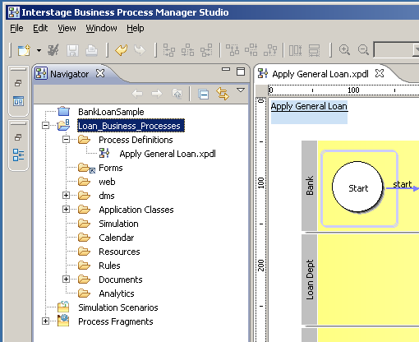
Deploying Workflow Application
Deploy Workflow Application
  Upload Business Process Definitions and related files and resources to Interstage BPM Server
Notes:
Deploy Workflow application and all related files using Interstage BPM Studio. Select the Workflow application to upload and right click to display menu.

Slide 25
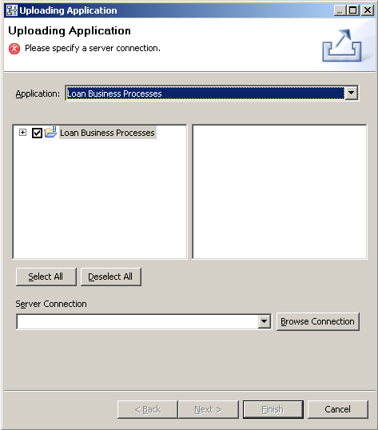
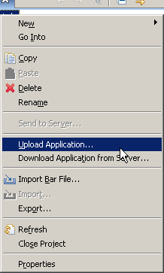
Deploy Application
Select Upload Application
  Choose Server Connection
Notes:
Select Upload Application, this will display the Uploading Application Dialog. Take the default option of uploading the entire Workflow application or we can choose to select only certain Process Definitions to upload.
Select the Server to deploy the Workflow application to using the Server Connection drop down.

Slide 26
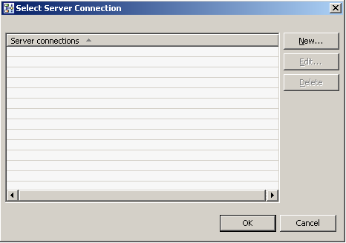
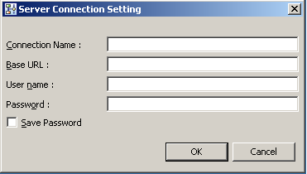
Create Server Connection
Create New Sever Connection
  Connection Name
  Base URL
  User name and Password
Notes:
Create New Connection to a Interstage BPM Server. Enter a Connection name, Base URL, User Login name and password.

Slide 27
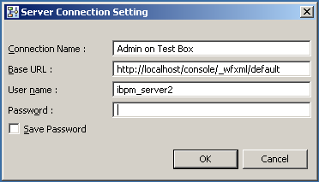
Create Server Connection Settings
Connection Name: “Admin on Test Box”
Base URL: http://<host:port>/console/_wfxml/<tenant name>
  e.g. “http://localhost:49950/console/_wfxml/default”
User name and Password
  Admin user access is required to deploy
Notes:
Create New Connection to a Interstage BPM Server. Enter a Connection name, Base URL, User Login name and password.
In the example we will use “Admin on Test Server”, Base URL http://localhost/console/_wfxml/default, user ibpm_server2 and password is “password”

Slide 28
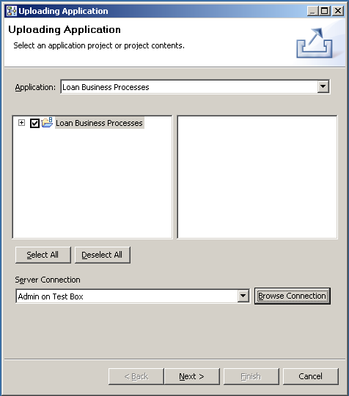
Select Server Connection
Select Server Connection
  “Admin on Test Box”
Notes:
Select the Server Connection of the Interstage BPM server to deploy the Workflow application to.

Slide 29
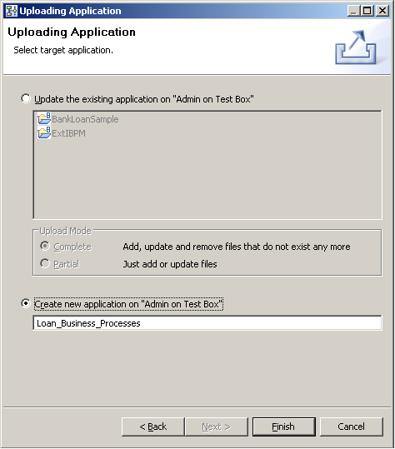
Create or Update Workflow Application
Create Workflow Application
Update Workflow Application
Notes:
Create New Project
If the project already exists you can pick the project and update. The result is the Process Definitions are versioned allowing both the old and the new existing on the Server
It’s best to do a delete and do a create project

Slide 30
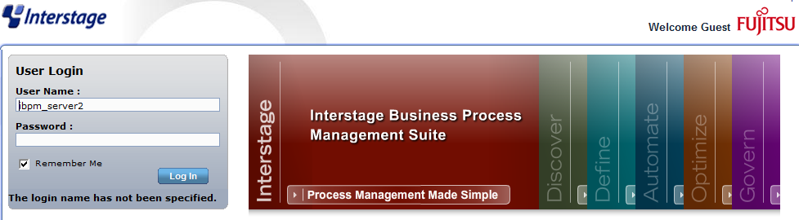
Interstage BPM Console
Administer Workflow Application using the Interstage BPM Console
Notes:
Interstage BPM Console is used to administer the Interstage BPM server and for process users to interact with the running Business Processes.

Slide 31
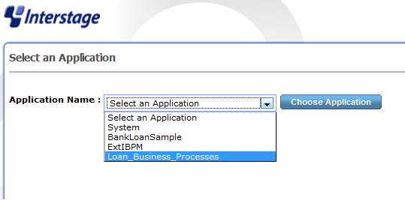
Interstage BPM Console
Select Workflow Application
  Loan_Business_Processes
Notes:
Select the Workflow Application you would like to view and work with. We will select the example Loan Workflow Application “Loan_Business_Processes”

Slide 32
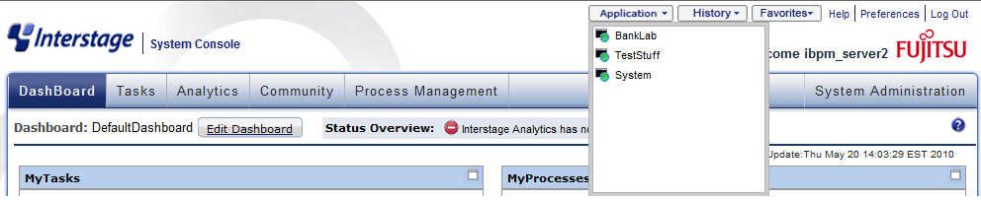
Application Selection
Change Application Selection
  Select Application Dropdown

Slide 33
Creating Users and Groups
Prior to executing a Business Process ensure all roles exist on the server
Business Process “Apply General Loan” needs these roles
  Loan Agent
  Loan Officer
  Customer Service
Notes:
Prior to executing a Business Process ensure all roles exist on the server that were defined in the Business Process. Apply General Loan

Slide 34
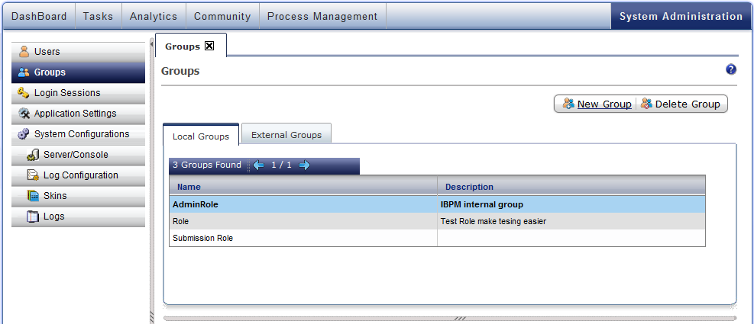
Create Roles (groups)
Select “System Administration” Tab
Select Groups
Click “New Group”
Notes:
Navigate to the Groups Section located under the System Administration Tab and click “New Group”

Slide 35
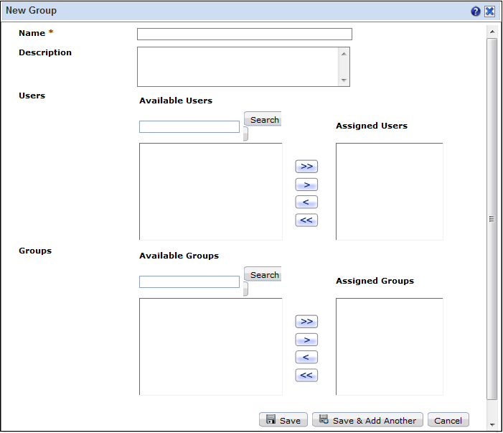
Group Details
Enter Group Details
  Name
  Description
Notes:
Enter Group Details, Name “Loan Agent” and an optional description.
Repeat for “Loan Officer” and “Customer Service”

Slide 36
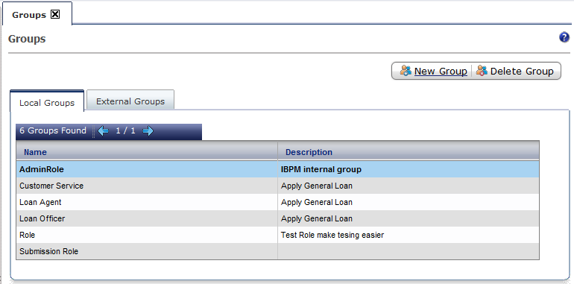
Loan Example Groups (roles)
Groups required for Loan example
Notes:
The Loan Agent, Loan Officer and Customer Service groups listed as Local Groups in Interstage BPM Server.

Slide 37
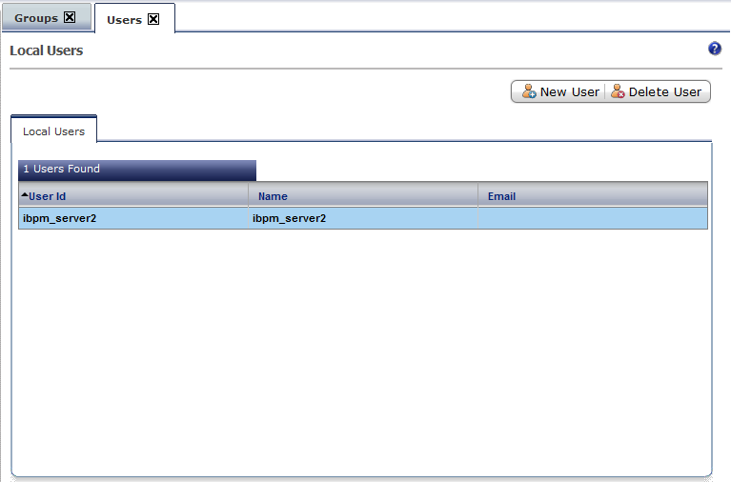
Adding Users
Select Users Tab
Click New User

Slide 38
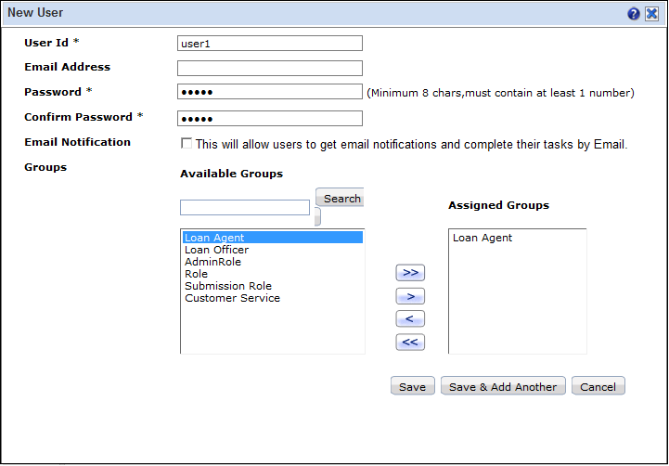
Enter User Details
Enter User Id, Password (min 8 chars and 1 numeric)
Assign Group
Notes:
Enter the User Id and Password. Password must be at least 8 chars and one numeric. The example we used “user1234” for all the user passwords.
When entering multiple users consecutively use the Save and Add Another Button.

Slide 39
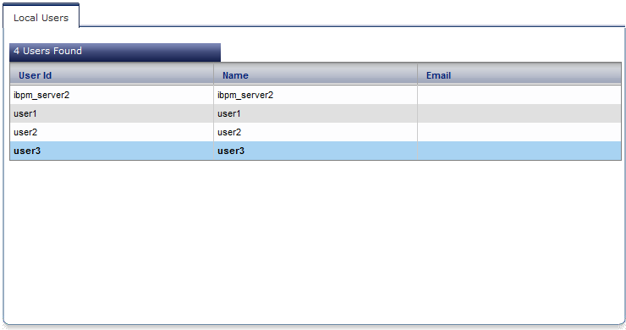
Loan Example Users
Users required for Loan example
  user1 – Loan Agent Role
  user2 – Loan Officer Role
  user3 – Customer Service Role
Notes:
Users created and assigned to their respective roles to successfully execute the Loan Example Process Definition.

Slide 40
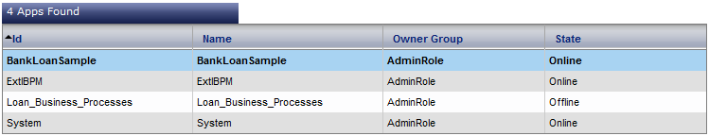
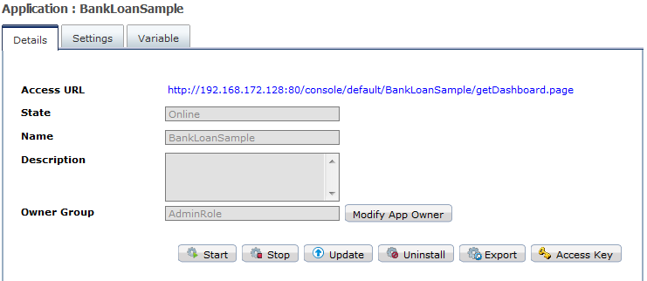
Start Bank Loan Application
Start Loan_Business_Processes Workflow Application
Initial State is Offline
Click Start Button to change to Online State
Notes:
Workflow Applications must be in a online state to execute the PD and in a offline state to update the PD

Slide 41
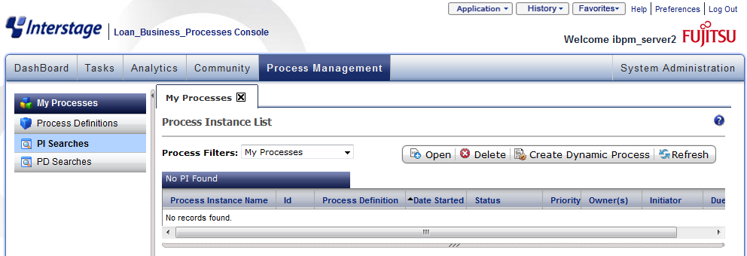
Process Definitions
Navigate to Process Definitions Section
  Process Management Tab
Notes:
Workflow Applications must be in a online state to execute the PD and in a offline state to update the PD

Slide 42
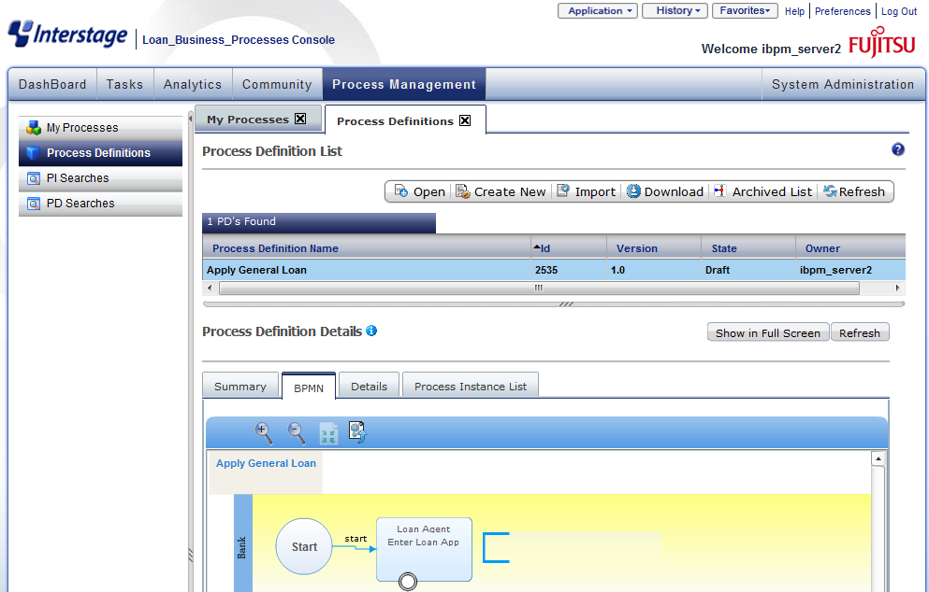
Process Definitions
Select Process Definitions Tab
Business Process Definition List
Notes:
Select the Process Definitions Tab. View changes and shows all Business Process Definitions in Loan_Business_Processes Workflow application.

Slide 43
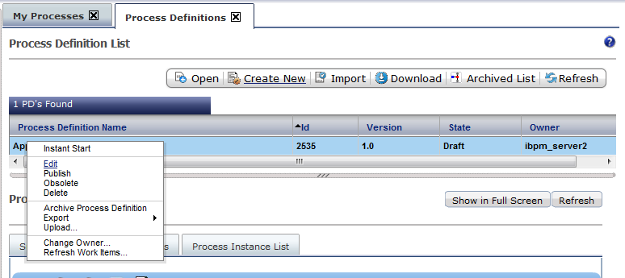
Start Process Definition
Start (execute) “Apply General Loan” Process Definition
Right-Click on Process Definition
Click Instant Start
Notes:
Start or execute the Apply General Loan Business Process by selecting the Process Definition from the list of Process Definitions. Right-click on the Process Definition to display the options menu. Select Instant Start from the menu.

Slide 44
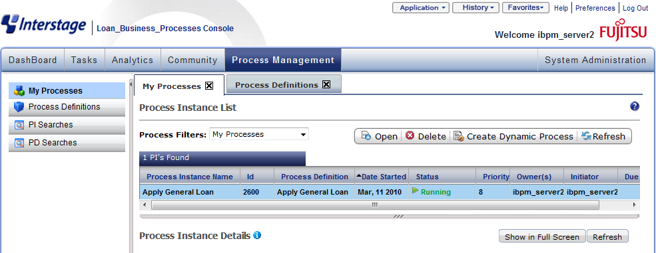
Process Instance Status
Change to My Process Tab
Check the status of running business processes
Notes:
Change to the My Process Tab where we can view the running business processes for the ibpm_server2 user. We can also see the Process Instance is running that we just created and started.

Slide 45
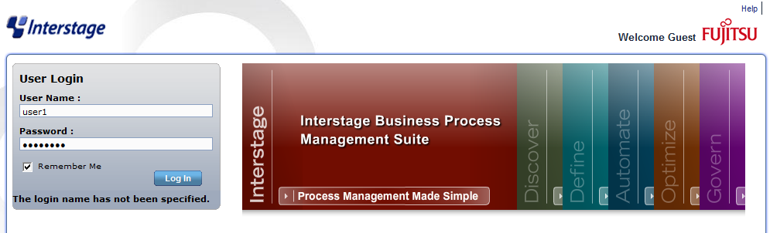
Process User Login
Log-in as user1 – member of Loan Agent Group
Notes:
Login as user1 password is “user1234”

Slide 46
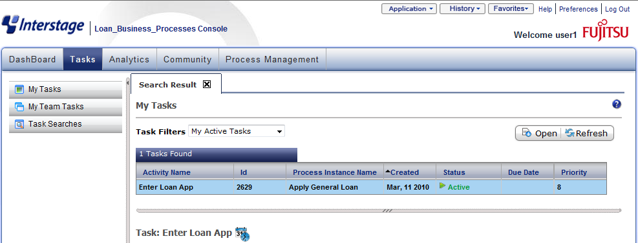
User1 Tasks
Login as user1
  member of Loan Agent Group
Tasks for user1 are displayed
  Allowing for quick and easy access to workflow
Notes:
Login as user1 who is also a member of the Loan Agent role will display all WorkItems, i.e. tasks assigned to this role.

Slide 47
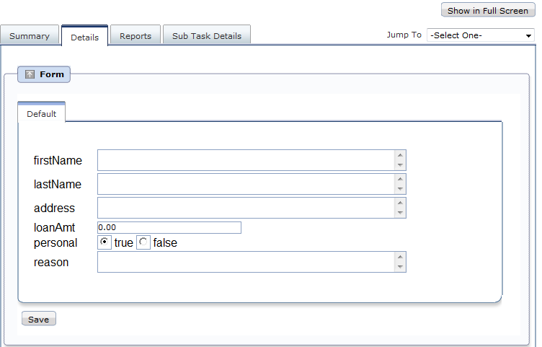
Performing Work - Details
Change to Details Tab
Form displays UDA values for the workitem
Notes:
Change to the Details tab. The form section is the UI to the WorkItem and is where a Process User interacts with the Process workflow. As we can see the UDAs are displayed and can be modified by the Process User.

Slide 48
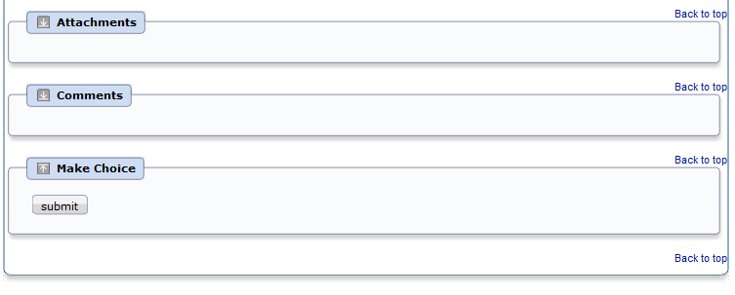
Performing Work – Details
Make Choice – Submit Loan Application
Notes:
Other sections within the Details tab include the Attachments where files are attached to the Workflow and are accessible by all users, Comments where comments can be added to the workflow also accessible by all users and the Make Choice Section which displays the choices a Process user can make in the workflow. To progress the workflow we will click the submit button to proceed to the next activity.

Slide 49
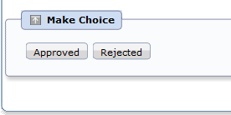
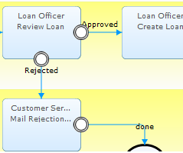
Making a Choice
“Review Loan” activity choices are "Approve" or "Reject"
Loan Officer decides to either Reject or Approve the Loan Request
Make Choice displays the Arrows defined in the Process Definition.
Notes:
The arrows used to defined the business process define the choices the process user can make in the process workflow. The Review Loan activity has two arrows or paths the process workflow can take. The process user or more specific the Loan Officer decides to Approve or Reject the Loan App.

Slide 50
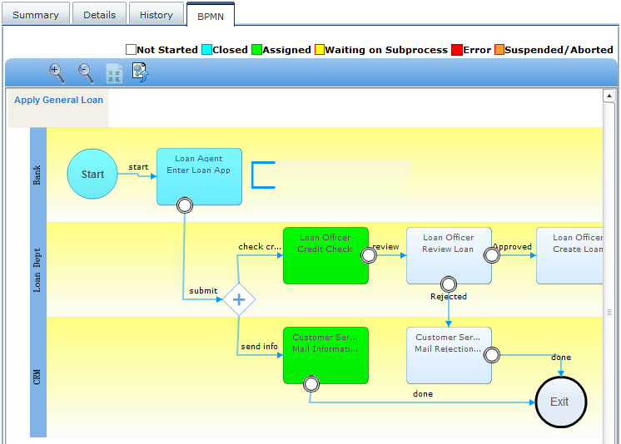
Reviewing the Status as Process Owner
Login as Process Owner
Select the “Apply General Loan” process instance
completed
Notes:
Login as the Process Owner in this example the Process Owner is the ibpm_server2 user which is also in the admin Role. Navigate to the “Apply General Loan” Process Instance and view the progress of this Process Instance. As we can see the first activity has completed “Enter Loan App” and now the Process Instance is processing the Check Credit and Mail Information activities.

Slide 51
Process Definition – System Attributes
Essential attributes of a process definition
  Name
  - the name of the process definition
  Title
  - the title of the process definition
  Description
  - what the business process represents
  Process owners
  - who will be in charge of monitoring this process
  Version
  - the version of the process definition
  State
Notes:
These example Process Definition System Defined Attributes, from Interstage BPM, include:
Name
- the unique name of the process definition;
Title
- for example, Process Loan Application – Type 1;
Description
- for example, This process handles the processing of housing loan applications for amounts up to half a million dollars;
Process owners
- the people responsible for monitoring this process;
Version
- the version this definition;
State
- the definitions state in its lifecycle, for example: draft, published, etc.

Slide 52
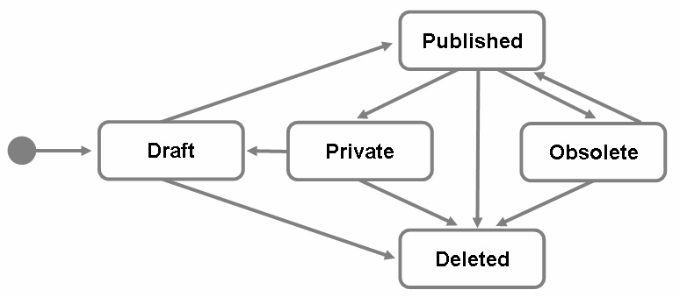
Process Definition Version and State
New process definitions are automatically assigned a version number of 1.0, e.g. “Purchase Order 1.0”.
Any update to PD results in a new version
Process Definitions state defines where the process is, in its lifecycle
  Definitions are by default
  in draft state
  Definitions should be
  published in production
  environment
  Published definitions
  cannot be edited
Notes:
Most BPMS support versioning but there is no standard as to how to number the versions.
This example comes from Interstage BPM.

Slide 53

Process Definition - Version and State
Version
State
Notes:
This display is from the Interstage BPM Console.
It shows a number of Process Definitions along with their version and state.

Slide 54

Process Instance States
A Process Instance transitions through many states during it’s life cycle. These states are:
  Initial
    When a process instance is created, it is in “Initial” state until it is started.
  Running
    When a process instance is started, it transitions to “Running” state until it is completed or suspended.
  Completed
    When a process instance normally exits, it reaches “Completed” state.
Notes:
A Process Instance transitions through many states during it’s life cycle. These states are:
Initial
When a process instance is created, it is in “Initial” state until it is started.
Running
When a process instance is started, it transitions to “Running” state until it is completed or suspended.
Completed
When a process instance normally exits, it reaches “Completed” state.

Slide 55
Process Instance States
Suspended State
  Process instance can be suspended during the course of execution.
  Suspending a process instance temporarily removes it from the running state.
  Any active work items or running sub-processes are also moved to suspended state.
  Suspended process instance cannot be modified.
  The process definition from which the suspended process instance was created, also cannot be modified.
Resume/Reactivate
  Resuming a suspended process instance activates it and state is changed to “Running”.
  Any work items and sub processes are also activated.
Notes:
Suspended
Process instance can be suspended during the course of execution.
Suspending a process instance temporarily removes it from the running state.
If this process instance has any work items or running sub-processes, they are also put in the suspended state
a suspended process instance cannot be modified.
A suspended process instance is, however, not in a completed state.
The process definition from which a suspended process instance was created, also cannot be modified.
Suspended process instance cannot be reassigned.
Resuming a suspended process instance activates it (puts it back in “Running” state) along with any work items or sub processes it has.

Slide 56
Task Assignment
Activities need Role name as assignee
Roles are “groups” of users with specific attributes, qualifications or authority (e.g. accountants, managers).
Roles are resolved to members/users at runtime for task assignment.
Work Items are created when the Process Instance reaches an Activity node.
Individual work items for each member/user in the role is created
Only one user can work on the task
Notes:
Roles are usually groups of users who have specific and similar attributes, qualifications or authority, for example:
managers;
accountants;
supervisors;
customer service representatives;
etc.
Each Activity Node in a Process Definition is assigned to a set of users and/ or roles.
At run-time groups resolve to sets of users (the members of that role).
A Work Item is created when the Process Instance reaches a User Activity node. The Work Item can be one where:
each assigned user receives their own copy; or
the set of assigned users shares a single copy (Group Work Item).

Slide 57
Role Resolution
Role - Managers
Role resolution
Members
Mike
Cindy
John
Notes:
Multiple users assigned to a role and the BPMS would retrieve a list of users for that role and assign them Work items

Slide 58
Work Item Creation
Start
Start
Start
Start
Request Purchase
Employee
Managers
Request Purchase
Request Purchase
Request Purchase
Employee
Employee
Employee
Approve/ Reject
Manager
DONE !
Approve/ Reject
John
Approve / Reject
Approve/ Reject
Mike
Approve/ Reject
Cindy
Approve / Reject
Approve / Reject
Work items
Manager
Manager
Manager
Mike
Cindy
John
Exit
Exit
Exit
Exit
When a member of the group marks the work item as complete it disappears from the worklist of all members of the group
Notes:
A Process Instance starts and reaches the “Approve/ Reject Manager” activity.
Work Items are created for each user belonging to that group. <c>
Any of those users may take responsibility for the Work Item by accepting it. <c>
At this time the other uses will see the Work Item status change to Inactive.
Once the user completes the Work Item it will disappear from all users lists of Work Items.

Slide 59

Performing Work
Users select which tasks to work on
Task Options (Accept, Reassign ,Decline)
Notes:
A user of a role has the option of deciding to Accept, Reassign or decline a WorkItem. Interstage BPM Console displays a multi-tab window for a WorkItem. The Summery tab is displayed by default and shows a summary of the WorkItem.

Slide 60
Work Item Operations
Assigned user can perform these actions:
  Make Choice (Complete)
    Under the Choices tab the names of all of the outgoing arrows from the activity node are displayed
    Selecting one of these will close the work item and the process will proceed forward along the selected arrow.
  Save
    Saves any changes in the work item
  Accept
    This assigns the work item to the user
    No other assignee will be able to update the work item
  Reassign- reassigns the work item to another assignee
  Decline- to decline the work item.
Notes:
Process users have the following options when interacting with a Process Workflow: Choice, perform work and choice which step in the workflow to execute next, Save – save work, Accept WorkItem, Reassign WorkItem to another role or decline the WorkItem.

Slide 61
Reassign Task
Tasks can be assigned to another user or users if required
  Assigned user is not available to work on the task
  Information from another user is required to complete the task
On Reassign, task is removed from original assignee’s queue and assigned to new user/users.
Assignment Mode Setting
  Regular Mode – activity assignees or process instance owners can reassign
  Process-Instance-Only – only process instance owners can reassign
  No-Reassignment – reassignment is not allowed
Notes:
Reassign task to a different Role by clicking the Reassign button.

Slide 62

Reassign Task
Reassign Task to group or a specific user(s)
Notes:
Reassign the Task to all the users in the group or select user(s) to assign task to.

Slide 63
Work Item States
Active – assigned to user or users
Read - has been viewed by the current user
Accepted - accepted by the current user and therefore unavailable (inactive) to other users in that role
Declined - current user has declined the work item
Inactive - another user has accepted this work item so it is unavailable for the current user
Completed
Notes:
A WorkItem is created for each member in a Role when the activity is activated.
Interstage BPM has the following states associated with a WorkItem, active, read, accepted, declined, inactive and completed.

Slide 64


