Slide 1
Studio modeling basics

Slide 2
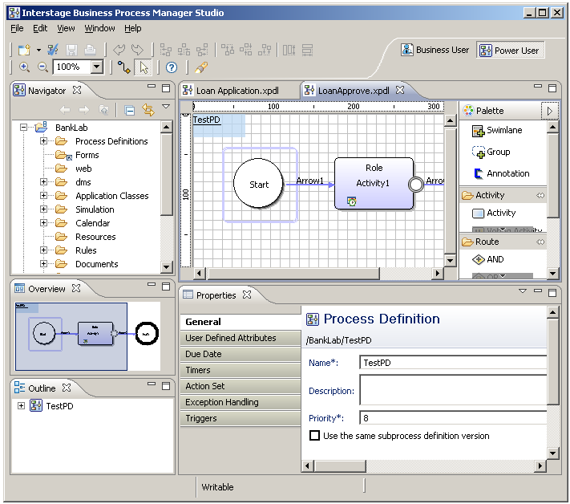
Process Designer
WYSIWYG Editor
Palette
Overview
Properties
Outline
Notes:
1 WYSIWYG Editor – create and design Business Models graphically
2 Drag and Drop Symbols from the Palette on to the WYSIWYG editor to create BPD
3 Properties Pane configure symbols properties and add integration functionality and error handling and more
4 Outline – text view of the BPD
5 Overview – navigate and view large BPD

Slide 3
User Perspectives
Business User
  Simplified View for Business Users
  Textual View for Process Definitions
  No knowledge of BPMN required
  Gantt Chart View
Power User
  Technical User
  Process Modeling
  Forms Design
  Business Rules

Slide 4
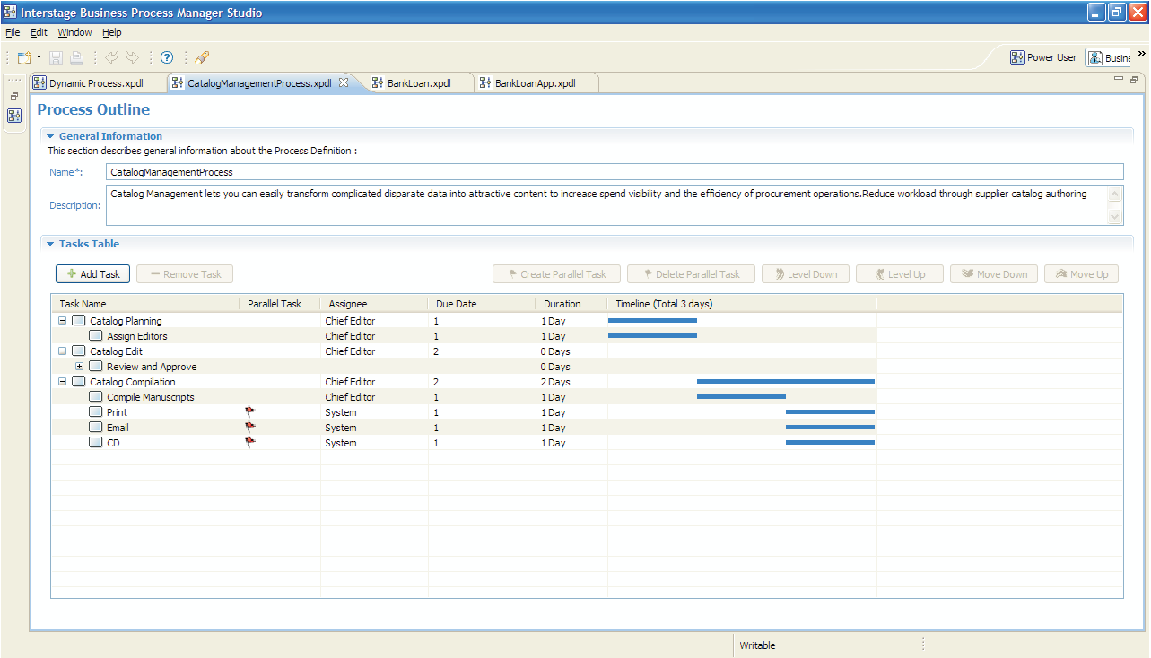
Business User Perspective

Slide 5
Process Outline Editor
Process Outline
  Name – required (no spaces)
  Description
  One or more Tasks
Task
  Name
  Assignee (Role)
  Due Date
  Duration – Days
  Execution Method
    Sequential
    Parallel
Notes:
Process outline has a required Business Process name, optional description and at least one Task. Task’s have a required name and Assignee (Role) with an optional Due Date, Duration in Days and execute in sequence or in parallel to another task.

Slide 6
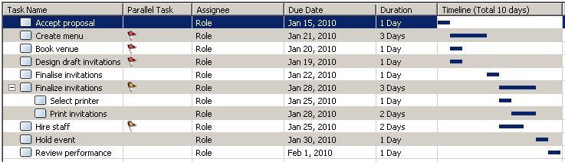
Process Outline Editor
Tasks created in this view represent activities/nodes in the process.
Editor options include:
  Add or Remove a task;
  Create or Delete parallel tasks;
  Make a task a subtask or a subtask a task; and
  Change the order of tasks.
Process Outline Editor example …
Notes:
The Process Outline Editor allows the user to create a list of tasks which will become the activities in the process.
The options available in the editor include:
Add or Remove a task;
Create or Delete parallel tasks;
Make a task a subtask or a subtask a task; and
Change the order of tasks.
<c> This is an example of the Process Outline Editor screen.

Slide 7
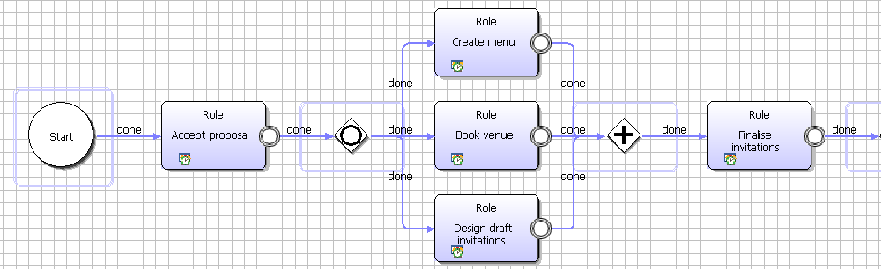
From Business User to Power User Perspective
Parallel tasks
A
Notes:
<c> Clicking the “Power User” button switches back to the Power User perspective which displays this process definition …
<c> Note how the parallel tasks and shown and <c> how the subtasks become Compound Activity Nodes.

Slide 8
Power User
Process Modeling for Analysts and Developers
Based on BPMN specification
Add due dates, timers, actions
Create Business Rules
Create Forms
Notes:
Power User perspective allows for more options in defining a Business Process. Business Processes are modeled using Business Process Modeling Notation (BPMN) and are graphically depicted. Business Process Diagrams (BPD) are created using a WYSIWYG editor using drag and drop palette of symbols and quickly configured using a context-sensitive properties panel.
A BPD can easily be extended using reusable Process Fragments, Business Rules and Business Forms.

Slide 9
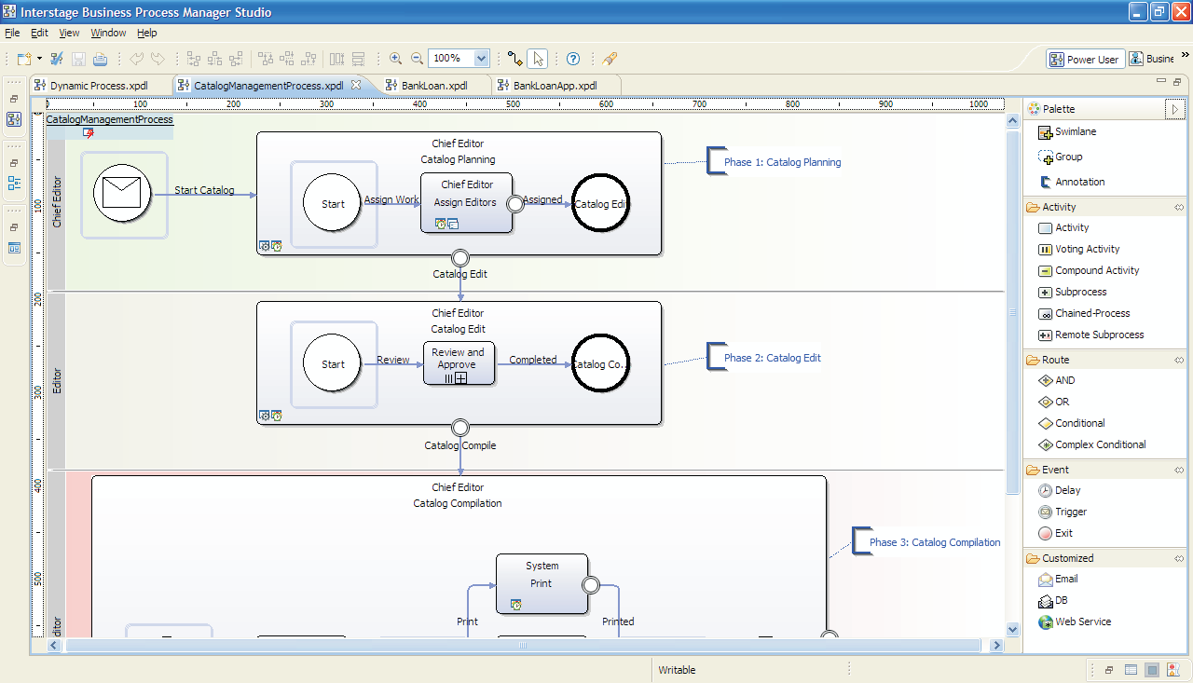
Power User Perspective

Slide 10
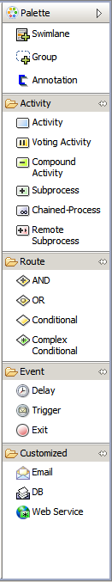
Studio Node Palette
Process Definitions can be created and edited in either the IBPM Studio or IBPM Console.
There are basic and advance nodes available to create processes by drag-n-drop.
Both IBPM Studio and IBPM Console use the same BPMN node palette.
Notes:
In Interstage BPM Process Definitions can be created and edited in either:
the Interstage BPM Studio; or
the Interstage BPM Console.
Process definitions are ultimately stored on the Interstage BPM Server.
Interstage BPM Studio is an Eclipse based client application used to create and edit process definitions.
It allows definitions to be saved locally and optionally uploaded to an Interstage BPM Server.
Studio uses an AJAX based forms editor.
It supports process simulation.
Interstage BPM Console provides a Flash based editor which is accesses via a web browser.
Process definitions are edited on the Interstage BPM Server to which the browser is connected.
Bothe IBPM Studio and IBPM Console use the same BPMN node palette.

Slide 11






Process Nodes
Basic node:
  Start Exit
  Activity Condition
  AND OR
Notes:
Nodes are the basic building blocks for process definitions.
They can be interactive or non-interactive.
An Activity node would usually be interactive while the remaining nodes would be non-interactive.
The basic node types are:
Start;
Activity;
And;
Or;
Condition; and
Exit.
The advanced node types, which are covered in the next module, include:
Voting;
Sub-process;
Email;
Delay; and
Web Service.

Slide 12
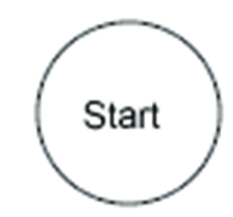
Start Node
Purpose:
  marks the beginning of a workflow process.
  every process must have one and only one Start Node.
Activated by:
  a process instance being started.
Behavior:
  produces an event on each outgoing arrow

Slide 13
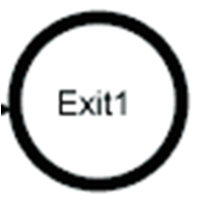
Exit Node
Purpose:
  marks the end of a workflow process
  every process has at least one Exit Node
Activated by:
  an event on any incoming arrow
Behavior:
  sends the process into the completed state
  the first exit node execution completes the process flow
Notes:
Here is an exit node with two incoming arrows.
An event on either incoming arrow <c> will cause the Exit to be activated.

Slide 14
Arrow
Purpose:
  propagate activation events
  Name of arrow is used as the name of choice for the task action
Behavior:
  activate the node at the tail of the arrow
Approve

Slide 15
Activity Node
Purpose:
  represents an activity requiring user interaction
Activated by:
  an event on any incoming arrow
Role resolution:
  using the directory service a list of assignees are identified
  each assignee has a work item added to their worklist
Loan Application
Approve
Credit Card Application
Reject

Slide 16
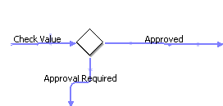
Conditional Node
Purpose:
  Route process to alternate path based on business conditions
Activated by:
  an event on any incoming arrow
Behavior:
  compares the value of the specified
  Process Attribute against conditions specified for the outgoing arrows
  produces an event on the outgoing arrow which satisfies the condition
Notes:
The Conditional Node is used to choose one of many possible exit paths.
It does this without user intervention.
The Conditional Node is activated by an event on any incoming arrow.
It compares the value of a specified User Defined Attribute against a specified condition to determine which of the outgoing arrows to use.
An event is generated on the outgoing arrow that satisfied the condition.

Slide 17

Conditional Node Example
Cost = 2000
Cost < 1000
Cost >= 1000
Notes:
Anticipated question:
Can you have multi-way branch? Yes.
What happens if the conditions selected are disjoint? There is a “default” arrow.

Slide 18
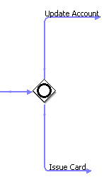

OR Node
Purpose:
  Split process into parallel path
Activated by:
  an event on any incoming arrow
Behavior:
  produces an event on each outgoing arrow
Notes:
The Or Node serves two purposes. It can:
Split a single process path into multiple simultaneous paths; and
Join multiple input process paths.
It can both split and join in the same node.
The Or Node is activated by an event on any incoming arrow and produces an event on each outgoing arrow.
It can have an Epilogue Action and Exception Handling defined.

Slide 19
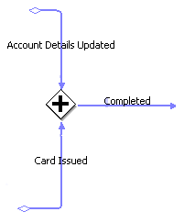
AND Node
Purpose:
  join multiple parallel process flows
Activated by:
  an event on any incoming arrow
Behavior:
  waits for an event on each incoming arrow
  produces an event on each outgoing arrow
Notes:
The And Node joins multiple simultaneous process paths like the Or Node but, unlike the Or Node, it waits until an event has occurred on all input arrows.
It then generates an event for each outgoing arrow.
It can have an Epilogue Action and Exception Handling defined.

Slide 20

AND Node
1
2
Waiting …
3
4
Notes:
In this example the And Node is both joining and splitting.
There are two incoming arrows and two outgoing arrows.
When an event is detected on either incoming arrow, <c> in this case arrow 1, the And Node waits for an event on arrow 2.
<c> When that event arrives events are generated on both outgoing arrows.

Slide 21

Delay Node
Purpose:
  Makes the process to pause and re-start at a later time
Activated by:
  an event on any incoming arrow
Behavior:
  waits for specified amount of time (delay time can be defined in node property)
  produces an event on each outgoing arrow
Notes:
The Delay Node causes a process to pause and restart at a later time.
It is activated by and event on any incoming arrow.
The Delay Node waits for the specified time before producing and event on each outgoing arrow.
It can have an Epilogue Action and Exception Handling defined.

Slide 22
User Defined Attributes (UDA)
Data used by a Business Process Definition is defined using User Defined Attributes (UDA)
UDA has a name, data type and optional default value
Interstage BPM uses the following types
  STRING,
  FLOAT,
  INTEGER,
  LONG,
  BOOLEAN,
  DATE,
  BIGDECIMAL
  XML
Notes:
Interstage BPM uses UDAs to define a Process Definitions data attributes. At minimum a name and type is required to define a UDA. Supported types are String, float, Integer, Long, Boolean, Date, BigDecimal and XML.

Slide 23

View Report
View Reports

