Slide 1
Business Process Management Concepts

Slide 2
Outline
Introduction to Workflow
Process Definition
Process Instance
Work Items
Attachments and Actions
Notes:
These are the topics discussed in this module.

Slide 3
Workflow
A Sequence of Steps required to complete a specific Business Process, for example:
  Processing an insurance claim.
Typical Implementation: combination of manual and automated activities
  A clerk fills out a claim form and routes the form to the Claims department
Notes:
Workflows have existed for many years in business and have been mostly manual.

Slide 4
Workflow Elements
Process Definition
Activities
Arrows
Data Attributes
Process Instance
Work Items or Tasks
Notes:
Each Process Instance:
encapsulates the run time aspects of a Business Process;
is instantiated from a Process Definition;
is managed individually by the Business Process Management System; and
has state, for example:
initial;
running;
error;
suspended; or
completed.
The relationship between a Process Instance and a Process Definition is very similar to the relationship between an object instance and a class in OO.

Slide 5
Process Execution Lifecycle
Model Process Definition
Deploy in BPMS
Instantiate process definition/Create Process instance
Server enacts the
process instances
Work Items generated
and assigned to roles
Users or agents complete
assigned work items
Process Instance Completes
Notes:
As with Process Definitions, Process Instances also have a lifecycle.
The Process Instance:
is created from a Business Process Definition;
its Work Items are generated and assigned to Roles;
work is performed; and
the instance is completed.

Slide 6
Process Definition
Definitions …
  “Representation of a business process in a form which supports automated manipulation such as modeling or enactment by a workflow management system”.
  The Process Definition consists of a network of activities, their relationships and criteria to indicate the start and termination of the process, and information about the individual activities, such as participants, associated IT applications and data …
    Its synonyms include “Workflow”, “Process Diagram”, ”Process Model”, “Business Process Diagram (BPD)”.
    It encapsulates the design time aspects of a process and acts as a template for runtime process instances
Start
Request Purchase
Employee
Approve / Reject
Manager
Exit
* Workflow Management Coalition Terminology and Glossary - WFMC-TC-1011
Notes:
The Definition comes from Keith Swenson Whitepaper “The Business Value of Workflow and BPM”.

Slide 7
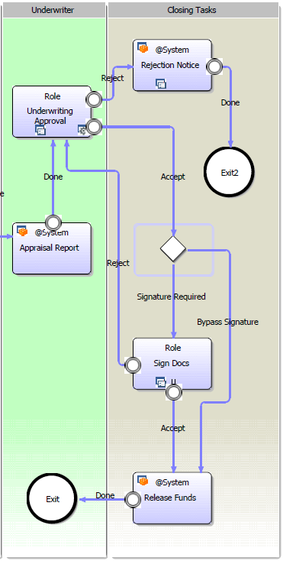
Process Definition Model
Nodes
  Activity nodes represent user tasks
Arrows
  Connect nodes and direct the flow
Gateways
  Branching and Merging of Process Flow
    Condition, And, Or
Events
  Control process flow
    e.g. START, EXIT, Trigger
Notes:
The main Business Process Model Notation symbols used in a Business Process Diagram are:
Nodes <c>
- which represent tasks;
Arrows <c>
- which connect nodes and events and direct the flow;
Gateways <c>
- which represent the branching or merging of flows; and
Events <c>
- which represent, for example, Start, Exit and Triggers.

Slide 8
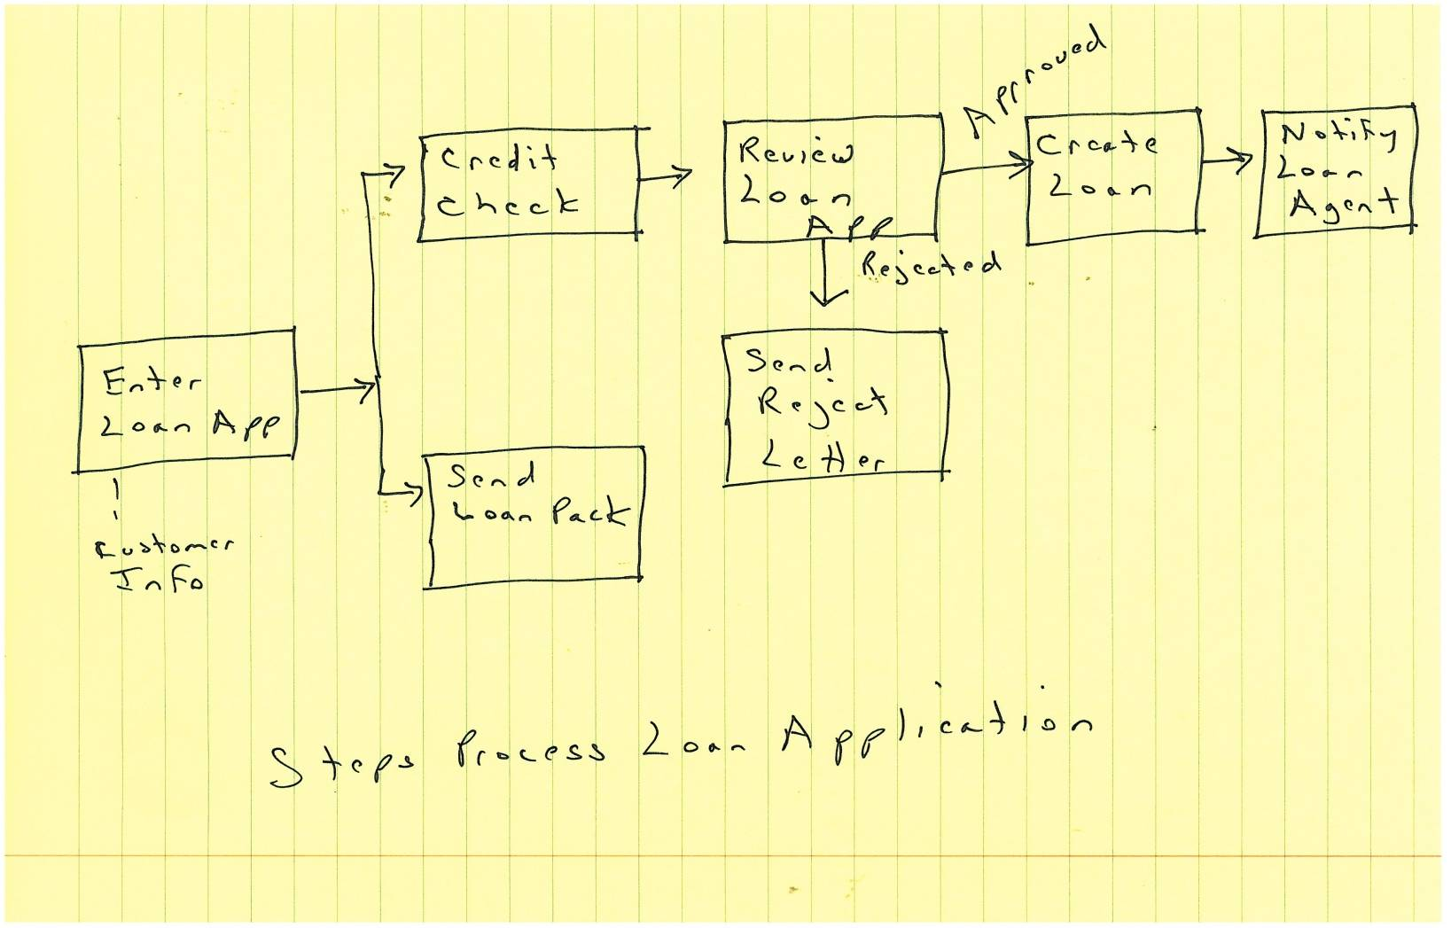
Loan Application Process
Notes:
Loan Application Business Process brain stormed on notebook paper.

Slide 9
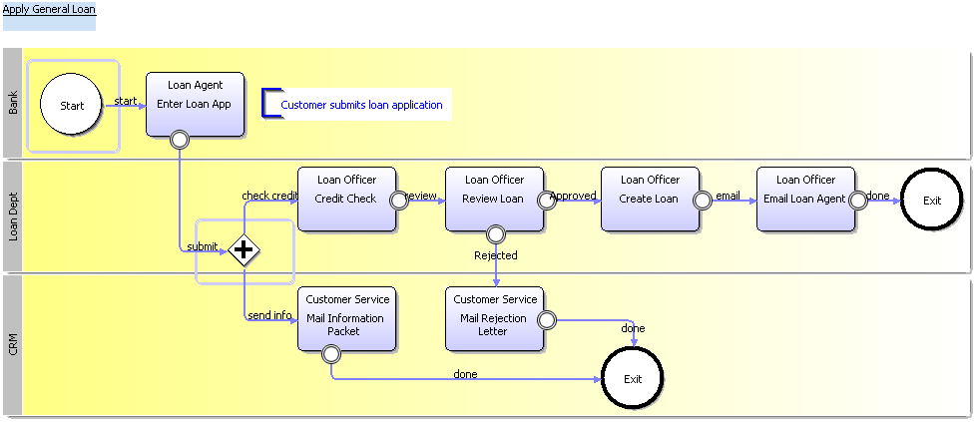
Business Process Model
“Apply General Loan” Business Process Model
Notes:
The completed “Apply General Loan” Business Process Definition diagram. The next section will review the steps to deploy and execute the BPD on Interstage BPM.

Slide 10
Process Instance
Encapsulates the run time aspects of a business process
Instantiated from a Process Definition
Each instance is managed separately by the BPMS
Start
Employee
Manager
Exit
Notes:
Each Process Instance:
encapsulates the run time aspects of a Business Process;
is instantiated from a Process Definition;
is managed individually by the Business Process Management System; and
has state, for example:
initial;
running;
error;
suspended; or
completed.
The relationship between a Process Instance and a Process Definition is very similar to the relationship between an object instance and a class in OO.

Slide 11
Work Items
Represent manual/human activities in the Process Definition.
Work Items are created from Activity Nodes.
Work Items are generated for an activity/node when Process Instance advances to that Node.
Work Items are assigned to a Role and only the members of that role can see them.
Notes:
A Work Item:
represents an instance of an activity in the Process Definition which requires a participant to perform some work;
is created from an Activity Node in the Process Definition; and
is instantiated when the Process Instance reaches that node; at which time it
is assigned to a Role (and only the users of that Role can access the Work Item).
In some cases the work of a Role participant may be performed by an “agent” (executable code) on their behalf.

Slide 12
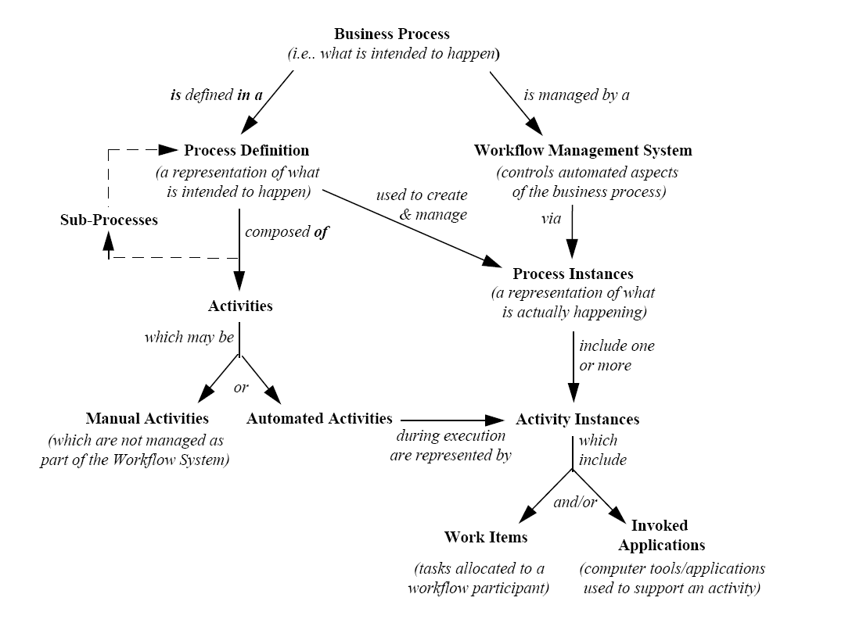
Workflow Terminology
Definition
Execution
(Diagram courtesy of the Workflow Management Coalition Terminology and Glossary - WFMC-TC-1011)
Notes:
Main terms used in BPM and derived from the material produced by the Workflow Management Coalition (WfMC).
<c>The left side of the diagram <c> shows the elements concerned with the design and definition of business processes.
The right side of the diagram <c> shows the elements concerned with the execution of business processes.

Slide 13
BPM Lifecycle
Model
Integrate
Automate
Analyse
Optimize
Notes:
BPM is designed to keep pace with the changes in an organization.
The BPM lifecycle supports organizations in their quest to evolve and improve their business processes.
Model -> Integrate -> Automate -> Analyze -> Optimize.
The Fujitsu BPMS approach combines methodologies and software to help you:
Discover & visualize your as-is processes as they really are! This jump-starts process improvement
Use this as the basis for further refinement and extending into a complete process-based application with the required rules, forms, KPIs and integration hooks
Automate the process – which involves getting the right people the right information at the right time; providing capabilities to collaborate to complete tasks; timers, reminders, and escalation paths are in place
Analyze process performance
Optimize processes by identifying bottlenecks (back to discover & visualize)
Govern – central to all of this is the concept of process governance; all processes and assets are stored for reuse; you also know who changed what when; especially important in a shared services environment
This diagram and terminology are from Interstage BPM marketing material.

Slide 14
Attachments
Users can attach any document to a Process Instance.
Documents are stored by reference, using name and file-path.
  for example:
    Name : Loan Application Form
    Path: “C:\<Interstage BPM Dir>\<tenant>\<application>\LoanApp_Cust1234.pdf”
Once attached, it is available to each participant in the process.
Each type of attachment can be associated with application responsible for its processing (opening).
Notes:
External file system objects can be linked to a Process Instance.
The link is stored as a pair of strings that contain a file system object name and a path.
Attachments can be available to all participants in the process.
The attachment is usually processed at the client level by its associated application program, for example Word or Excel.

Slide 15
JavaScript/Java Actions
Allows process data (usually user defined attributes) to be manipulated by Java code.
This code can be executed at certain locations in a process:
  process instance start time
  - init script/action, process instance owner script/action
  work item assign to role time
    - role script/action, role script/action
  work item activation time
  - prologue script/action
  work item completion time
  - epilogue script/action
  process instance end time
  - commit script/action
  timer expiry or a due date is reached
  – timer action
Notes:
Generally Business Process Management Systems provide the ability to execute code as part of the running of a Process Instance.
In the case of Interstage BPM this is Java code or JavaScript.
The code can manipulate process data and influence execution of a Process Instance.
It can be executed at various points in a Process Instance, including:
process instance start time
- init script/action, process instance owner script/action
work item activation time
- prologue script/action, role script/action
work item completion time
- epilogue script/action
process instance end time
- commit script/action
timer expiry or a due date is reached
– timer action

Slide 16


