Slide 1
Bpm 101

Slide 2
What is Business Process
A business process is simply a set of activities and transactions that an organization conducts on a regular basis in order to achieve its objectives.
Business Processes can be
  Simple
      Example: Expense reimbursement
  Complex
      Example: trade approval
  Short-Running
      Example: Online sales processing
  Long-Running
      Example: Insurance or loan processing
  Department Specific scope
      Example: Claims and Billing
  Organization wide scope
      Example: Strategic sourcing

Slide 3
What is Business Process
BPM - a management practice that provides for governance of a business process environment toward the goal of improving agility and operational performance
Goal
    The automation of a business process, in whole or part
    Do the right thing, with the proper information, at the right time, by the right person/application
    People-to-People
    Systems-to-People
Enabling Technology
    BPMS: software to support the design and execution of business processes, involving human interaction
    Traditional client-server architecture
Benefits
    Connecting people and applications, BPM brings together the advantages of traditional workflow capabilities and Enterprise Application integration into one area of practice called BPM.

Slide 4
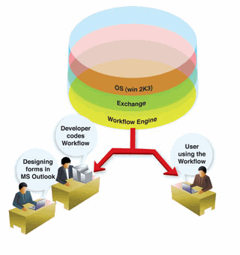
Traditional Workflow
Traditional workflow management connected people by automating inefficient manual processes within a single application
This approach had several drawbacks
  Extensive coding required to implement the business logic in a procedural language.
  High maintenance costs.
  Low reusability.
  Unnecessary code replication
  No “application to application” interaction

Slide 5
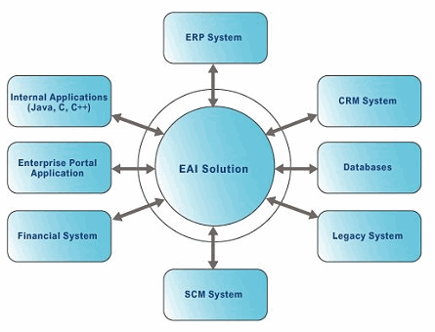
EAI
Enterprise Application Integration (EAI) enables to integrate applications by providing data exchange mechanism so that data can be automatically synchronized throughout the organization
EAI has several limitations with respect to processes
  Cannot automate interactive processes (which requires someone to take action or make decisions).
  Cannot automate long running processes.
  Failed to connect people.

Slide 6
BPM Yesterday vs. Today
1990s workflow systems:
  Proprietary systems
  Managing document-based processes
Today’s BPM systems:
  Manage processes that include person-to-person steps
  System-to-system communications
  Include integrated features such as:
    Process modeling
    Simulation
    Code generation
    Process execution
    Process monitoring
    Customizable industry-specific templates and UI components
    Out-of-the-box integration capabilities with support for web-services-based integration.
Notes:
6

Slide 7
Two Types of BPM
Front-Office BPM
  human-centric workflow products
  provide capabilities of person-to-person process integration
  Vendors include: Fujitsu, TIBCO, FileNet, IBM, PegaSystems, Global360, Oracle, DST Systems, Computer Associates, Ultimus, Savvion and MetaStorm, among others.
Back-Office BPM
  system-to-system integration
  manage aggregation and composition of all services for the enterprise
  Vendors include: Fujitsu, IBM, Oracle, TIBCO, Sun, CapeClear, Software AG, Fiorano Software, Sonic Software, among others.
Notes:
7
It is much easier to view BPM solutions in two basic categories:
Front-Office BPM (FO-BPM) and
Back-Office BPM (BO-BPM).
While vendors are racing to provide both types of BPM solutions, the maturity of their capabilities in each area tends to depend on their history and depth of experience in each domain.
The FO-BPM solutions (with roots in human-centric workflow products) provide capabilities for person-to-person processes in which "work items" are created and routed along with any attached documents. A partial list of vendors that provide FO-BPM capabilities would include TIBCO, FileNet, IBM, PegaSystems, Global360, Oracle, DST Systems, BEA (with recently acquired Fuego) , Computer Associates, Ultimus, Savvion and MetaStorm, among others.
On the other hand, the back-office-oriented BPM solutions (such as ESB products) enable system-to-system integration in which a single process may rely on multiple external processes (and possibly heterogeneous platforms) to complete its work. These suites also manage aggregation and composition of all services for the enterprise. Vendors such as IBM, Oracle, TIBCO, Sun, CapeClear, WebMethods (soon to be acquired by Software AG), Fiorano Software, Sonic Software and BEA Systems, among others, have specialized products in this space.
Front-office- and back-office-oriented BPM systems are aimed at different problems. For example, front-office BPM applications typically involve transactions that are "short running." This may not be the case when an internal process is integrated with Web-service-based processes (possibly outside of an enterprise), which can result in "long-running" transactions. Managing the transaction context of a process involving multiple resource managers requires an alternative approach in BO-BPM. (We will cover this in more detail later on).

Slide 8
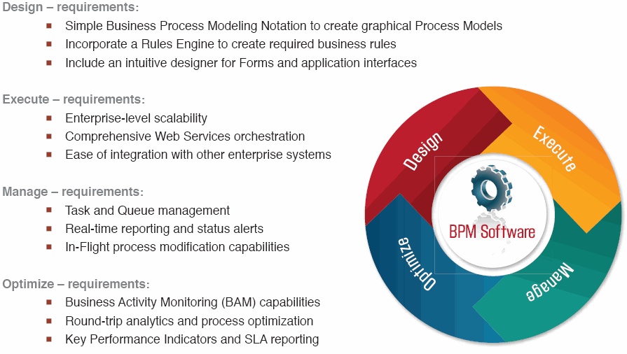
BPM – Core Functionalities

Slide 9
Design: Process Modeling
The modeling phase is typically supported by a visual process design tool.
Process consists of multiple activities.
Activities are linked to each other to form the flow of a process.
Conditions define how and when an activity must be executed.
Visual representation standard: BPMN (Business Process Modeling Notation)
Outcome of modeling phase is a pseudo-executable process flow model, exported in an executable language format (XPDL or BPEL).
Some modeling tools produce UML diagrams to go from business design to technical design.
Advanced simulation tools let you simulate processes by changing activity parameters to test impacts and process efficiency.
Notes:
9
The modeling phase is typically supported by a visual process design tool. Some vendors have their own proprietary tools while others provide specialized plug-ins that extend existing IDEs or products such as Microsoft Visio or Eclipse-based modules.
A process consists of multiple activities (also know as "steps" or "tasks").These are created and linked to each other to form the flow of the process. Conditions that define how and when an activity must be called are also are defined during the modeling phase. Process activities can include attachments, such as documents or images, that are passed to the next activity along with associated data. In addition, process can be split into parallel execution paths and joined at a predetermined step. If needed, an instance of a process can be started by an external event, such as the arrival of an e-mail, message or document. These capabilities can be graphically depicted using the same visual design tool. The activities within a process either require human involvement or are processed without any human interaction. Therefore, the modeling tool needs to support person-to-person and system-to-system processes.
Since different types of activities usually have their own visual representations (such as activity icons and graphics), this area of design and presented an opportunity for standardization. One such standard that is widely accepted is Business Process Modeling Notation (BPMN).
The outcome of the process modeling phase is usually a pseudo-executable process flow model that can be exported in an executable language format supported by the BPM engine. Thus, there needs to be a mapping from a modeling language (such as BPMN) to a process execution language (such as XPDL or BPEL) understood by the BPM engine of your choice (more on this later).
To streamline the transition from business design to technical design, some process modeling tools are also capable of producing application design diagrams in Unified Modeling Language (UML). Advanced modeling tools also let you simulate processes and changing activity parameters such duration and resource utilization to test impacts on process efficiency.
Most BPMS vendors supply modeling tools that are optimized to work with their solution, but there are a number of vendors that specialize in process modeling (and analysis, to be covered later), including IDS Scheer, Performa, Mega, iGrafx, Telelogic and Casewise.

Slide 10
Design: Process Implementation
Common characteristics:
  Metadata-driven development
  code-generation
  APIs and Web Service interfaces.
  Prebuilt-components to integrate with documents/CMS, security repositories, third-party apps, middleware products, etc.
  Design forms
  Define data fields
  Customize process templates
  Setup access control lists
  Configure integration capabilities
  Manage deadlines
  Back-end process composition
  Data/message transformation
  Automatic creation of service interfaces
Notes:
10
To create the business logic of the modeled activities, one must provide the necessary instructions (beyond those required to manage the execution flow and pass necessary data). Further, the complex activities within a process often need to be programmed at a lower level to do such things as accessing databases or performing business calculations.
The development environment varies by vendor strategy, but this typically comes in the form of either an integrated development environment (IDE) that is integrated with the modeling tool or a separate IDE. Regardless, all vendors try to minimize the need for hard-coding by supporting a visual programming environment. The most common characteristic of BPM IDEs are meta-data-driven development and code-generation aimed at speeding implementation. The programming language used might be an inference-based business rule engine or a standard language such as Java or C++. To implement more complex business logic, it might be necessary to rely on different programming tools. To ensure flexibility, almost all vendors provide a set of APIs and Web service interfaces.
Front-office-oriented BPM systems typically let you design forms, define data fields, customize process templates, set up access control lists, configure integration capabilities and manage deadlines. Since back-office-oriented BPM solutions aren't intended to support human-centric workflow (and therefore don't require form capabilities), they focus instead on features such as back-end process composition, data/message transformation and automatic creation of service interfaces to ease implementation.
If your application requires integration with external systems, look for out-of-the-box support first. Usually, vendors offer prebuilt components to integrate with document/content management systems, security repositories, third-party packaged applications and middleware products.
Once process activities are implemented, the application is deployable and ready to execute on the vendor's chosen platform, such as J2EE or .Net.

Slide 11
Process execution
Process engine executes the process model
Requires low-level services:
  Security
  Transaction
  Concurrency management
Control of execution:
  Orchestration
  (assumes one owner, in-house)
  Choreography
  (co-owned by participants, exchange message contracts)
Standards:
  BPEL (orchestration approach)
  WS-CDL (choreography approach)
Notes:
11
The process engine that runs on the BPMS vendor's server is responsible for executing the process model exported for execution and activities programmed. A typical run-time environment also needs other low-level services, such as security, transaction and concurrency management. These services are either provided by the same vendor or the vendor relies on another technology, such as applications or servers. If the transactions involve multiple business partners, the challenge of managing those transactions gets more complex.
To control the execution of process activities, there are basically two approaches: orchestration and choreography. The distinction lies in the point of view on "who is the process owner" of an internal corporate process, an external public process (peer-to-peer/B2B) or combinations of both.
The orchestration approach mainly assumes that the process owner is always a single-entity that has total control of all message exchanges between activities. An example is a workflow application for an in-house loan-approval process.
The choreography approach, on the other hand, implies that the process is owned "jointly" by all participants, and the sequence of multiple message exchanges among participants are driven by mutually agreed "contracts." Examples of this include the fulfillment processes of a purchase order in a B2B environment.
Among process execution languages, BPEL more closely resembles the orchestration approach. Another standard, WS-CDL, mostly addresses the needs of the choreography approach. XPDL, on the other hand, is mostly seen in human-centric workflow tools/applications. In the future, expect BPEL to include similar capabilities from XPDL and WS-CDL.

Slide 12
Manage and Optimize: Monitoring and Analysis
Report business performance metrics
BAM (Business Activity Monitoring)
Two types of BAM:
  Real-time
    Tightly integrated to BPM solution
    Monitor metrics for work-in-progress
    Record execution pattern, signaling process failure
    Predicts work loads for better resource utilization
    Filters and reacts to business events
  Historical
    Provide analysis reports: conclusions from historical execution
    Compare KPIs and SLAs against data
    Can integrate with existing data stores (BI)
Notes:
12
The ability to report business performance metrics is increasingly important and is a major differentiator among BPM suites. Given the large potential impact on process efficiency, BPM vendors are rushing to include this type of business activity monitoring (BAM) capability in their suite through acquisitions, partnerships or enhancements of existing tools.
Unfortunately, would-be customers are usually confused about how to best use BAM capabilities. Part of the reason for this confusion is that there are two types of BAM: real-time and historical. Yet the distinctions between the two are not clear to most.
Real-time BAM components are tightly integrated within the BPM solution to monitor metrics for work-in-progress (such as the number of process instances started, execution times of activities and so on). Advanced real-time systems can do such things as record an execution pattern signaling process failure so you can avoid them in the future. Real-time BAM also predicts work loads for better resource utilization. Filtering and reacting to business events is also a key feature. For example, based on a certain business condition (such as receiving an electronic order), the following actions can start: send e-mail to a user, automatically start another process instance and send alerts to dashboard/console.
Historical BAM components, in contrast, provide analysis reports to draw conclusions from purely historical execution of already completed processes. Process-specific key performance indicators (KPIs) and service level agreements (SLAs) can then be compared against this data. These tools can also integrate with existing data warehouses and may require a different server platform than the BPM server.
Collecting execution metrics also enables "closed loop" modeling in which process simulations can be adjusted to improve efficiency.

Slide 13
BPM Suite
There are four important components of a BPM Suite
  Process Engine – a robust platform for modeling and executing process-based applications, including business rules
  Business Analytics — enable managers to identify business issues, trends, and opportunities with reports and dashboards and react accordingly
  Content Management — provides a system for storing and securing electronic documents, images, and other files
  Collaboration Tools — remove intra- and interdepartmental communication barriers through discussion forums, dynamic workspaces, and message boards

Slide 14
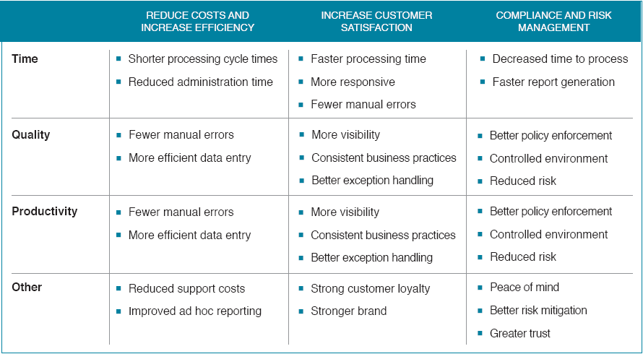
Why Business Process
By decreasing costs, increasing revenue and improving agility, BPM Suites provide a solid return on investment. (ROI)

Slide 15


